Slide 1
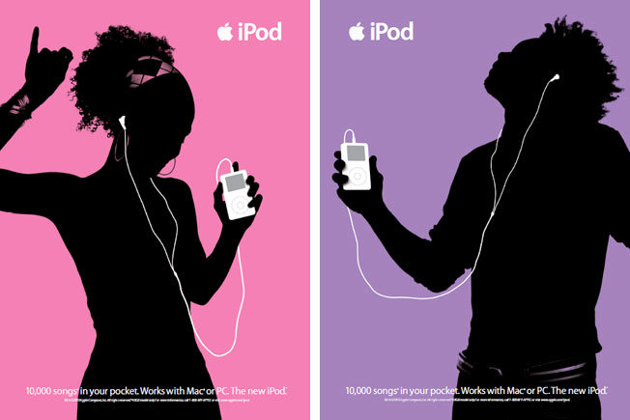
Space
Apple iPod Ads
Notes:
The author is reticent about defining the term, space. He calls it the “presentation of a piece of work.” He says it can be the “area of design.” He also says it can be a technique (49). As you can tell, he opts for the first of these explanations: size, scale, and relationship between objects in both 2 and 3 dimensions.

Slide 2
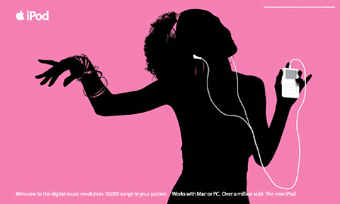
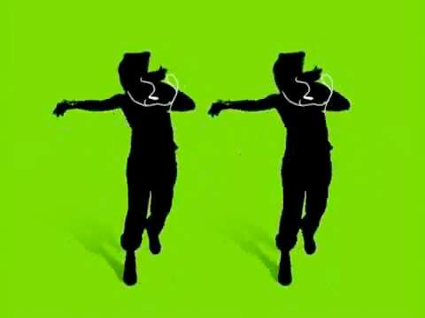
Space
is the size, scale, and relationship between objects in both two & three dimensions

Slide 3
Space involves
Format (i.e. size, scale, and presentation)
Relationships among objects and the areas surrounding them: positive and negative space
Perceived third dimension: illusionary space
Notes:
There are three issues relating to space that you need to be concerned with as designers: space in terms of format, space in terms of volume, and space in terms of dimensions.

Slide 4
Space Considerations
Size of media object in relation to display size (width & height)
Monitor resolutions (not the same as monitor size) for media objects
Format = size, scale, & presentation
Notes:
I want to begin with format. I want you to think about the display of information. Is the information going to be used on a 24 “ desktop computer? A 17” laptop? An iPhone? When designing you must taking into consideration the format of the object you are producing and what it will look like on multiple displays. This is format in terms of size. Format also pertains to monitor resolutions. Is the computer set at 1024 X 768? 800 X 600? It makes a difference to your design in the way it is displayed on screen.

Slide 5
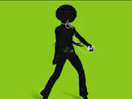
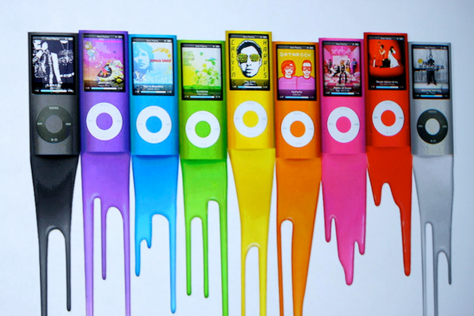
Space Considerations
An image that takes up a tiny amount of space draws attention to itself
An image that takes up the whole space allows the viewer’s eye to wander around the image
Notes:
Once you determine the medium and narrow down the resolution, you need to move ahead in thinking about how to fill the space. Keep in mind when doing this that there are no absolute rules. But it is important to remember that designs that take up little space draw attention to itself, and designs that take up a lot of space compels us to explore the space.

Slide 6
Positive & Negative Space
Relationships among objects and the areas surrounding them
Positive space are parts of the image are perceived to be solid, such as an object (re: volume)
Negative space is everything else
Notes:
As designers you must understand the importance of using positive and negative space. Positive space is generally space that possesses volume; it is generally thought of as the part of space that an object inhabits. And for that reason, it is the many times the main focus of a design. Negative space, on the other hand, is space without volume, without objects. But it is not a space without importance.

Slide 7
Negative space
is not “left over” space but can enhance your design
Notes:
We need negative space in order to perceive contours of an object. So, the term is not a good one, really. Negative space is not really negative in the sense that it is bad. You should not see it as space that is leftover after you have produced an object, nor should you see it as space that needs to be filled. It can enhance important parts of your message.

Slide 8
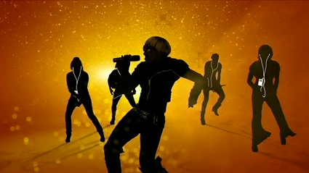
Working with Negative Space
The use of texture for filling negative space with the perception of volume; limit use of texture when working with smart devices
Notes:
On page 57, the author shows this image. He says that the “negative space . . . was made more interesting by filling the bottom half with a texture.” In this way, the designer retained the negative space while giving the perception of volume.

Slide 9
Illusionary Space
Create the illusion of a third dimension by varying placement: lower = closer
Notes:
So, varying size is one way to represent depth. Another way is to “position” an object “along the vertical axis to convey illusionary space” (59). In this example, the image seems to have depth because the one soldier positioned lower than the others gives a 3-dimensional feel to the image.

Slide 10
Illusionary Space
The illusion of a third dimension is created by using lighter or purer colors for foreground objects
Background objects seem less sharp or distinct than foreground objects
Notes:
Another way to give the perception of depth is to utilize light and color: to make “objects that are father away from the viewer darker” or using “colors that are closer to a ‘pure color’ for objects that are in the foreground and to use muted or subdued colors for objects that are in the background of an image” (60). In this image, for example, some of the objects on the left are lighter than those on the right. The darker objects behind other objects give the perception of depth.

