Slide 1
Theories and Critical Practices of Electronic Literature
Sandy Baldwin and Davin Heckman

Slide 2
Electronic Literature Organization definition: “Electronic literature, or e-lit, refers to works with important literary aspects that take advantage of the capabilities and contexts provided by the stand-alone or networked computer.” Hayles: “Electronic literature, generally considered to exclude print literature that has been digitized, is by contrast "digital born," a first-generation digital object created on a computer and (usually) meant to be read on a computer.” Alice Bell, digital-born literature means “written for and read on a computer screen that pursues its verbal, discursive and/or conceptual complexity through the digital medium, and would lose something of its aesthetic and semiotic function if it were removed from that medium.”

Slide 3
Eagleton on criticism, literature, and the public:
Circulation can proceed here [within the public sphere] without a breath of exploitation, for there are no subordinate classes within the public sphere - indeed in principle, as we have seen, no social classes at all. What is at stake in the public sphere, according to its own ideological self-image, is not power but reason. Truth, not authority, is its ground, and rationality, not domination, its daily currency. It is on this radical dissociation of politics and knowledge that its entire discourse is founded, and it is when this dissociation becomes less plausible that the public sphere begins to crumble (The Function of Criticism, 17).

Slide 4
”… one cannot tamper” with the form of the book ”without disturbing everything else …” (Jacques Derrida) ”wellllllll we all said how pornstars were bad actors but I think we found somthing worse” (Tahir in Rrixxx Kokuzno: David was, published by Ubermorgen.com through Amazon)

Slide 5
Choose two works from the Electronic Literature Collection, either volume.http://collection.eliterature.org Critically describe the works. Use any theory and method you choose. Work with a partner, someone new. Plan a 10 minute presentation.

Slide 6
<stop>

Slide 7
"Our writing tools are also working on our thoughts” – Nietzsche via Kittler “Media determine our situation which - in spite or because of it - deserves a description. […] Whosoever is able to hear or see the circuits in the synthesized sound of CDs or in the laser storms of a disco finds happiness. A happiness beyond the ice, as Nietzsche would have said. At the moment of merciless submission to laws whose cases we are, the phantasm of man as the creator of media vanishes. And the situation becomes recognizable.” - Kittler
Notes:
“Anyone who knows how to breath the air of my writings know that it is an air of the heights, a bracing air.” “The ice is near, the solitude is immense,” writes Nietzsche in Ecce Homo. “the only thing that has been forbidden so far is the truth.”
The modern man who is obsessed with the yea / and nay vs. the ice.
“Let us look each other in the face,” begins Nietzsche. “Beyond the North, beyond the ice, beyond death – our life, our happiness.” Nietzsche, Antichrist

Slide 8
Flusser explains, writing has multiple preconditions:
1) The blank surface,
2) A means to mark the surface,
3) An alphabet,
4) Knowledge of a “convention” which allows this alphabet to correspond to something else
5) Knowledge of the proper form for constructing these signs,
6) Knowledge of a specific language,
7) Knowledge of the rules of writing for this specific language,
8) An idea that can be communicated through writing,
9) A motive to communicate the idea through writing.

Slide 9
Media specific analysis, according to N. Katherine Hayles: Attuned not so much to similarity and difference as to simulation and instantiation, MSA moves from the language of "text" to a more precise vocabulary of screen and page, digital program and analogue interface, code and ink, mutable image and durably inscribed mark, texton and scripton, computer and book. […] The power of MSA comes from holding one term constant across media—in this case, the genre of literary hypertext—and then varying the media to explore how medium-specific constraints and possibilities shape texts. Understanding literature as the interplay between form and medium, MSA insists that "texts" must always be embodied to exist in the world. The materiality of those embodiments interacts dynamically with linguistic, rhetorical, and literary practices to create the effects we call literature.
Notes:
Technotext

Slide 10
Hayles Material Metaphor: “a phrase that foregrounds the traffic between words and physical artifacts […] We are not generally accustomed to think of a book as a material metaphor, but in fact it is an artifact whose physical properties and historical usages structured our interactions with it in ways obvious and subtle” Technotexts: "the physical form of the literary artifact always affects what the words and other semiotic components mean"

Slide 11
Serge Bouchardon, Three Levels of the Digital a theoretical level, an applicative level and an interpretative level. level 1: the theoretical possibilities of the Digital level 2: the potential of the applications level 3: the expressive potential of the contents. In other words: level 1 corresponds to ‘What can be theorized about the Digital?’ level 2 to ‘What purpose can be served by the applications?’ level 3 to ‘What can be expressed by the contents?’

Slide 12
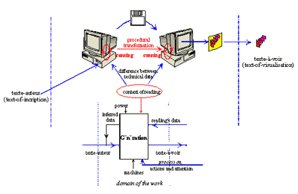
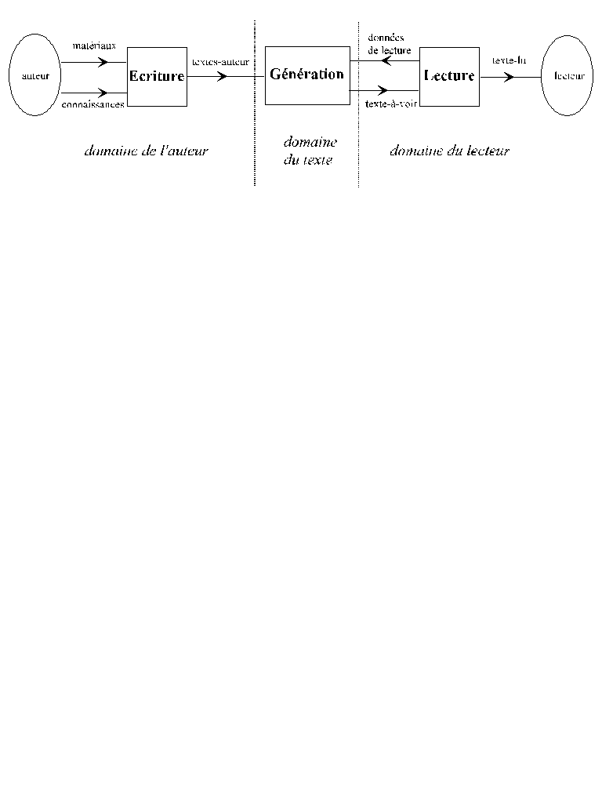
Philippe Bootz, Model of Reading

Slide 13
<stop>

Slide 14
Stiegler on the transformation of the technical system: This transformation first started taking place during the nineteenth century (which nevertheless still constitutes a transitional period), with the appearance of the first communication, information and signal- processing technologies. Over the course of the twentieth century, however, communication and information industries have become the centre of the technical system responsible for the production of material goods. What I previously described as 'convergence' between computer, audio-visual and tele-technologies also seems to refer to a convergence between the technical system of material transformation and the technologies of memorization.

Slide 15
the ingraining of lineal, sequential habits […] the visual homogenizing of experience of print culture, and the relegation of auditory and other sensuous complexity to the background. [...] The technology and social effects of typography incline us to abstain from noting interplay and, as it were, ‘formal’ causality, both in our inner and external lives. Print exists by virtue of the static separation of functions and fosters a mentality that gradually resists any but a separative and compartmentalizing or specialist outlook. - McLuhan 1962

Slide 16
The protean nature of the computer is such that it can act like a machine or like a language to be shaped and exploited. It is a medium that can dynamically simulate the details of any other medium, including media that cannot exist physically. ... It is the first metamedium, and as such it has degrees of freedom for representation and expression never before encountered and as yet barely investigated.
(Alan Kay, 1977)

Slide 17
Ted Nelson: hypertext is "non-sequential writing" and “you may read [it] in all the directions you wish to pursue. There can be alternate pathways for people who think different ways.” Landow: “encourages branching and consequently reader’s choice”

Slide 18
John Cayley on Google and language We hand over our culture to Google in exchange for unprecedented and free access to that culture. We do this all but unconscious of the fact that it will be Google that defines what “unprecedented” and “free” ultimately imply. As yet, we hardly seem to acknowledge the fact that this agreement means that it is Google that reflects our culture back to us. They design the mirror, the device, the dispositive, as the French would put it. They offer a promise of “free” access in many senses of that word including zero cost to the end-using inquirer and close to zero cost to the institutions that supply the inscribed material culture that Google swallows and digests. But Google does not (some might here add “any longer”) conceal the fact that this free access does come at a cost, another type of cost, one that is also a culture-(in)forming cost: Google will process all (or nearly all) this data in order to sell a “highly-cultivated” positioning of advertisements (“Writing to be Found”).

Slide 19
Raley on Tactical Media "signifies the intervention and disruption of a dominant semiotic regime, the temporary creation of a situation in which signs, messages, and narratives are set into play and critical thinking becomes possible”

Slide 20
<stop>

Slide 21
there is no such thing as digital media, but only digital code which can be stored onto and put out via analog media – Florian Cramer

Slide 22
To make a Dadaist poem: Take a newspaper. Take a pair of scissors. Choose an article as long as you are planning to make your poem. Cut out the article. Then cut out each of the words that make up this article and put them in a bag. Shake it gently. Then take out the scraps one after the other in the order in which they left the bag. Copy conscientiously. The poem will be like you. And here you are a writer, infinitely original and endowed with a sensibility that is charming though beyond the understanding of the vulgar. - Tristan Tzara

Slide 23
Queneau, Cent mille milliards de poèmes
http://www.bevrowe.info/Queneau/QueneauHome_v2.html

Slide 25
Just as every fact is also metaphysical, every piece of hardware implies software: information about its existence. Television is the software of the earth. Television is invisible. It's not an object. - Jack Burnham (1970) dematerialization or immaterial software

Slide 26
Literature is a conceptual art in that is not bound to objects and sites, but only to language. The trouble the art world has with net.art because it does not display well in exhibition spaces is foreign to literature which always differentiated between an artwork and its material appearance. Since formal language is a language, software can be seen and read as a literature. - Florian Cramer

Slide 27
The virtualization, immateriality, flickering, translatability of text may be a new qualification of “literariness” but this does not mean you may read in “in all the directions you wish to pursue”

Slide 28
<stop>

Slide 29
Christopher Strachey’s Love Letter Generator, 1952
In 1951, the Ferranti Mark I at Manchester University was the first computer with stored programs, which allowed computation and recombination of data.
The mathematician Christopher Strachey contacted Alan Turing at the Manchester lab, and proposed to write a program to play checkers on the computer.
Strachey next wrote a program that generated love letters – the first piece off electronic literature.

Slide 31
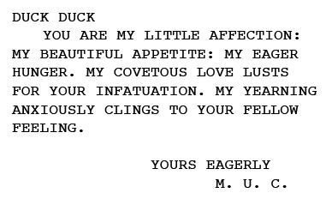
MY JEWEL HONEY
MY DARLING HUNGER SIGHS FOR YOUR SYMPATHY. YOU ARE MY SEDUCTIVE PASSION. MY LOVESICK ARDOUR WOOS YOUR FONDNESS. YOU ARE MY IMPATIENT HUNGER: MY SWEET EAGERNESS.
YOURS FONDLY
M. U. C.

Slide 32
Strachey, in Encounter, 1954
The chief point of interest, however, is not the obvious crudity of the scheme, nor even in the ways in which it might be improved, but in the remarkable simplicity of the plan when compared with the diversity of the letters it produces.

Slide 33
The literary field as combinatory letters (in both senses of the word)
Love letters and love of letters
Love of the space of letters and of the space of love letters

Slide 34
Nick Montfort’s PPG 256 Series
http://nickm.com/poems/ppg256.html

Slide 35
Whitman FML
http://www.amazon-noir.com/

Slide 36
<stop>

Slide 37
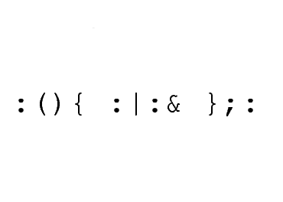
Forkbombs
%0|%0

Slide 38
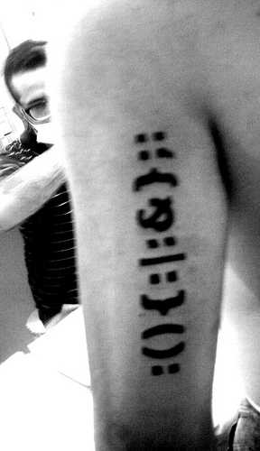
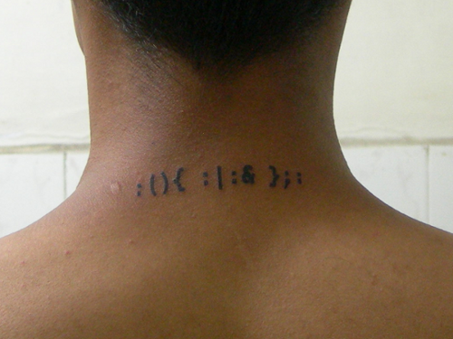

Slide 39
The project formerly known as kindle forkbomb
http://uuuuuuuntitled.com/

Slide 40
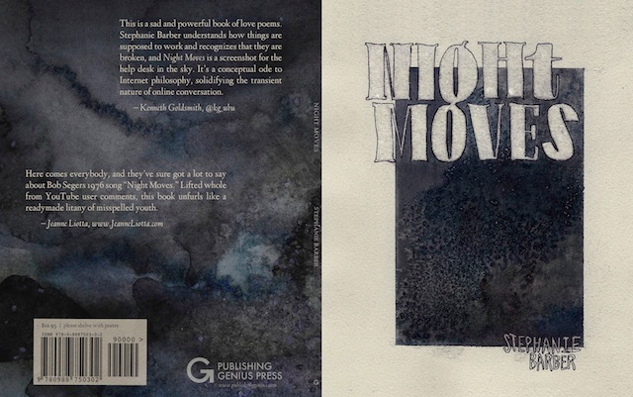
Stephanie Barber, Night Moves
http://poetry.rapgenius.com/Stephanie-barber-night-moves-annotated

Slide 41
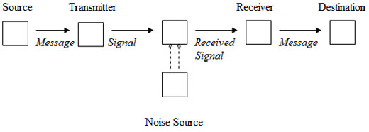

Slide 42
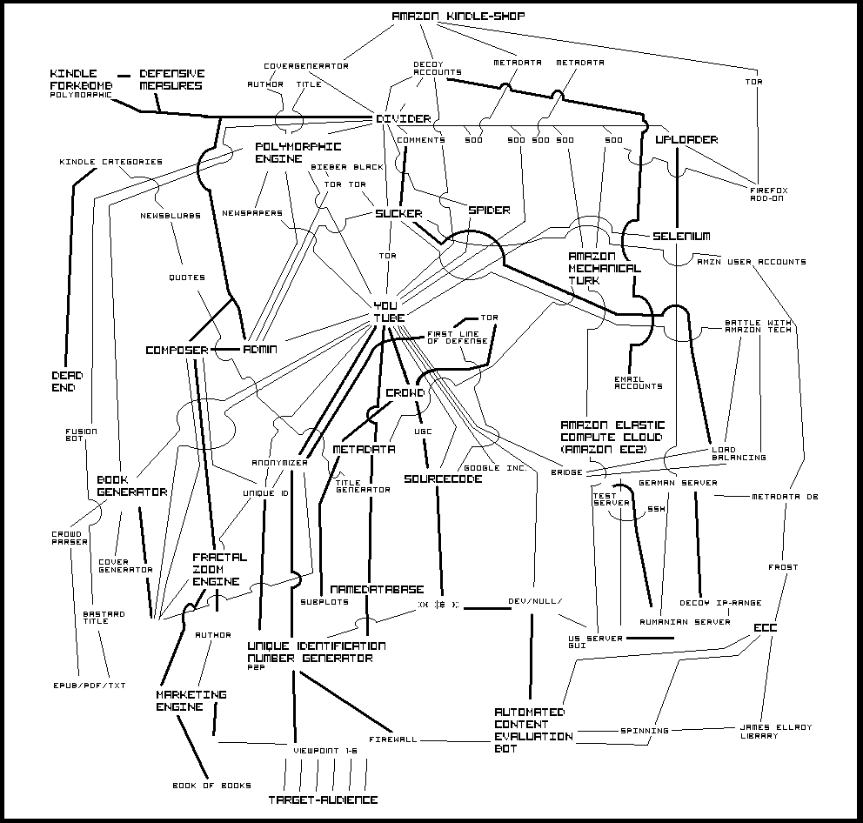

Slide 43
Philip M. Parker
http://en.wikipedia.org/wiki/Philip_M._Parker
http://www.amazon.com/s?ie=UTF8&page=1&rh=n%3A283155%2Cp_27%3APhilip%20M.%20Parker

Slide 44
<stop>

Slide 45
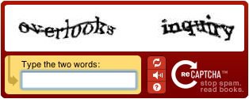

Slide 46
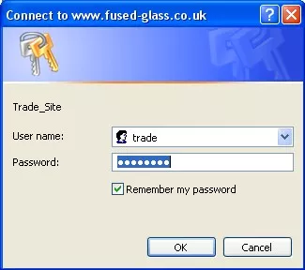

Slide 47
Amazon Mechanical Turk
https://www.mturk.com/mturk/welcome

Slide 48
Emoji Dick
http://www.emojidick.com/

Slide 49
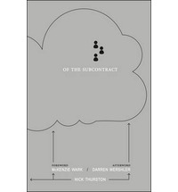
Thurston, Of the Subcontract: Or Principles of Poetic Right (2014)

Slide 50
Poem 0.04 Am I blind, or maybe dumb? To see TWO cents has made me numb. Would you do work for this measly amount? Would you take it seriously, would it even count. This is insulting in so many ways.

Slide 51
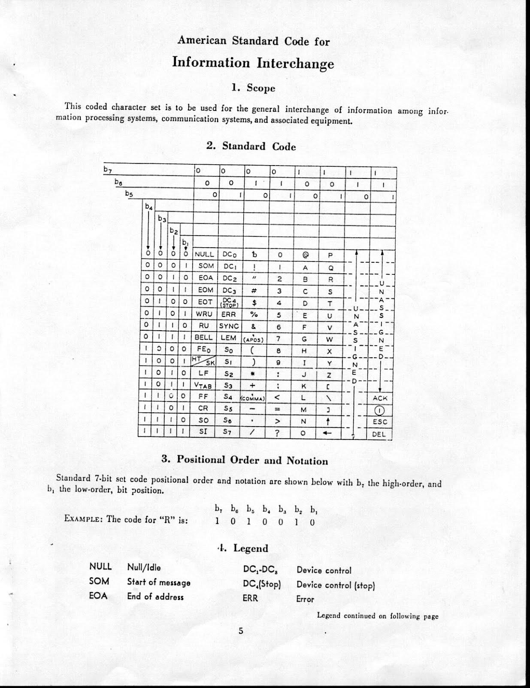
ASCII Table

Slide 52
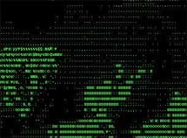
Vuk Cosic, Deep ASCII

Slide 53
Knowlton, Studies in Perception, 1966

Slide 54
<stop>

Slide 55
Event ➔ Process ➔ Sites of embodiment

Slide 56
“The body not as a site of inscription but as a medium for the manifestation of remote agents.” - Stelarc

Slide 57
Jason Nelson http://www.secrettechnology.com/evilmascot/mascotmascot.html http://www.secrettechnology.com/between/between.html

Slide 58
Stephanie Strickland http://collection.eliterature.org/2/works/strickland_slippingglimpse.html

Slide 59
Literal becoming literary, the mark as power or distribution of power Readings as dispersion of effects Biopolitics of how organisms live on networks and machines . In terms of patterns, systems of productions, consumption, control

Slide 60
Cannot distinguish literature and non-literature in terms of complexity and multimodality Cannot distinguish literature in terms of plurality of meaning and diversity of interpretation

Slide 61
First, a focus on technique or interface means literature can be no different from any other work

Slide 62
Second, there is no interpretation and no meaning of literature

