Slide 1
Mobile as a Medium
Brett Oppegaard, PhD DHSI Summer 2013
brett_oppegaard@wsu.edu
@brettoppegaard

Slide 2
Mobile as a Medium
Socrates (Plato, 1972): Writing is different than speaking.
McLuhan (1967): The Medium is the Message (and the Massage)
Medium Theory (Meyrowitz, 1985): A focus on the distinct characteristics of each medium (or channel of media distribution and reception) and how those characteristics may encourage or constrain forms of interaction and social organization.
Mobile media communication (both as an artifact and a process) is distinct from other forms of mediated interaction because of its fundamental characteristics of mobility, or use in the moment, which gives rise to a host of distinctive and social consequences and considerations (Campbell, 2013).
Brett Oppegaard, Ph.D., WSU Vancouver, brett_oppegaard@wsu.edu, @brettoppegaard, 360-546-9416 (o)

Slide 3
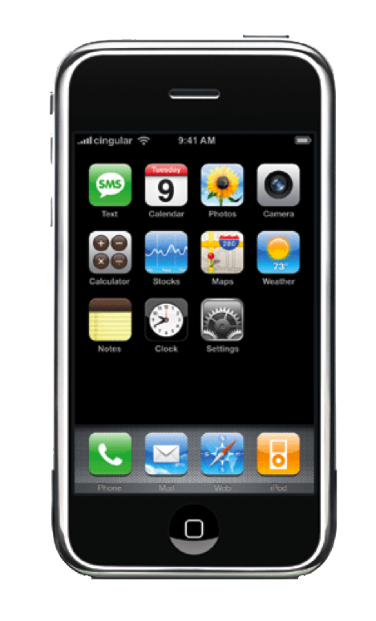
What is different about mobile?
It's not just about a telephone and a calendar
being in the same place, or even really the
convenience of convergence, carrying one technology device ...
Personalized, highly usable
Ubiquitous, part of us (like an appendage)
Connected to the communal brain; mobile search
Sensory inputs/outputs; creates interactive possibilities
Location / Spatial / Contextual awareness
Social connector, includer / Anti-social avoider, excluder
Direct link to people, not places; microcoordinator
Makes the inaccessible accessible; translations, AR, sources
Offers analytics, from self-awareness to surveillance
Synthesis of these creates new communication options
Brett Oppegaard, Ph.D., WSU Vancouver, brett_oppegaard@wsu.edu, @brettoppegaard, 360-546-9416 (o)

Slide 4
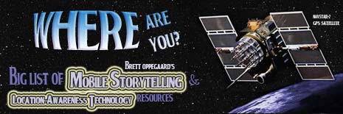
Resources
Campbell, S. (2013). “Mobile media and communication: A new field, or just a new journal?” Mobile Media & Communication 1(1): 8-13.
Plato (1972). Phaedrus. Cambridge, MA, Cambridge University Press.
McLuhan, M., & Fiore, Q. (1967). The Medium is the Massage. New York: NY, Bantam Books.
Meyrowitz, J. (1985). No sense of place: The impact of electronic media on
social behavior. New York, Oxford University Press.
www.mobilestorytelling.net
Brett Oppegaard, Ph.D., WSU Vancouver, brett_oppegaard@wsu.edu, @brettoppegaard, 360-546-9416 (o)

