Slide 1
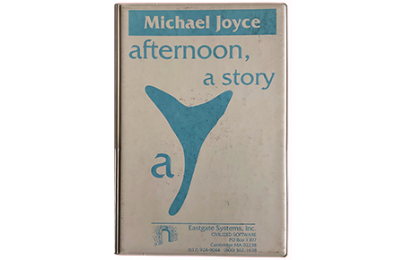
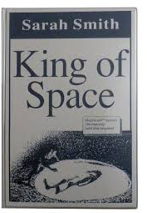
1990s Hypertext in the 21st Century
Dene Grigar
“The Effect of Migration on
Michael Joyce’s afternoon, a story”
Richard Snyder
“All Text Is a Game:
The Jubilant Literary Experiment
of King of Space”

Slide 2
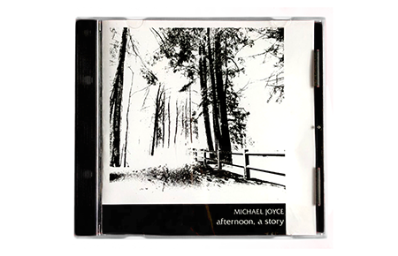
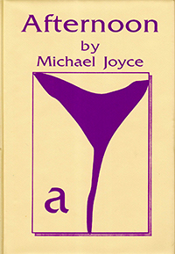
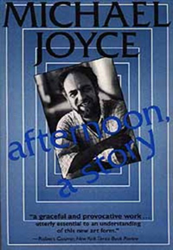
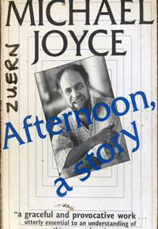
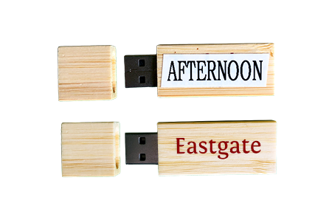


“The Affect of Migration upon Michael Joyce’s afternoon, a story”
by Dene Grigar, PhD, Director, Electronic Literature Lab

Slide 3
The “authoritative edition”
Kirschenbaum, “Editing the Interface,” 31

Slide 4
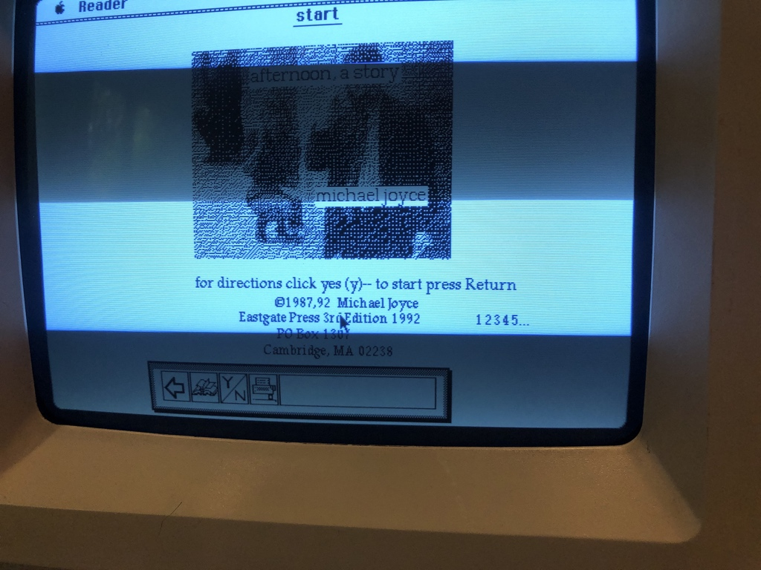
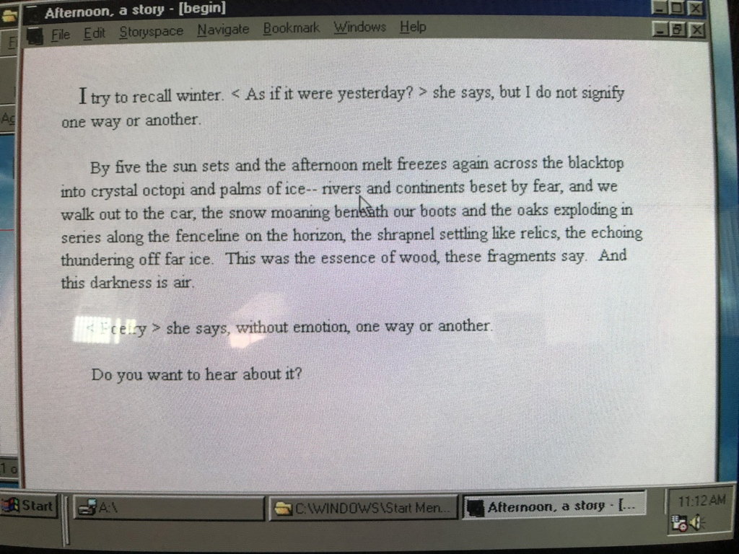
The 4th Edition
(1992 Macintosh)
Interface
The 7th Edition
(1994 Windows 3.1)
Interface

Slide 5
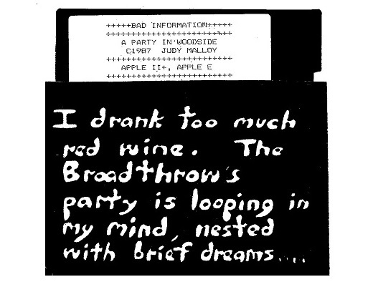
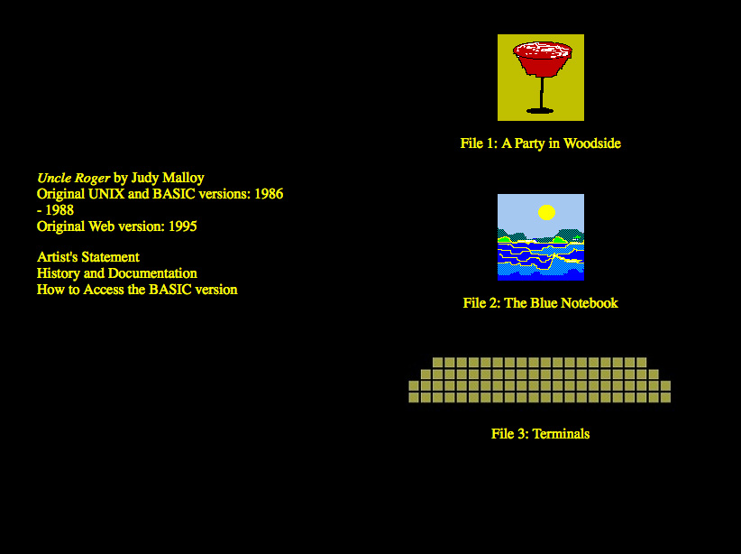
Judy Malloy’s Uncle Roger, 1986-2020
Version 3.3
5.25-inch floppy disk
for Apple II
1986-8
Version 5.1
World Wide Web
1995

Slide 6
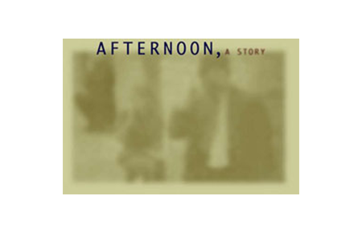
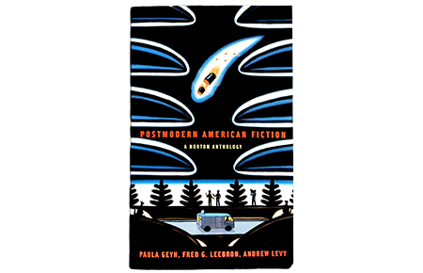
6 different formats—floppy disk, website, excerpt in a book, CD-ROM, USB Stick, and downloadable digital file
Floppy Disks: 1987-2001 (Editions 1-7; 14 years)
CD-ROM: 2001-2016 (Editions 10-11; 15 years)
USB Stick/Downloadable Digital File for Macintosh only: 2016-present (Editions 12-13; four years)

Slide 7
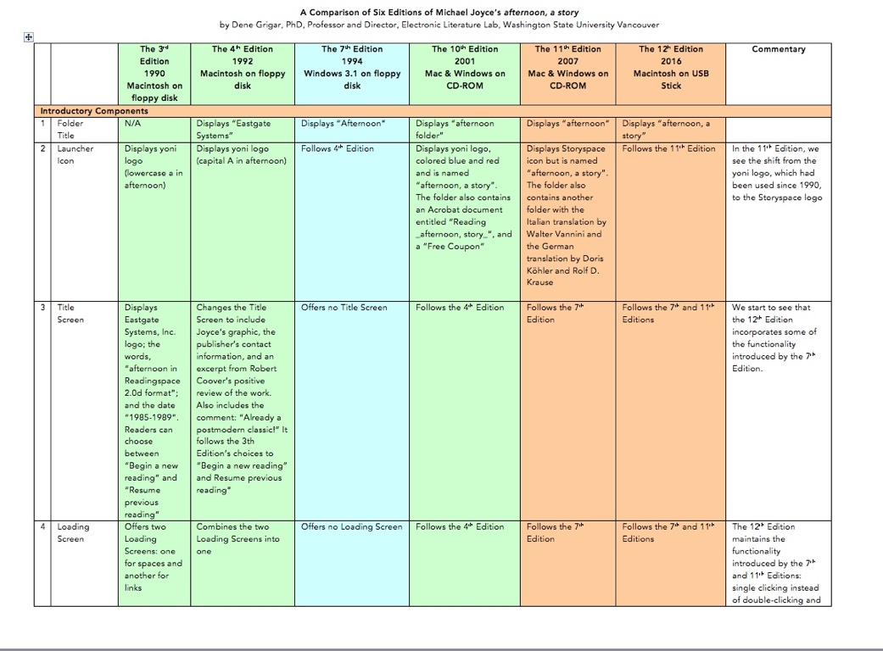

Slide 8
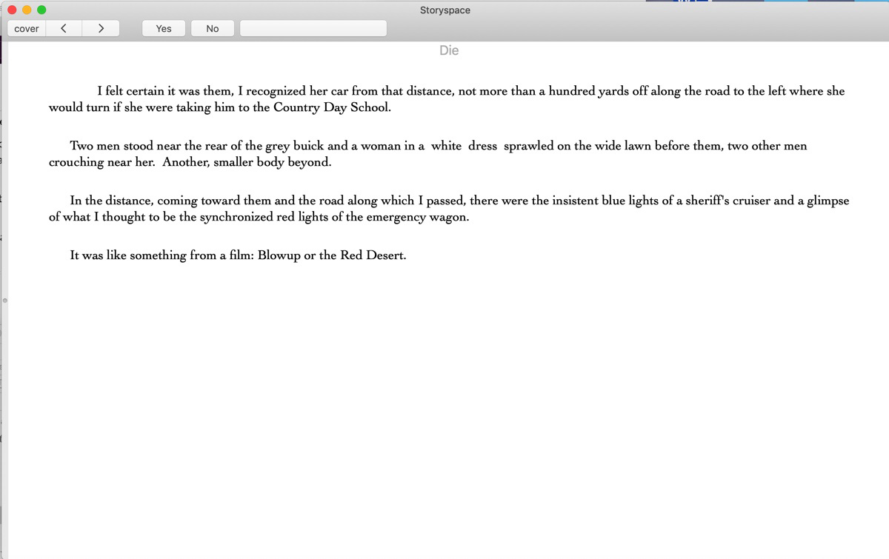
1) text that should link to another text but does not–– as a “dead link”
2) text that links to the wrong text
3) text that exists in one edition but is missing in another

Slide 9
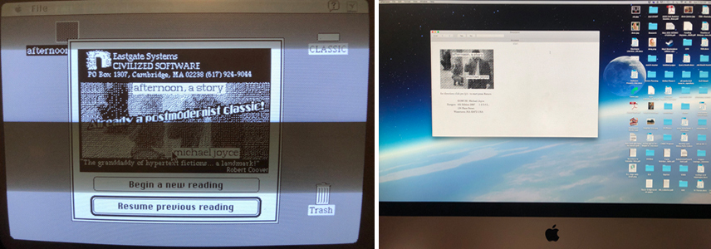
To Windows: changed the interface and functionality, evident in the 7th Edition and quite possibly the 5th for floppy disk
To MacOs X 10.5 0r higher in 2007, evident in the 11th Edition for CD-ROM
To the MacOS 10.5 and higher: Move some of the functionality of the Tool Bar into the top menu, evident in the 12th and 13th Editions for USB Stick & downloadable digital file

Slide 10
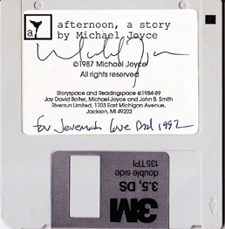
1st Edition, 1987
Authoritative editions of born digital media are difficult to maintain

Slide 11
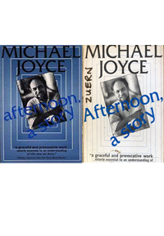
Because variations not unusual for works of born digital literature, scholars should provide exact information in regards to the edition used for study so that it is clear how interpretation may have been impacted by it.

Slide 12
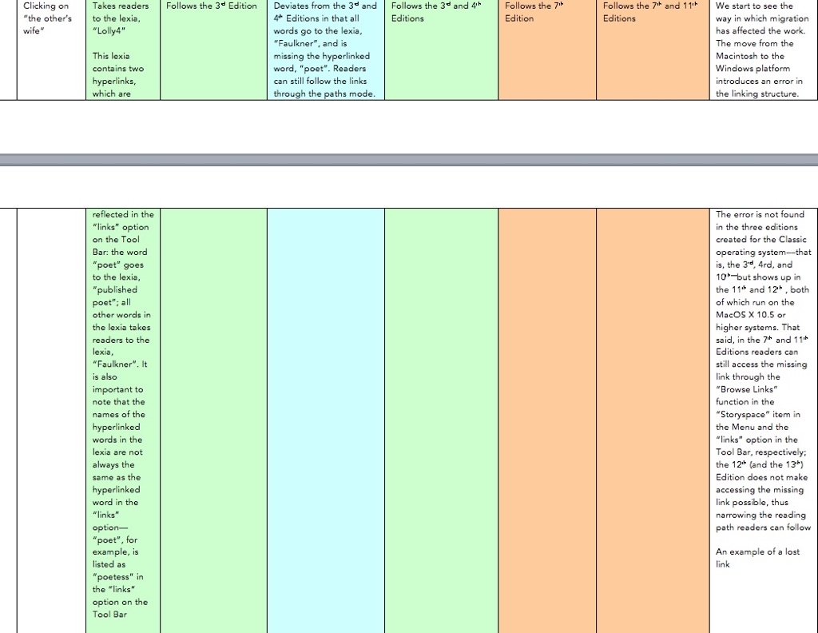
3rd
1990
Mac
4th
1992
Mac
7th
1994
Windows
10th
2001
CD-ROM
11th
2007
CD-ROM
12th
2016
USB Stick

Slide 13
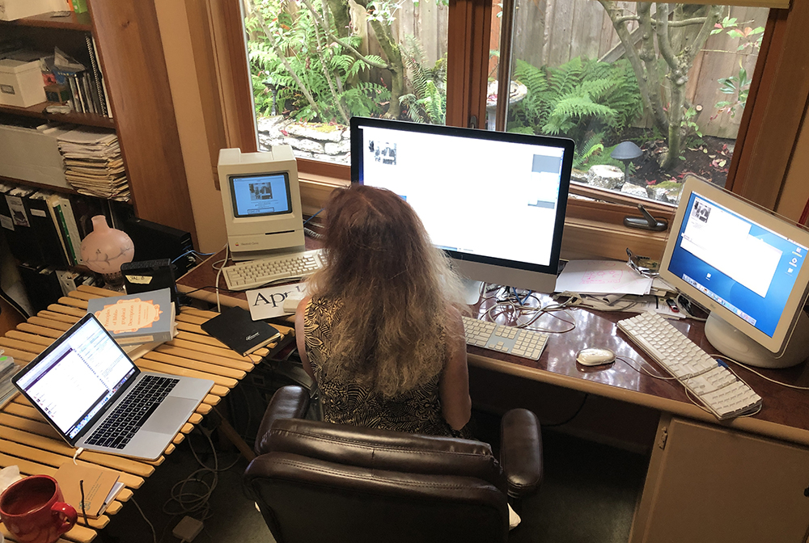
What does it mean for there to be an authoritative edition if one cannot access a copy of it?

Slide 14
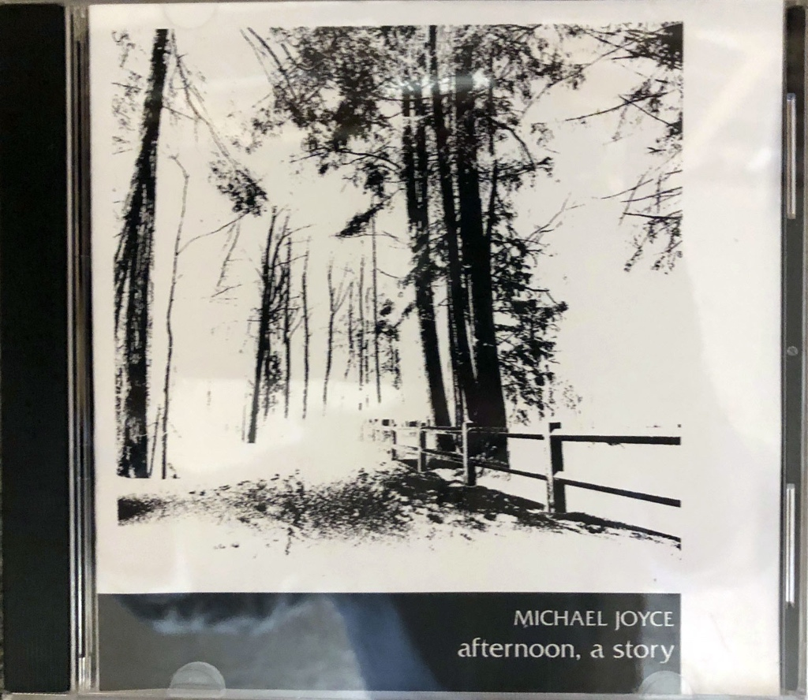
The 10th Edition, 2001
The 11th Edition, 2007
“...is typically cited without any acknowledgement or awareness of the differences between its versions, or even the fact that multiple versions exist” --Kirschenbaum, Mechanisms: New Media and the Forensic Imagination

Slide 15
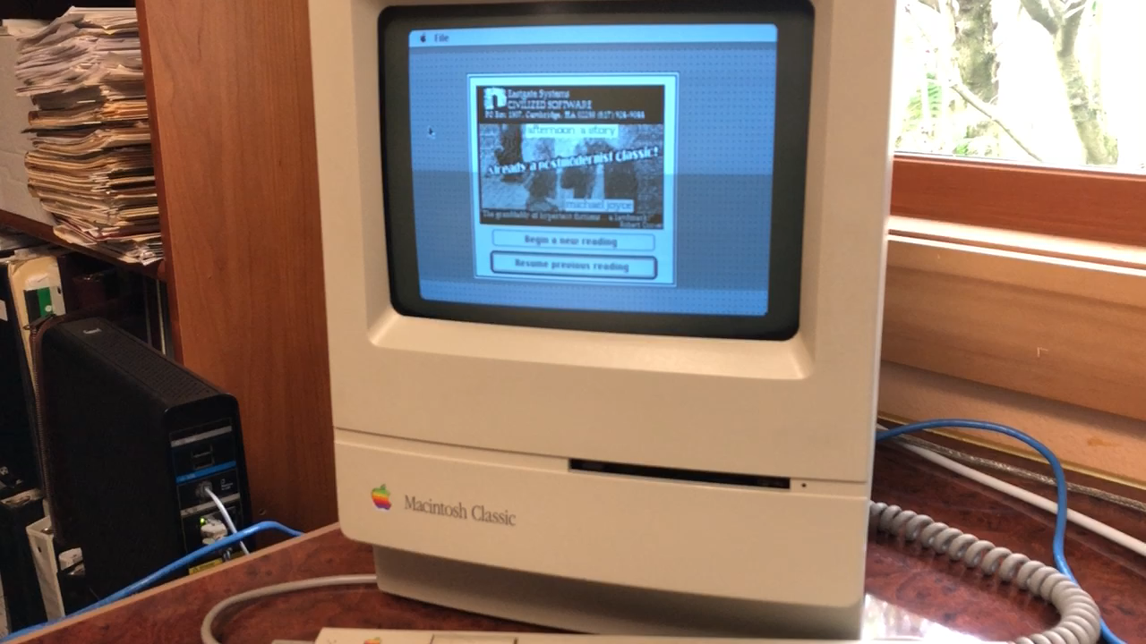
How in the world could it have survived these 13 migrations without variations?

Slide 16
dtc-wsuv.org/elo2020-hypertext
Dene Grigar, dgrigar@wsu.edu

