Slide 1
Balance

Slide 2
Weight of Elements
1. Large elements have more visual weight than small elements
2. Small elements can combine into a group with more visual weight

Slide 3
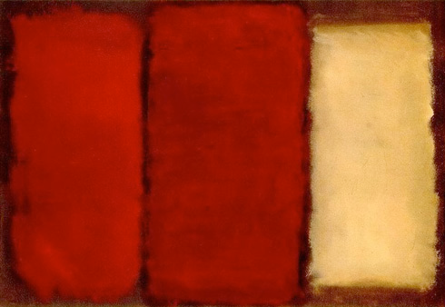
Point of Focus
Mark Rothko, Yellow and Gold, 1956
. . . the area of design that attracts the most attention — acts as the fulcrum of a balanced design

Slide 4
Point of Focus

Slide 5
Arrangement in Space
Elements can be arranged across the entire design space to create balance

Slide 6
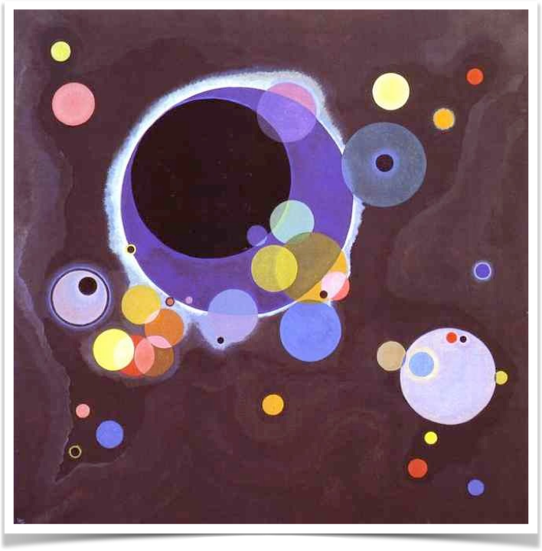
Wassily Kandinsky. Several Circles. 1926. Oil on canvas

Slide 7
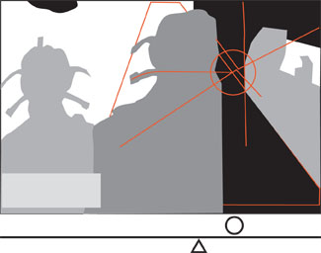
Balancing Irregular Elements
Elements such as negative space, text, & color contribute to balance

Slide 8
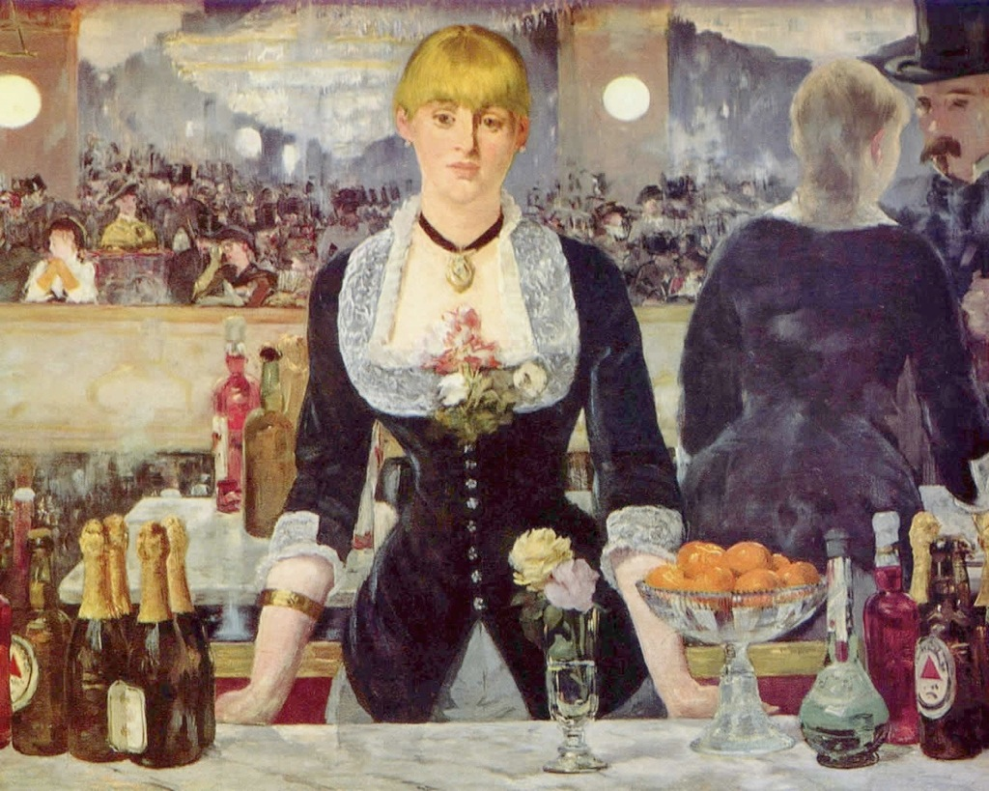

Slide 9
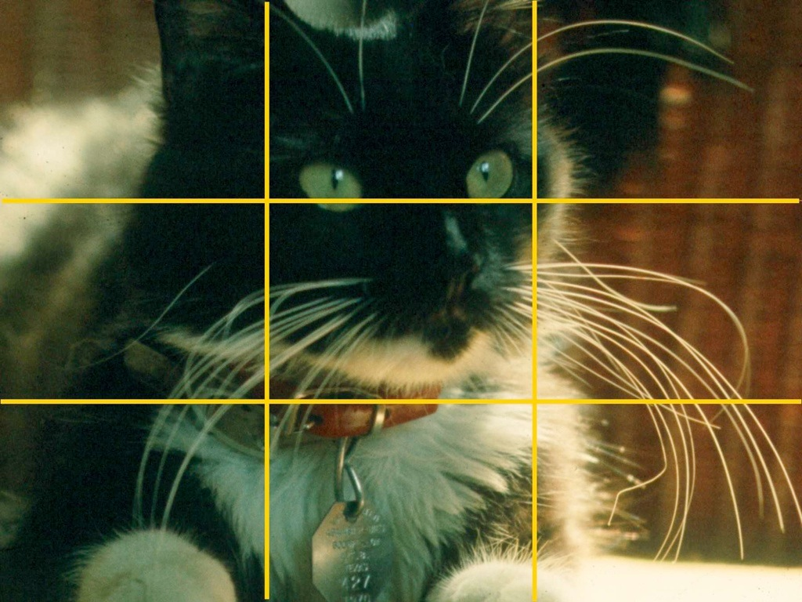
The Rule of Thirds
Step 1: Divide the space into 3 equal parts, horizontally or vertically.
Step 2: Give each part the same visual weight.

Slide 10
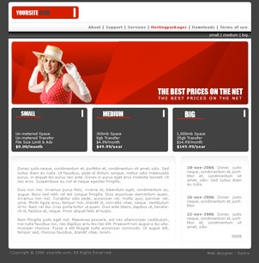
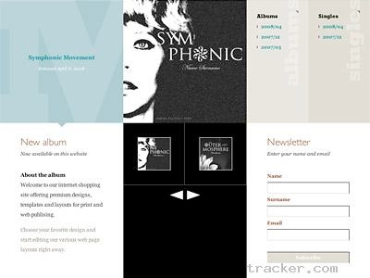

Slide 11
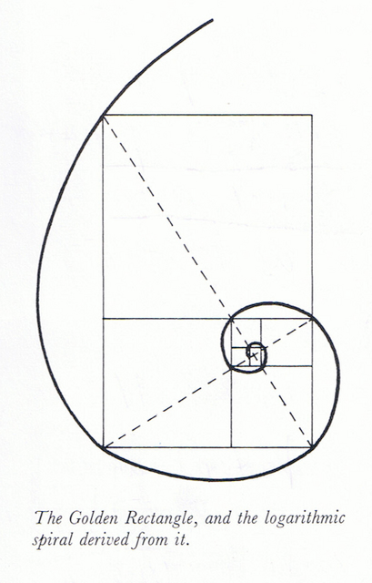
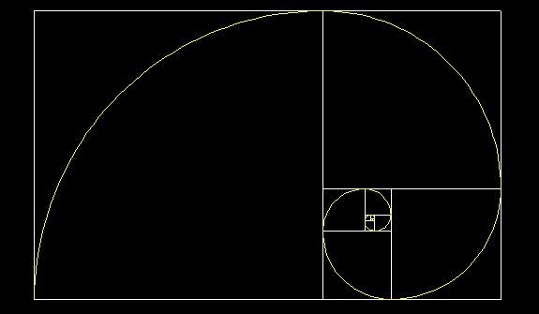
The Golden Spiral
Divide the space into thirds, then divide one third into three again, and again … to create the Golden Spiral.

Slide 12
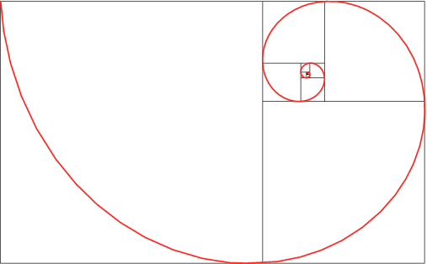
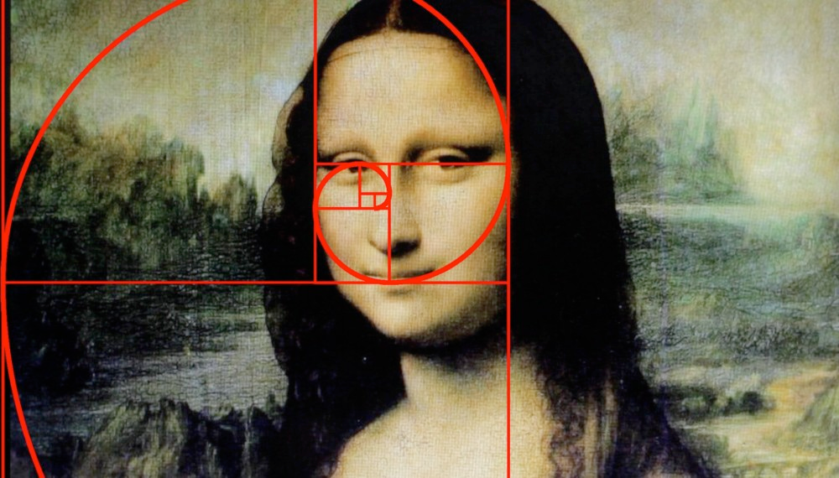
The Golden Spiral

Slide 13
Balance and Value

Slide 14
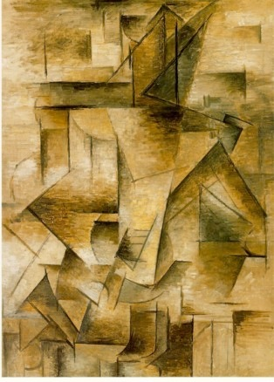
Balance and Value
Pablo Picasso, Guitar Player, 1910
The darker the object, the more visual weight it has but color relativity can change this general rule

Slide 15
Balance and Color
Color differences can influence the visual weight of design elements

Slide 16
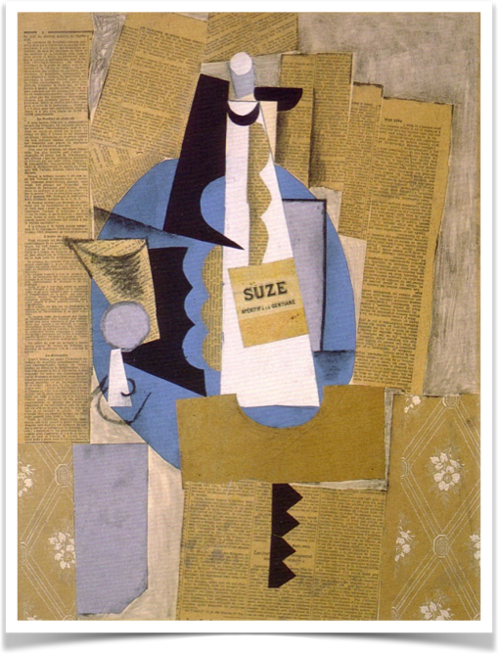
Pablo Picasso, Glass and Bottle of Suze, 1912

Slide 17
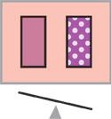
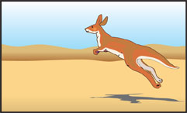
Balance Using Other Elements
Texture imparts visual weight
Implied motion imparts visual weight

Slide 18
Summary
1. The arrangement of elements of equal visual weight around the point of focus creates balance.
2. Lack of balance creates tension, which may be what you want.
3. Visual weight can be influenced by size, arrangement, value, color, and texture.

