Slide 1
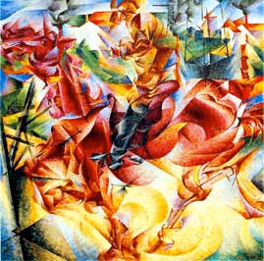
Color
Umberto Boccioni, Elasticity, 1912

Slide 2
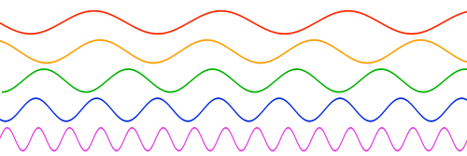
What Is Color?
The way “we perceive different wavelengths of light” (Bennett 139).
Different colors in the spectrum are created by different wavelengths of light.

Slide 3
Two Types of Color Models
1. Additive
2. Subtractive

Slide 4
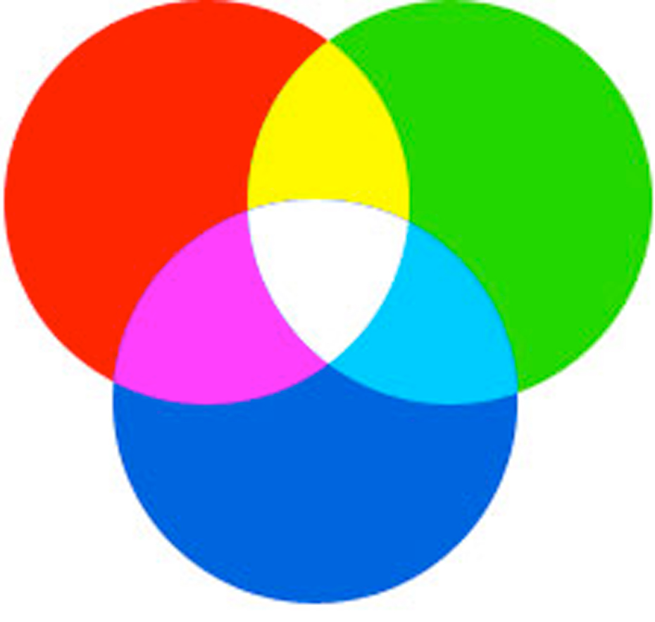
Additive Color
It’s the color model for digital media.
Its primary colors are red, green, and blue (RGB).
Its secondary colors (produced by adding two primaries) are cyan, magenta, and yellow.

Slide 5
Subtractive Color
It’s used for print-based media.
Its primary colors are Cyan, Magenta, Yellow, Black (CMYK); secondary colors are purple, green, orange.

Slide 6
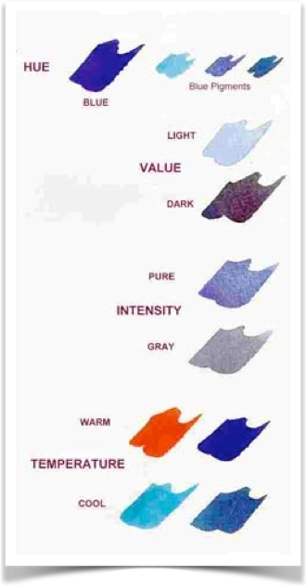
Hue
Value
Intensity
Temperature
Nita Leland, Color Speak,1998

Slide 7
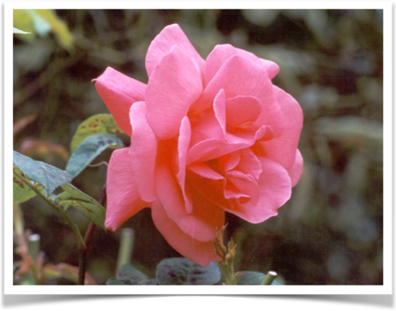
Hue
The primary or secondary color that makes up a given color. The hue of pink is red.

Slide 8
Value is the variation of light and dark
original color
shade
tint
Tint means that white has been added to a color.
Shade means that black has been added to a color.

Slide 9
Value Relativity
Dark colors seem to have more discernible tints while lighter colors seem to have more discernible shades (147-8).

Slide 10
From http://pixeltut.com/photoshop/difference-between-saturation-and-vibrance-in-photoshop
Intensity or Saturation is the level of pure color that is present.

Slide 11
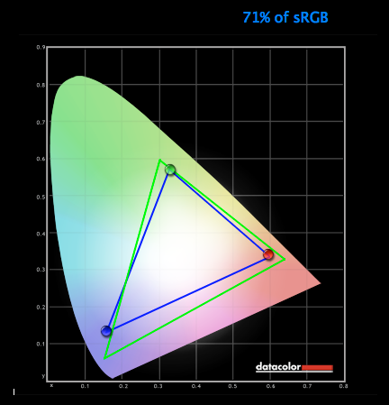
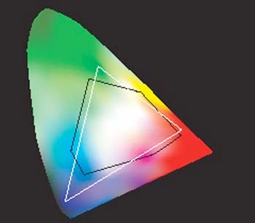
Gamut
is the spectrum of colors available in any medium
Gamut display for early MacBook Pro
Retina gamut display, MacBook Pro
Large area = Colors humans can see
White triangle = Colors a monitor can produce
Black line = Colors a printer can produce
Gamut display for computers circa 2005
See http://cdtobie.wordpress.com/2012/06/18/color-gamut-of-retina-display-macbook-pro/

Slide 12
Color on the Web
216: The number of colors available in the Web standard
256: The number of colors that can be produced by a 32 bit computer (1 byte, or 8 bits x 32 = 256)
212: The number of colors Internet Explorer can read

Slide 13
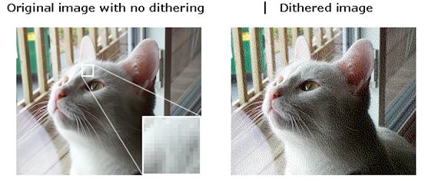
Dithering
The process a browser uses to produce a color outside the Web gamut
See http://www.sqa.org.uk/e-learning/BitVect01CD/page_63.htm

Slide 14
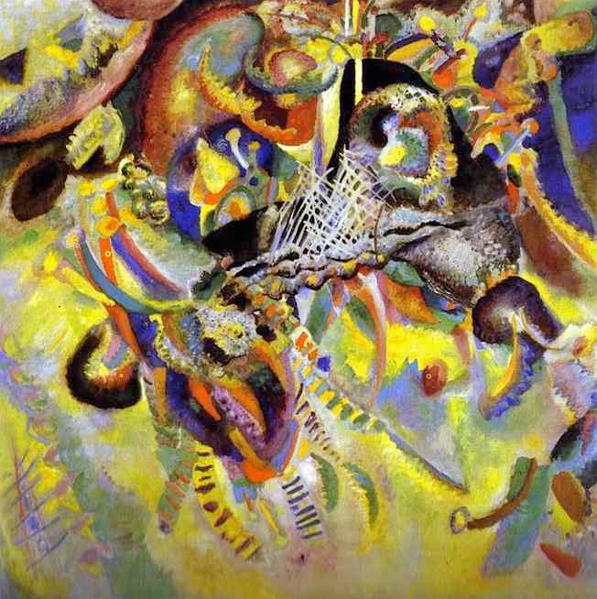
Summary
Color is determined by the wavelength of light rays.
Additive (RGB) color, used in digital design, mimics the way natural light behaves.
Subtractive (CMYK) color is used in printing.
The gamut of colors in the Web-safe palette is limited to 216 colors.
Wassily Kandinsky, Fugue, 1914

