Slide 1
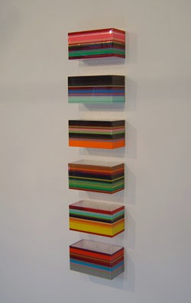
Repetition & Rhythm
Rana Begum, 2005

Slide 2
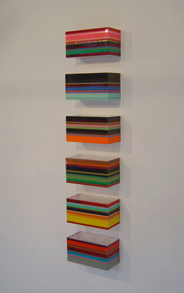
Repetition: An element repeated in a work
Rhythm: The repetition of a series of elements over time and/or space

Slide 3
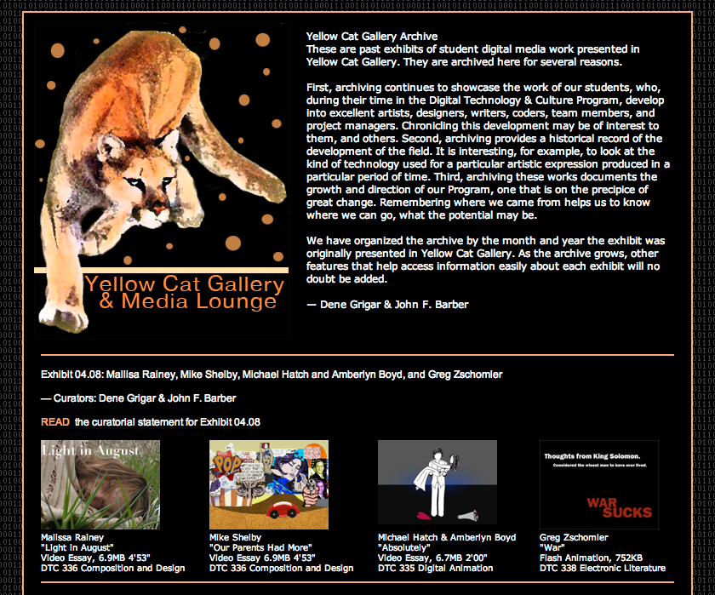

Slide 5
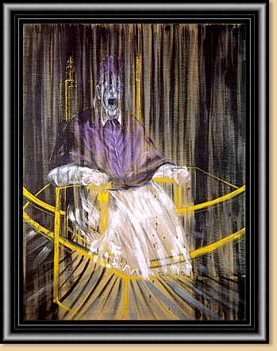
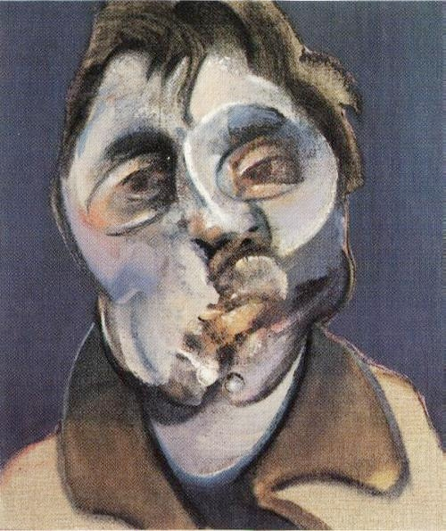
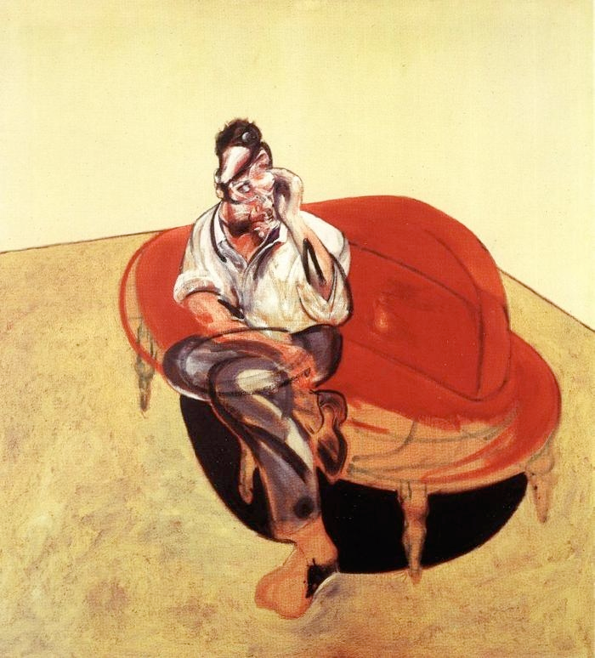
Visual Vocabulary:
Recognizable patterns
used in design
Francis Bacon, Study after Velazquez's Portrait of Pope Innocent X, 1953
Francis Bacon, Self-portrait, 1969
Francis Bacon, Portrait of Lucian Freud on Orange Couch,
1965

Slide 6
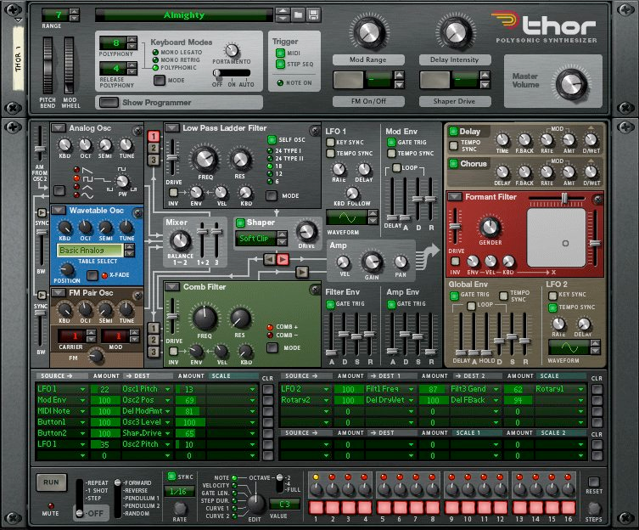
Reason interface

Slide 7
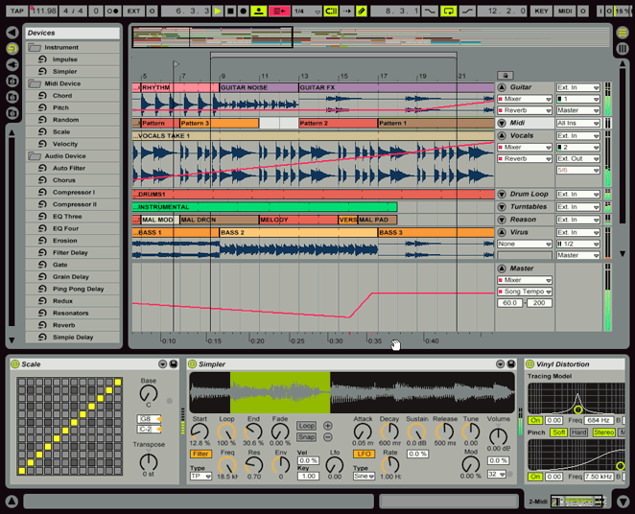
Ableton Live interface

Slide 8
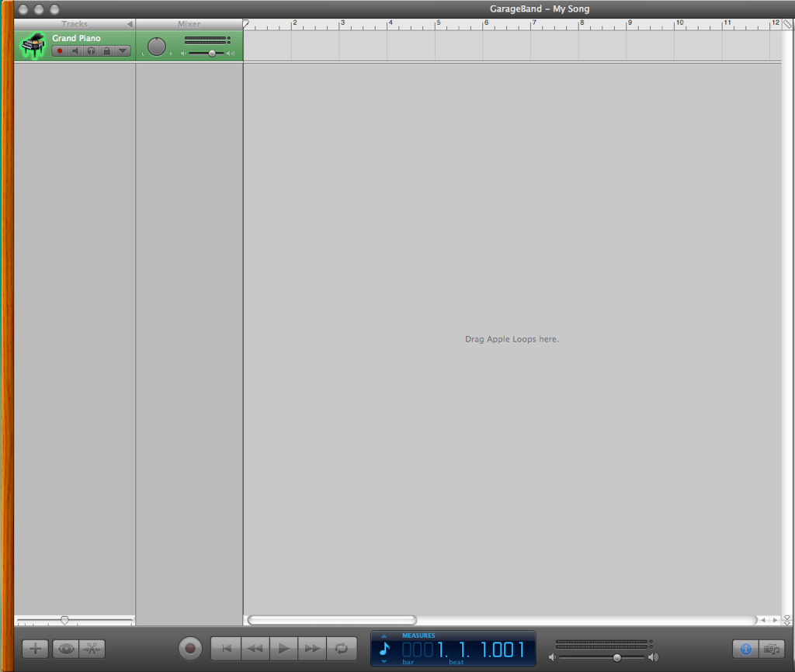
Garage Band interface

Slide 9
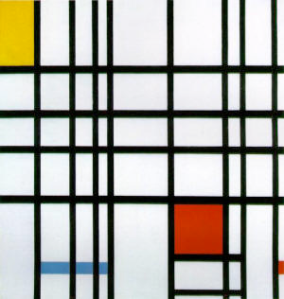
Altering Rhythm
Piet Mondrian, Composition with Red, Yellow and Blue, 1921

Slide 10
Ericka Walker
Non Linear Rhythm: The arrangement of elements in different areas of an image in a way that creates balance.

