Slide 1
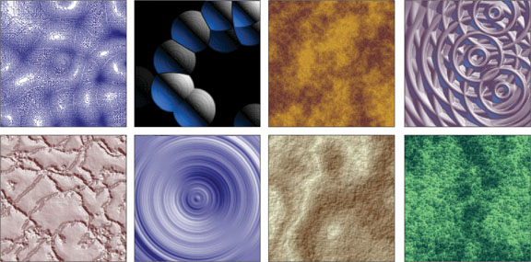
Texture
Notes:
This chapter focuses the element of design called texture.

Slide 2
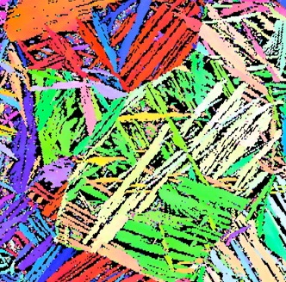
Enhances an image’s “richness and detail” (Bennett 124)
Notes:
There are five effects that texture can add to an image:
It can “transform a plain image into one that is full of richness and detail”

Slide 3
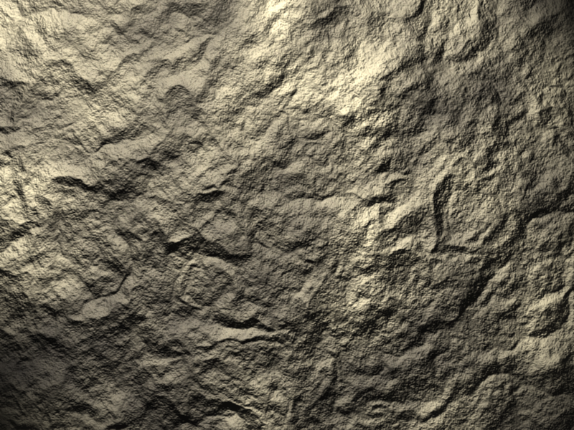
“[F]ills empty areas of an image” (Bennett 124-5)
Notes:
It can “fill empty areas of an image”

Slide 4
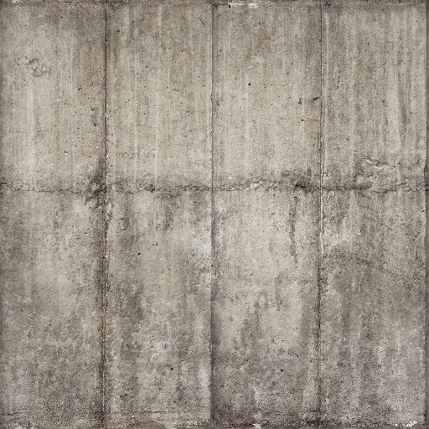
“[A]dds depth to space” (Bennett 124-5)
Notes:
It can “add depth to space”

Slide 5
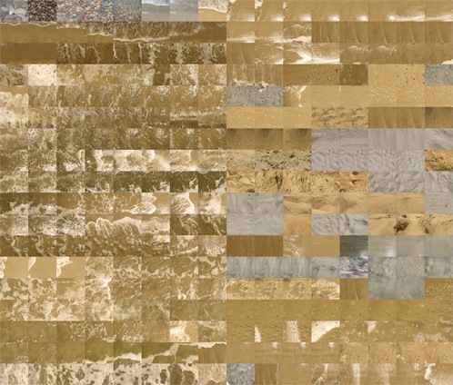
“[C]reates detail in an illustration” (Bennett 123-5)
Notes:
It can “create detail in an illustration”

Slide 6
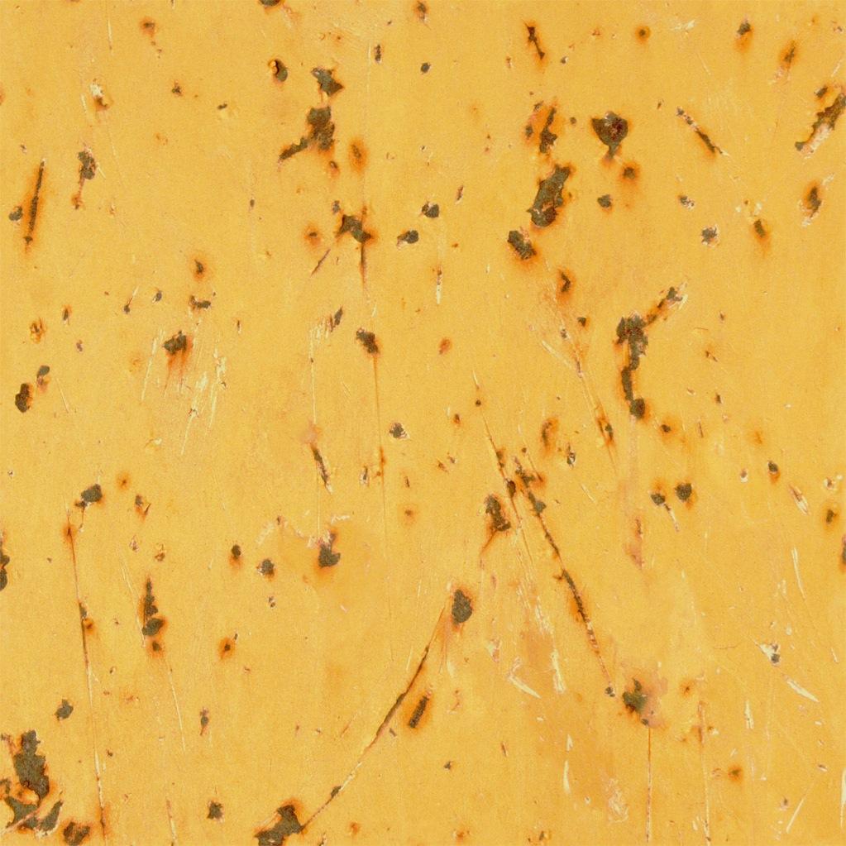
“[D]efines the style of an entire project” Bennett 123-5)
Notes:
It can “define the style of an entire project” (123)

Slide 7
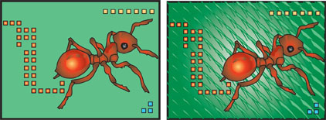
Notes:
This is the example the author gives for using texture as space. He tells us that “texture can also be sued as an element of design to fill in empty space” (124).

Slide 8
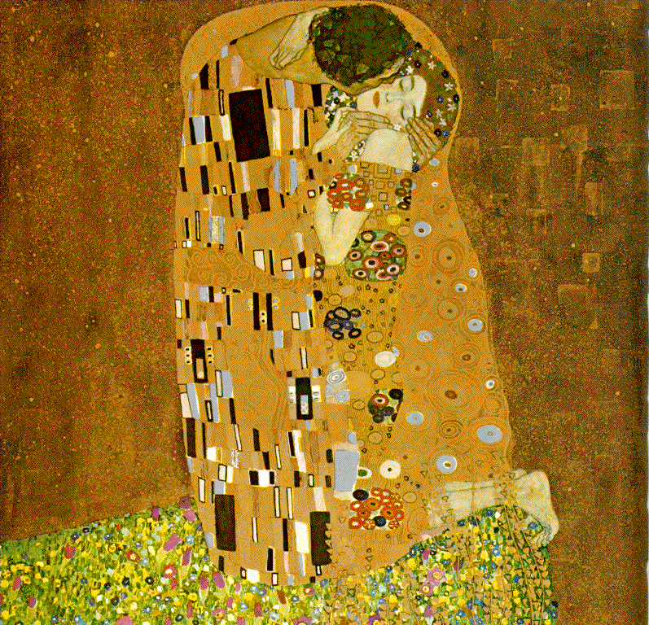
Gustav Klimt, The Kiss, 1907/08
Notes:
This is Gustav Klimt’s The Kiss painted in 1907/08. It shows the use of texture to fill space, show surface detail, and repeat a motif.

Slide 9
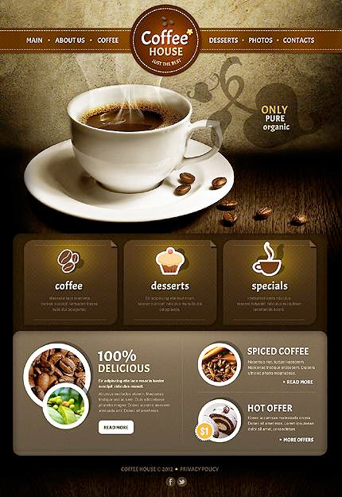
Don’t overuse them
Be mindful of real estate when using texture
Don’t settle for default settings
Use several filters to achieve texture
Notes:
The book talks about texture filters. We will actually work with textures in PhotoShop next Tuesday in our tutorial. But it is good to talk about drawbacks to using filters.
You can overuse them
You can produce an image similar to another using the same filter
Avoid using the default setting and apply “more than one filter to the same image” (130).

Slide 10
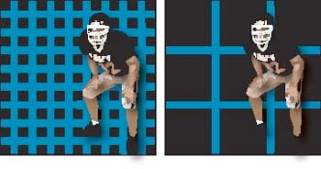
1. Oversized background texture can detract from the main image
2. Too many textures, or text over texture, can make it difficult for the viewer to perceive the most important information
Notes:
Texture design problems: Oversized background texture can detract from the main image.
Too many textures, or text over texture, can make it difficult for the viewer to perceive the most important information.

Slide 11
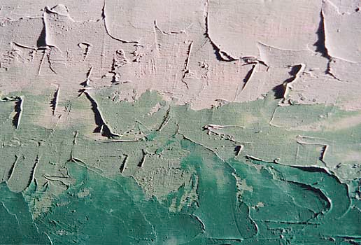
Summary
1. Visual elements can be used to create texture. Texture can be used to provide detail, increase interest, and create a compositional element.
2. Texture should be used mindfully.Don’t use too many, and be careful about putting texture under text.
Notes:
So, in conclusion: Visual elements can be used to create texture. Texture can be used:
♣ to provide detail
♣ to increase interest
♣ to produce a compositional element
Keep textures simple: Don’t use too many, and be careful about putting texture under text.

