Slide 1
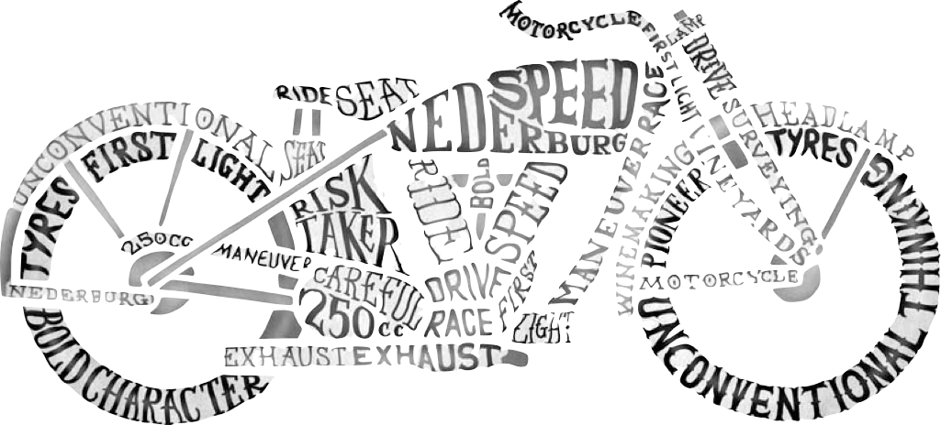
Typography

Slide 2
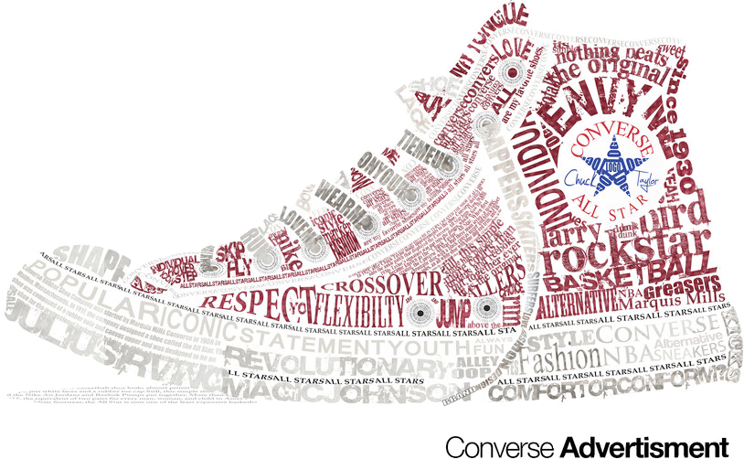
Type: Kind of lettering used
ex. “Arial”
Font: Specific type (size) used
ex. “72 pt.”

Slide 3
Anatomy of Type

Slide 4
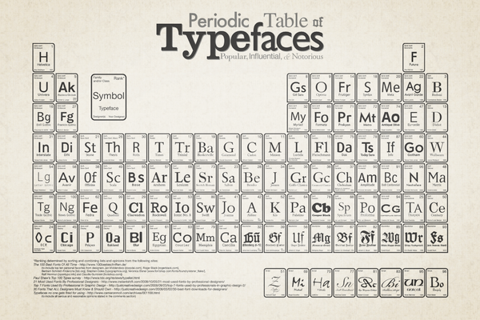
Type Families
See http://fda-visual-communication.blogspot.com/2009/04/bit-about-history-of-typography-and.html

Slide 5
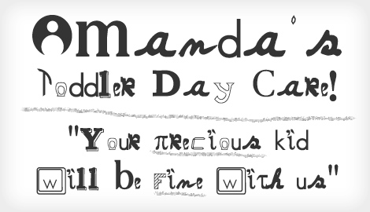
Working with Type
Type must be legible.
Too much distortion makes letters hard to read.
Simple serif fonts are best for long lines.
See http://bonfx.com/23-really-bad-font-choices/

Slide 6
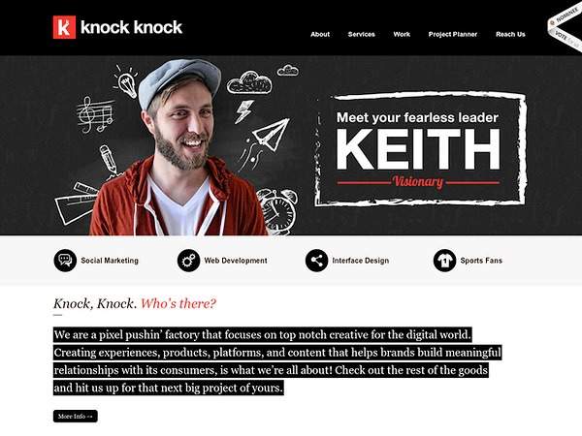
Combining Type
The unity of design is important but you can combine type by differentiating various kinds of text.
When using typography, ask: Is it legible? Does it look good as part of the whole design?

Slide 7
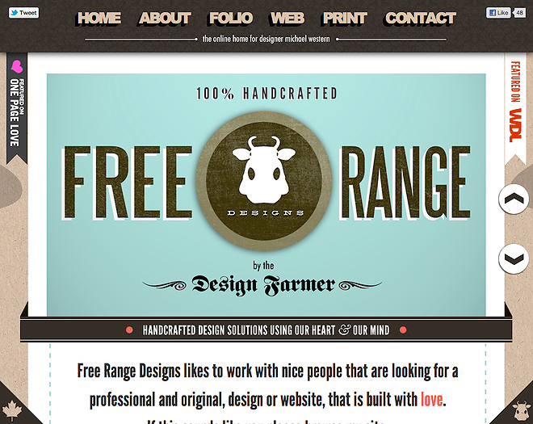
Combining Type
One way to avoid bad use of type is by using one typeface and varying the size. But using different type in the same project can add emphasis to certain parts.

Slide 8
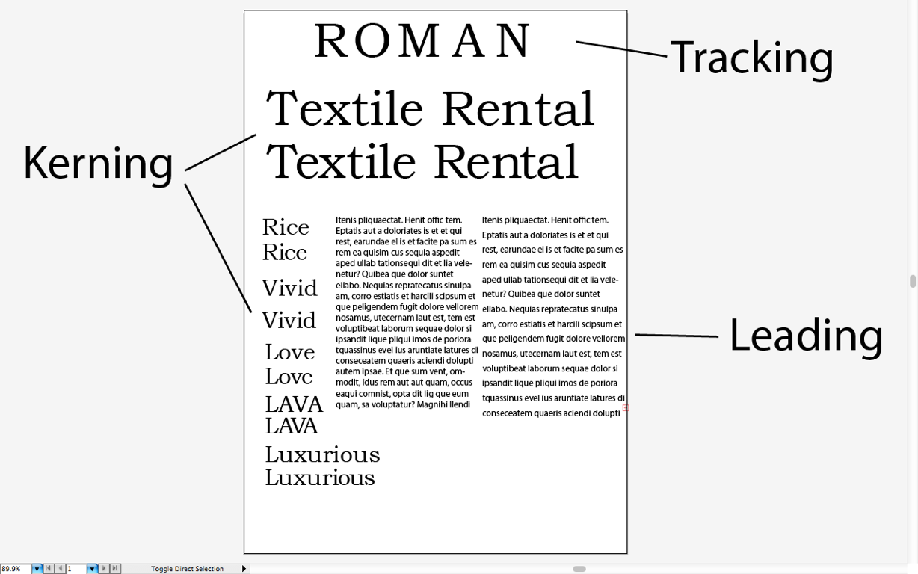
Type Adjustments
Kerning: The space between individual characters.
Leading: The space between lines.
Tracking: The overall spacing between all characters.

Slide 9
Type as an Element of Design
Type is not an afterthought, but an integral part of the design since different types can convey different emotional qualities.

Slide 10
Summary
1. Typography is the arrangement, style, and appearance of text.
2. Type families have common characteristics such as use (or not) of serifs.
3. Typography is not an afterthought, but an integral part of design.
4. Type must — above all — be legible.

