Slide 1
The Real Digital Divide?
Jacob Walton
4/26/13
DTC 101

Slide 2
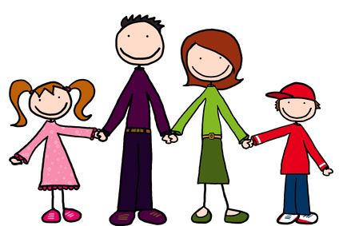
The Family
Hanna Walton, age 15
Emma Walton, age 12
Rhonda Walton, age 47
Richard Walton, age 51
Harold Walton, age 81

Slide 3
A Digital Divide
Hanna and Emma both commonly used social media but knew nothing about setting up websites of fixing problems.
Rhonda, Rich, and Harold used social media more sparingly, but were much more proficient at working software.
Pew Internet (www.pewinternet.org) claims that older generations have less internet presence, 20% to 9%.
Why these results?

Slide 4
Works Cited
www.pewinternet.org
Hanna Walton 4/2/13
Emma Walton 4/3/13
Rhonda Walton 4/10/13
Richard Walton 4/6/13
Harold Walton 4/7/13

