Slide 1
The Digital Divide Among Us
By: Brandon Phillips

Slide 2
Digital Divide you say?
The division between “those who are tech savvy and those who are not?”
“What’s that?”
Digital divide refers to the gap or imbalance that exists between those who have access to Information and Communications Technology (caricomict4d.org 1)

Slide 3
Who?
I interviewed my family members who were of age 16, 24, 30, 50, 59.
"How many hours a day, during the work week, do you spend on the internet?"
"What do you use it for?”
Do you know what the digital divide is, and if so can you define it?"

Slide 4
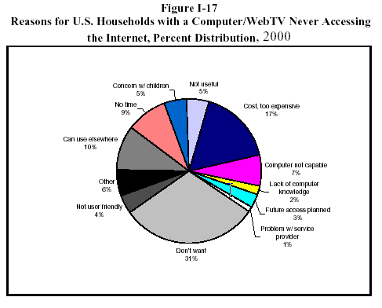
And…?
- Millions are without
internet
- “The internet is dangerous.”
- Factors:
Age 16-30 65%
Age 50-59 44%
Bill Gates’ explanation

Slide 5
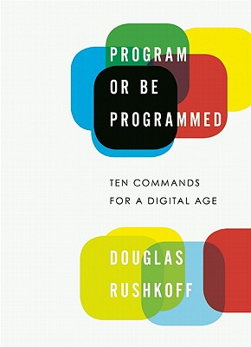
So what?
Fact, Openness, Social, and…
Inability to discern truth
Lack of information
Inability to share info
Prone to influence

Slide 6
Conclusion
Awareness of the digital divide is necessary
It is dangerous to be without internet access
Factors include: Age, Ethnicity, Lack of Education
Solution: Including internet in libraries and advertisement.
89% Have internet
27% of males and 26% of females use the internet at the libraries. Due to lack of advertisement.

Slide 7
Bibliography
Bolter, J. David, and Richard A. Grusin. Remediation: Understanding New Media. Cambridge, MA: MIT, 1999. Print.
"Definition of Digital Divide." Definition of Digital Divide. N.p., 18 Sept. 2008. Web. 22 Apr. 2013. <http://www.caricomict4d.org/ict-for-development-topics-mainmenu-132/digital-divide-mainmenu-175/69-definition-of-digital-divide.html>.
Gates, Bill. "Shaping the Internet Age." Shaping the Internet Age. N.p., 01 Dec. 2000. Web. 29 Apr. 2013.
Lenhart, Amanda. "Who's Not Online." PEW Internet. N.p., 21 Sept. 2011. Web. 22 Apr. 2013.
Phillips, Brett, Kristen Phillips, Lance Phillips, Michele Phillips, and Colbie Corrales. "Digital Divide." Personal interview. 21 Apr. 2013.
Rushkoff, Douglas, and Leland Purvis. Program or Be Programmed: Ten Commands for
a Digital Age. Berkeley, CA: Soft Skull, 2011. Print.

Slide 8
Thanks for Listening
Any Questions?

