Slide 1
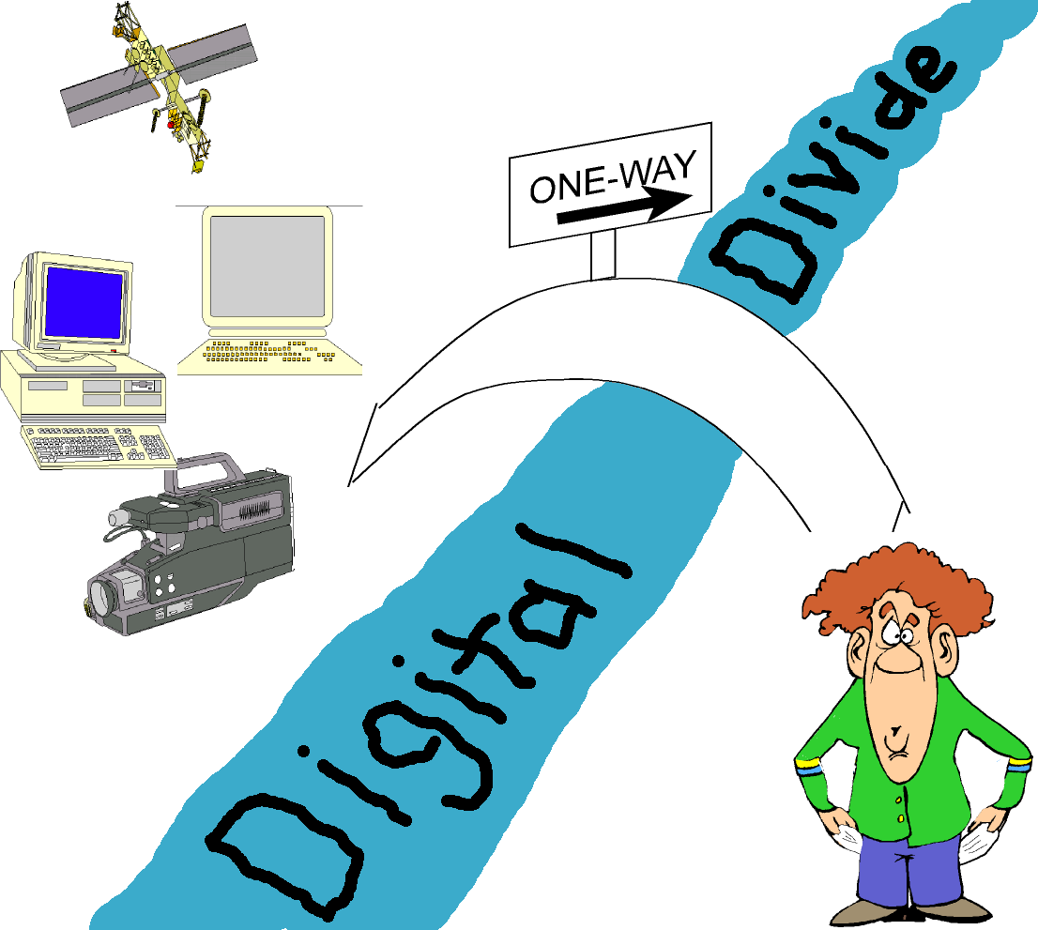
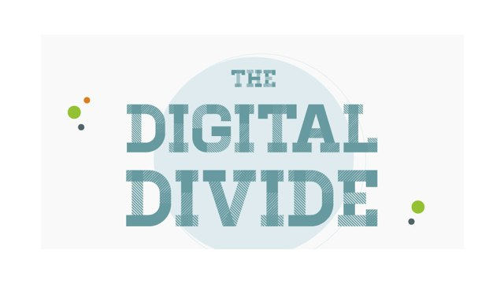
The Digital Divide

Slide 2
What is the Digital Divide?
“…the patterns of unequal access to information technology based on income, race, ethnicity, gender, age, and geography…”
“The metaphor of a great chasm – a divide – polarizes the issue as a matter of simply having, or not having, access to the internet.”
“Digital Divide refers to the gap between those who can benefit from digital technology and those who cannot.”

Slide 3
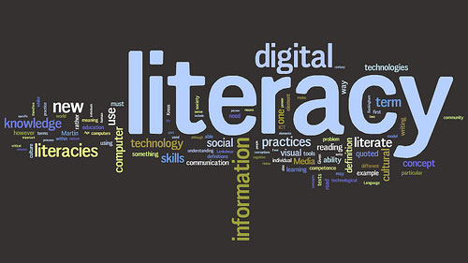
What is Digital Literacy?
“The ability to use digital technology, communication tools or networks to locate, evaluate, use and create information.”

Slide 4
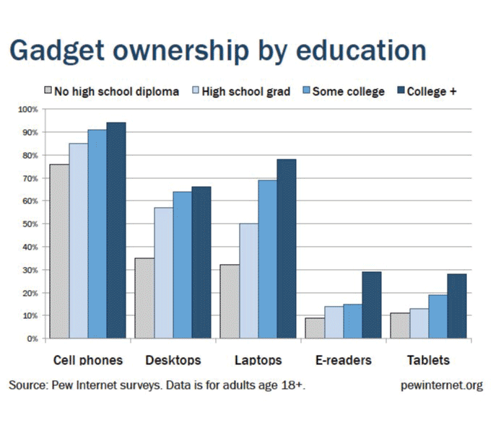
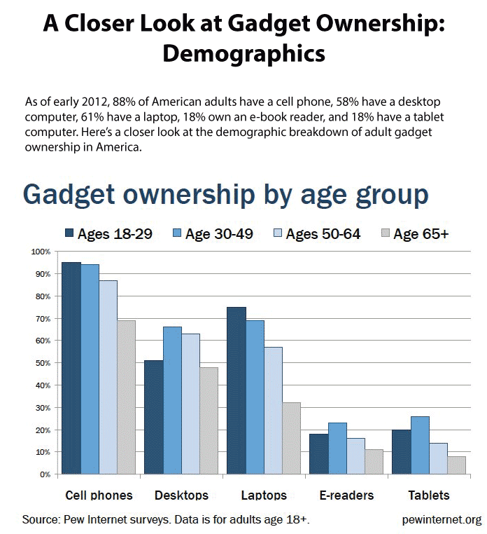
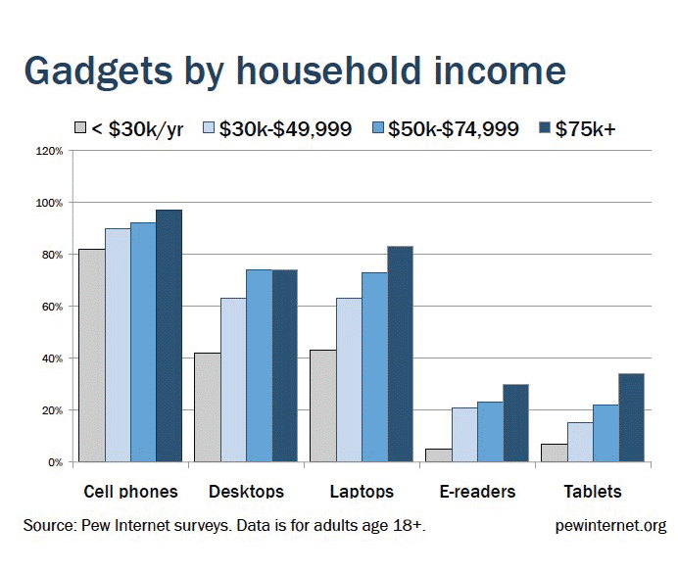
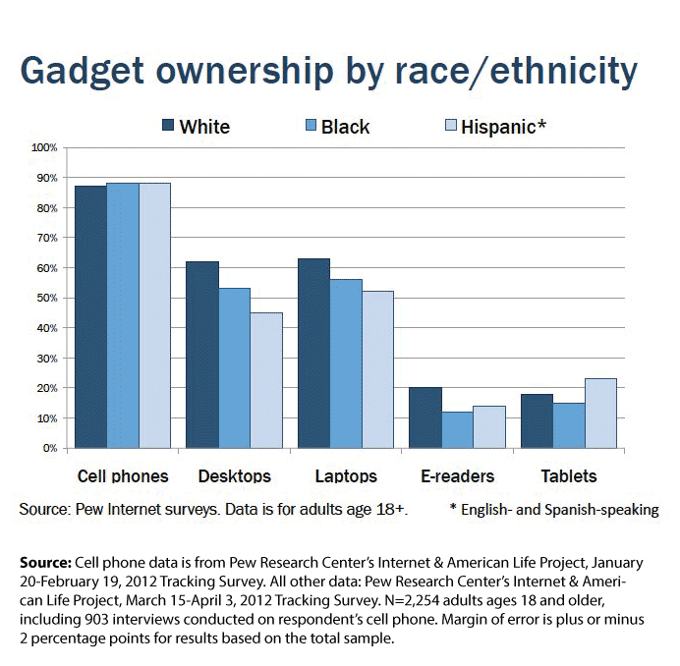
Pew Research Center

