Slide 1
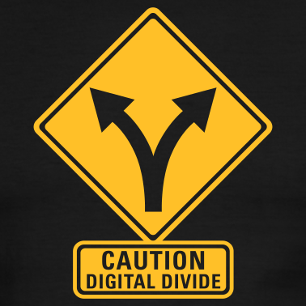
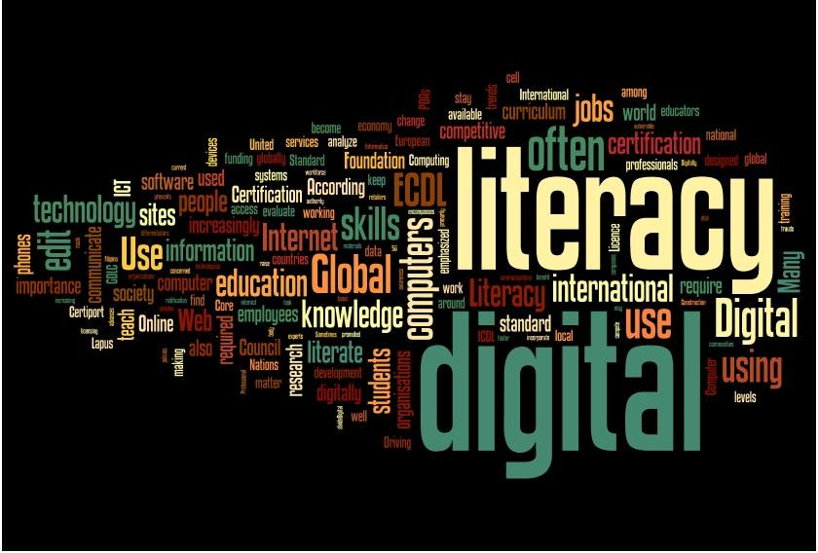
Digital Divide Authoring Project #2
By: Kyla Perrin

Slide 2
Digital Divide
Digital Literacy
“Disparities between those who have opportunities and skills enabling them to benefit from digital resources, such as internet, and those who don't have these opportunities and skills“
“Patterns of unequal access to information technology based on income, race, ethnicity, gender, age, and geography..."
“The ability to understand information and to evaluate and integrate information in multiple formats that the computer can deliver”
“Ability to read and interpret information."

Slide 3
People Interviewed
Beverly Watson-81 years old
Caroline Perrin-47 years old
Curtis Perrin-16 years old
Braden Aspon-11 years old
Brycelynn Holcomb-4 years old

Slide 4
Statistics
92% have used an online search engine
78% use internet on daily basis
22% don’t use internet
90% say they have internet in homes compared to May 2011 when only 88% had internet in homes

Slide 5
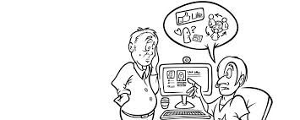
Conclusion
Will media and technology continue to expand?
Will the digital divide go away?

