Slide 1
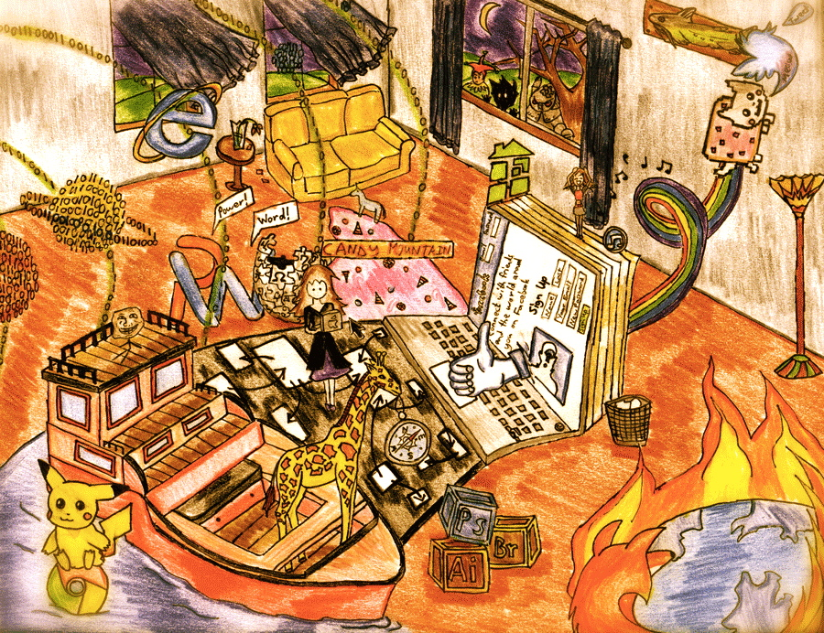
Digital Divide
Exploring Differences

Slide 2

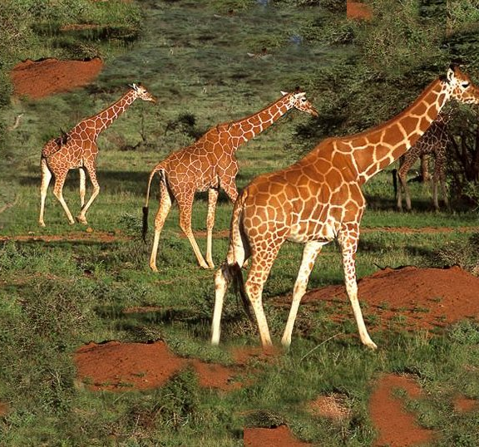
Connected Vs Disconnected
Safari
Safari

Slide 3
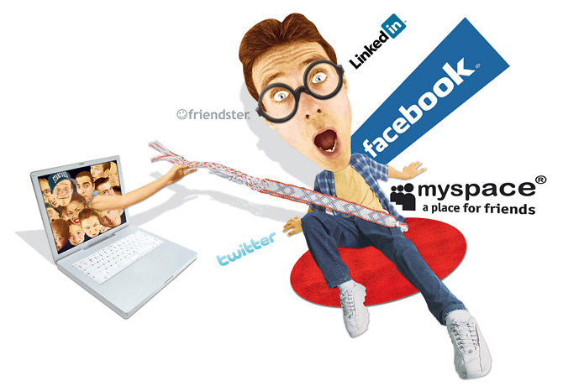
Younger Group-Interviews
Four people-19,20,21,21
All had a Facebook
15 total hours of the four spent on the Internet daily
All found the Internet distracting
Type Test Paragraph times added up-11min. 33sec.
Points for cell-phone rating:19. mean: 4.75.
All had more than 1 email

Slide 4

Older Group-Interviews
Four people-52,54,55,61
Half had a Facebook
6hr 30min total of the four spent on the Internet daily
Half found the Internet distracting
Type Test Paragraph times-added up to- 15min. 25sec
Points for cell-phone rating:11. mean: 2.75
Three had only 1 email

Slide 5
There’s a main divide of age, skill, and economics
But there’s always something to learn on each side of the divide.

