Slide 1
Digital Shift
DTC – Authoring Project 2
Audra Mann

Slide 2
Silent Generation & Boomers
65 and over
Great Depression
Digital Advances
38% online
50 to 64
Witness birth of PCs
70% online

Slide 3
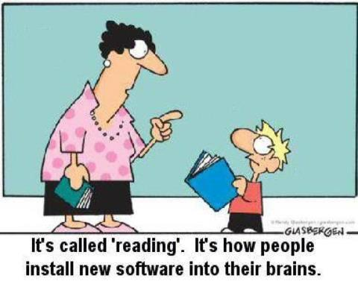
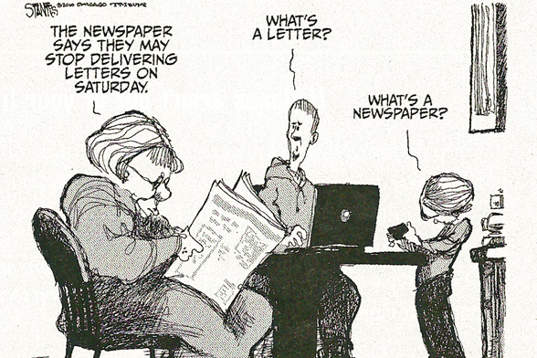
Gen X and Y
1965 to early 1980
30 to 47 years old
Last generation to grow up totally analog
Mid 80’s to 2000’s
93% of teens online
Smart phones

Slide 4
Generation Z
2000’s to now…

