Slide 1
Digital divide within family
Samai Mendoza

Slide 2
interviews
Family members ages 9,20,22,25, & 39
Same questions were asked
They all owned some sort of technology
      Laptop
      Ipad
      3ds
Internet access

Slide 3
Family & statistics
My mom is part of the “7% of the general population…to own a computer, but lack skills and interest in taking advantage of all the internet has to offer”
Esmeralda, 20 “The most social girl in her class doesn’t really socialize in the real world at all.” -Rushkoff

Slide 4
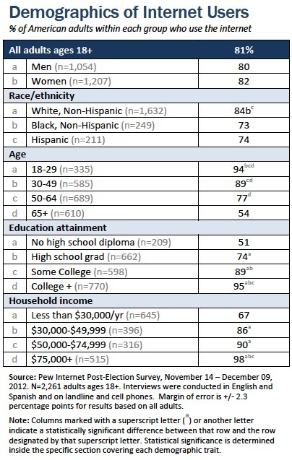
Pewiinternet.org

Slide 5
In Conclusion
Older people fall within the digital divide
why?
      They are not interested in learning and/or creating new technology
Why?
      They grew up without technology
      It’s too complicated for them to use and to learn new technology
      “The main reason they don’t go online is because they don’t think the internet is relevant to them”.

