Slide 1
Everyone Uses Technology

Slide 2
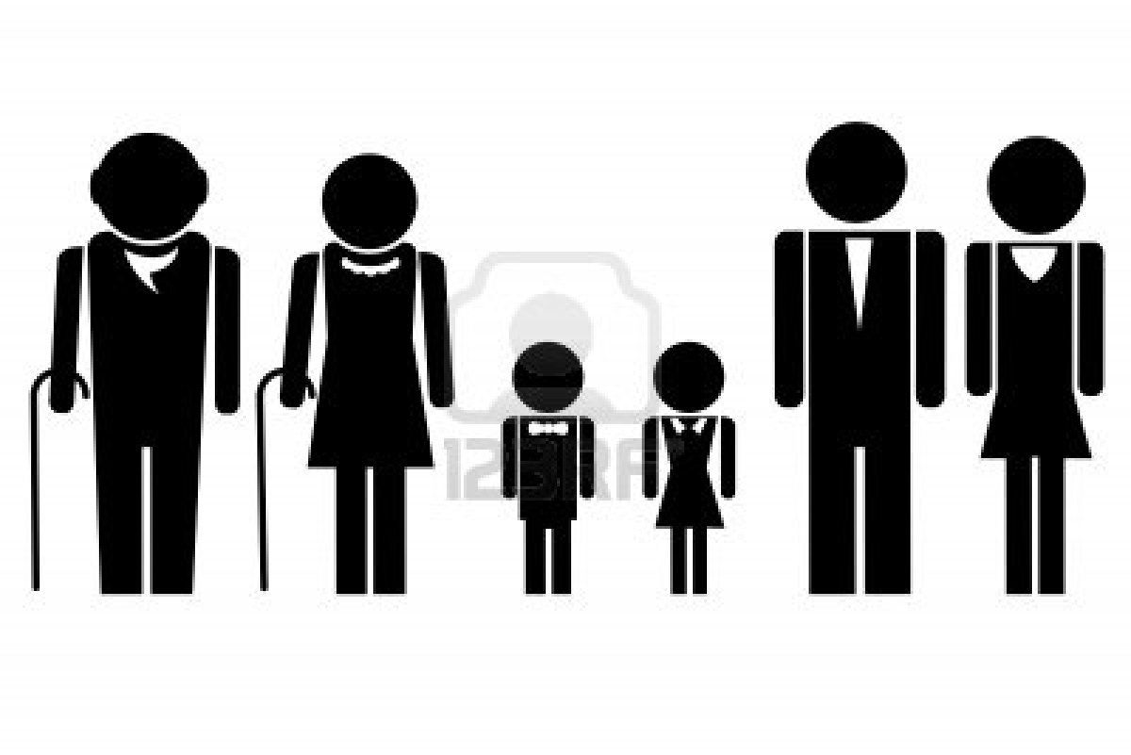
Interviewees:
72 years old
26 years old
15 years old
55 years old
3 years old

Slide 3
The Questions
How often do you use email? Do you have more than one email account?
What is your opinion on smartphones? Do you have one now? If not, what is the reason?

