Slide 1
Bridging the Digital Divide
Discovering the root of the problem
By Colleen Burke

Slide 2
Who is being left behind
Older people (Baby boomers and up)
Lower Economic classes
Rural populations
Immigrants

Slide 3
Biggest Factor: Cost

Slide 4
Internet use and income

Slide 5
Broadband at home and income

Slide 6
Smartphones

Slide 7
The US Rankings
US ranks 15 in broadband access
South Korea ranks # 11
19 million Americans have no access to high speed internet at all

Slide 8
Lack of Competition
The Internet is split between wired cable companies and wireless telecommunication

Slide 9
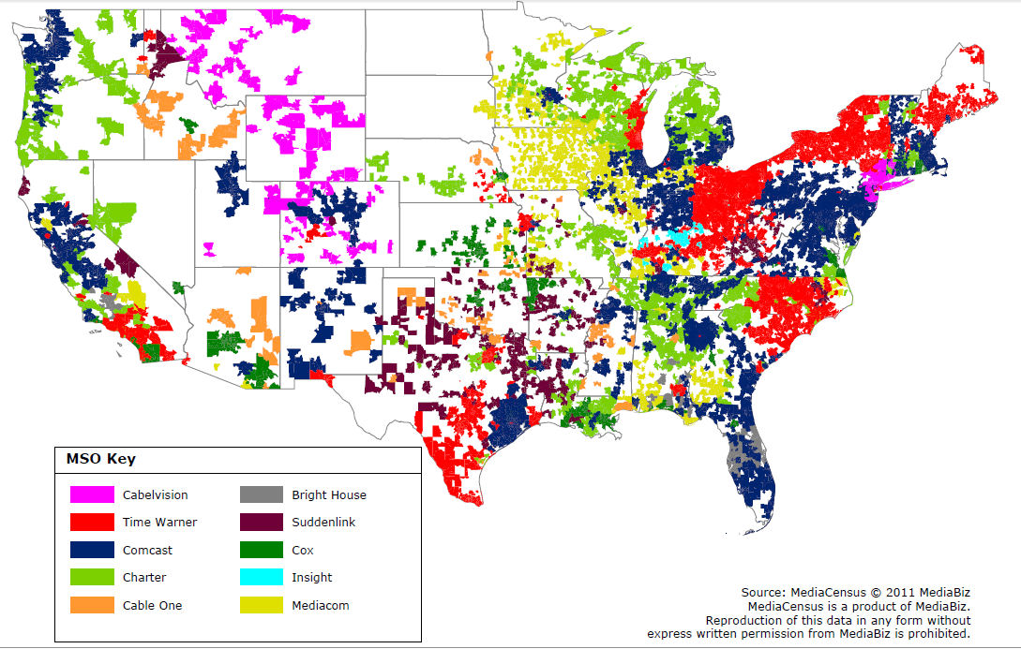
Location of Internet Providers

Slide 10
High speed internet cost per month
Hong Kong $25 per month
Seoul $30 per month
Time Warner plan $75 per month
AT&T Plan $70 per month

Slide 11
Like electricity internet is a right
In 1930 90% of people living in the city had electricity but only 10% of rural people did
Electric companies saw it as too expensive to provide coverage to the countryside
FDR saw it as a right passed the Rural Electrification Act in 1936

Slide 12
What Can We Do?
Treat internet access as a utility
Write your congressmen
Allow cities and towns to act as their own municipality
Encourage competition

