Slide 1
My Boyfriend Came Back From the War – A Modern Cinematic Version
By: Sydney Standish

Slide 2
Background
A grid system of changing visuals and text
Soldier returns from war
Two Lovers in a room
A conversation
Proposal
Affair
Hinted Violence
Ends with entirely blank screen

Slide 3
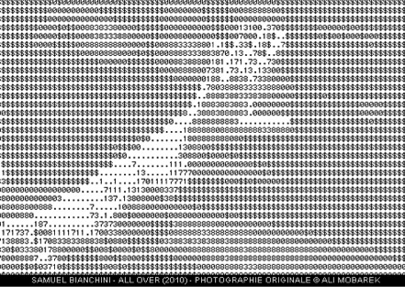
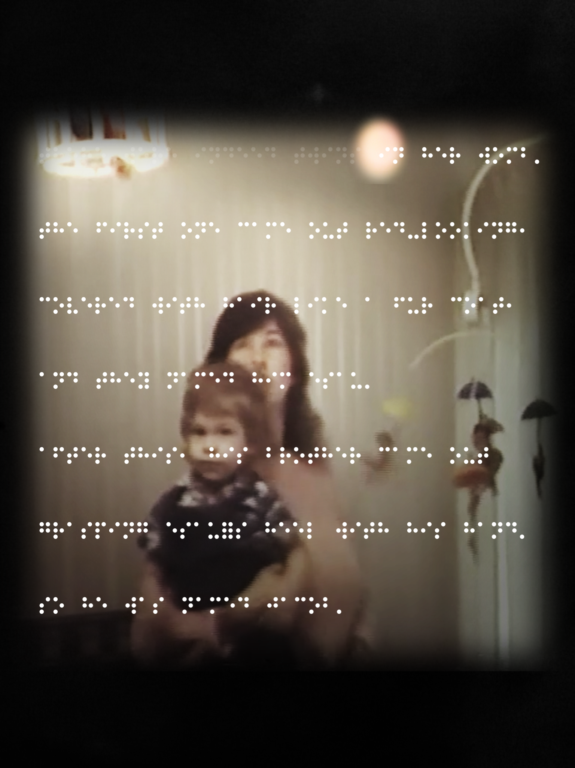
Net Art and Cinema-Writing
Net Art and Hypermedia
Art
Elusive
No order
Internet primary material
Other internet materials
Cinema-Writing
Visuals
Audio
No order

Slide 4
Brainstorming
Gif animations
Modern storyline but vintage themes
Connection to modern technology
PTSD inspired by Pry
Audio and visuals
Original grain and quality

Slide 5
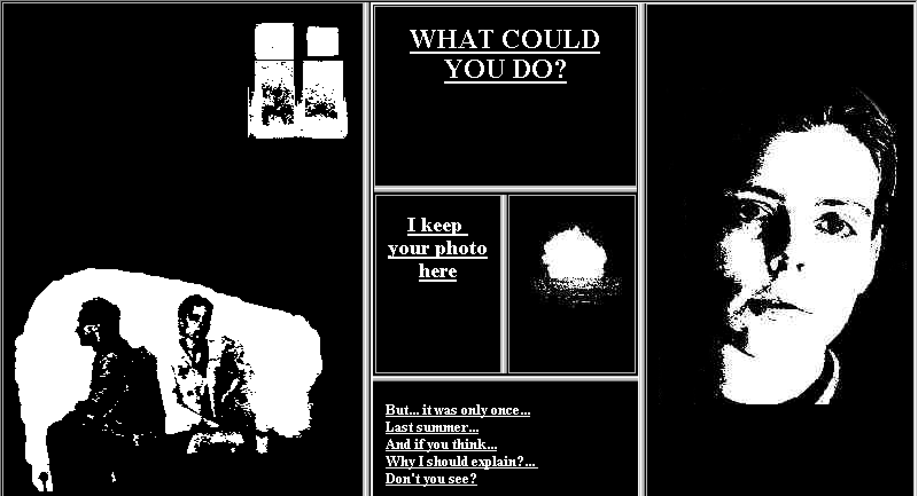
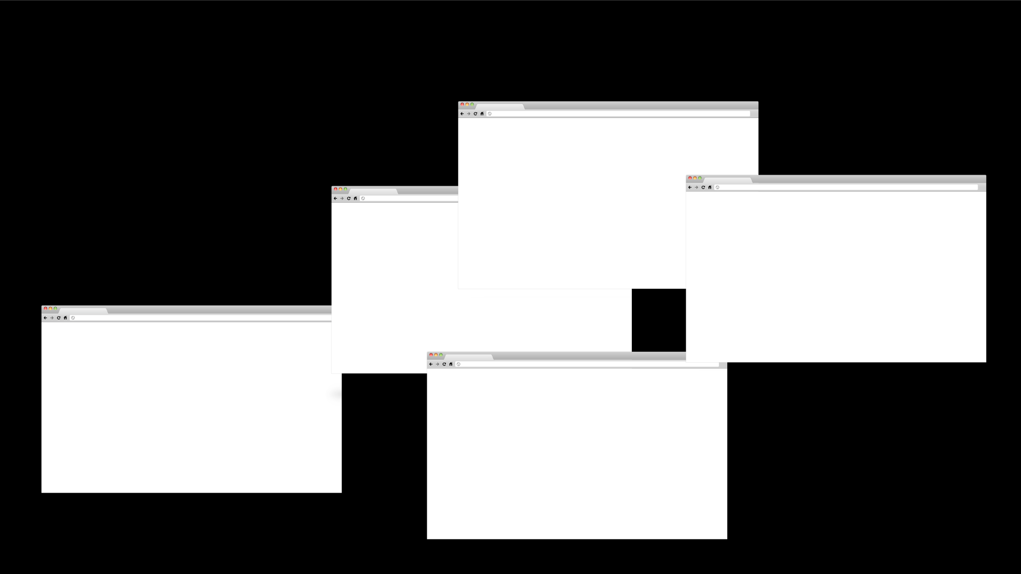

Slide 6
Mapped

