Slide 1
Chrono Crisis
By: Lucas Pauly, Dimitri Myers, and Michael Lidbetter

Slide 2
Part II: Genre, Backstory, Environment
3D Platformer
Time Runner
Time Warp
Time Periods
Race Against Time
Hazard
Fun, Yet Competitive

Slide 3
Part II Cont: Scope, Action, Promise of game
Multi-path
Multiple levels
Hazards & Obstacles
Race Against Time
Race Friends For Achievements

Slide 4
Part III: Backstory
Cadencians
Time Warp
Time Runners
Tempus Corp.
Echo
Big Bang
Time Ghosts

Slide 5
Part III Cont: UI Design
Start
Main Menu
Load
Level Select
Compare Times
Customize
Pause Menu

Slide 6
Part III Cont: Rules
Race To Be Fastest
15-30 Seconds
Collectibles
Pick-Ups
Chrono Clocks
Chronositer
Time-Freeze
Medal System
Gold
Silver
Bronze

Slide 7
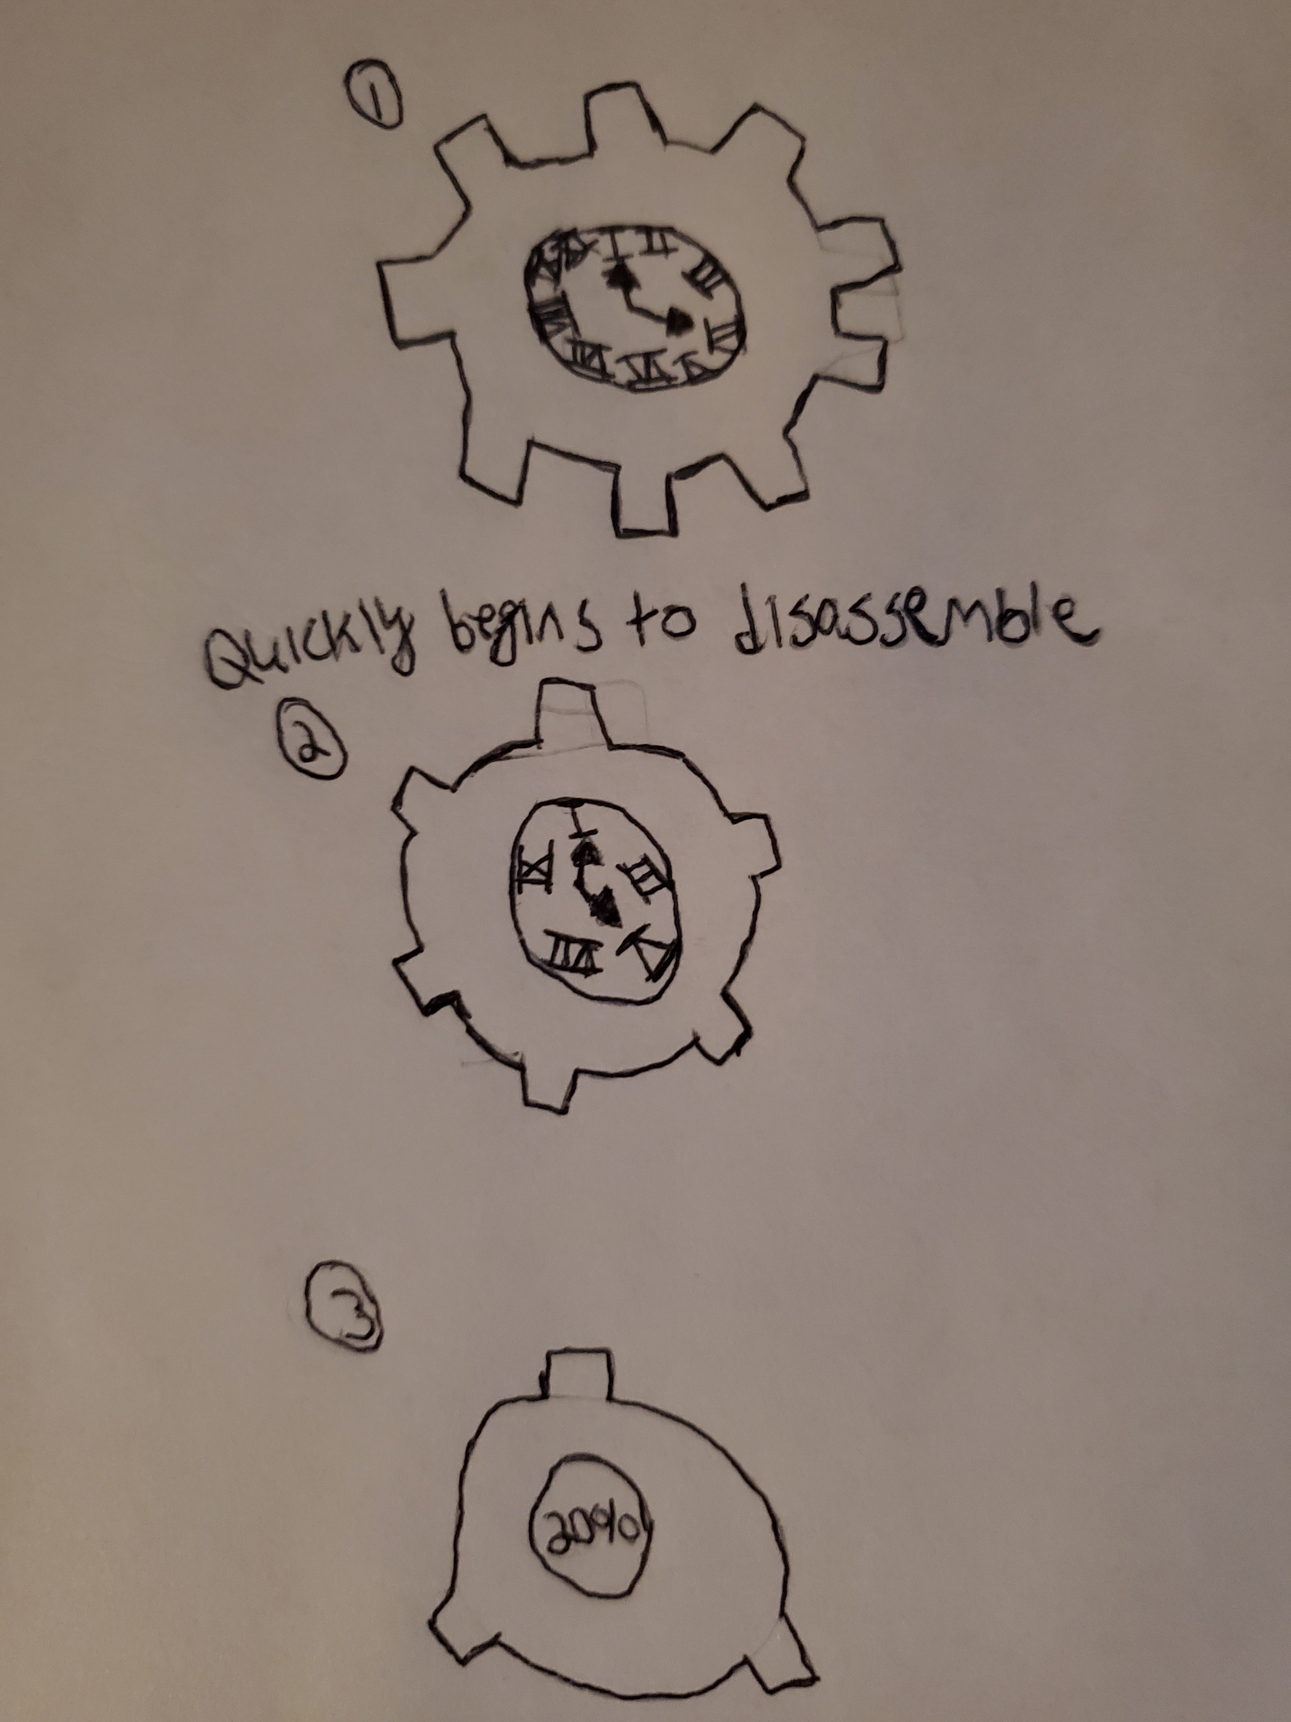
Part III Cont: 3 Sketches

Slide 8
Part III Cont: 3 Sketches

Slide 9
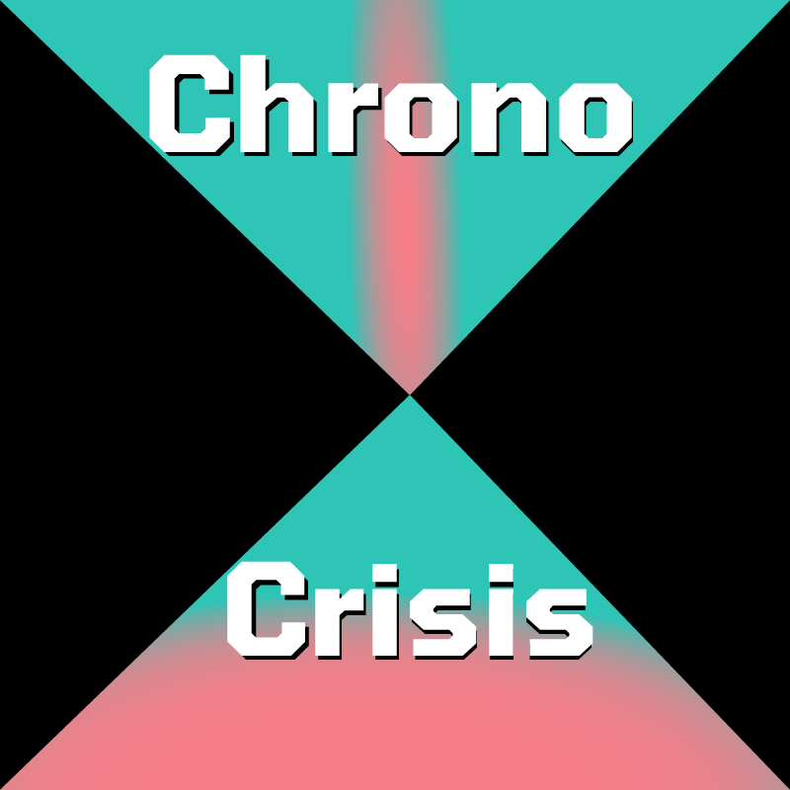
Part IV: Game Logo Design
Colors
Light Blue & White- Symbolize knowledge and time.
Shades of Pink accent the light blue and symbolizes the danger and urgency of fixing the Continuum.
Shading around the edges create a 3D style.

Slide 10
Part V: Promo Poster

Slide 11
Part VI: Final Thoughts

Slide 12
Credits:
Dimitri Myers
Prezi, Content, 2 Sketches, Logo design, UI Design.
Lucas Pauly
Content, Poster, 4 Sketches, UI Design.
Michael Lidbetter
Content, UI Design.

