Slide 1
Elgaroth Dungeons
By Dimitri Myers

Slide 2
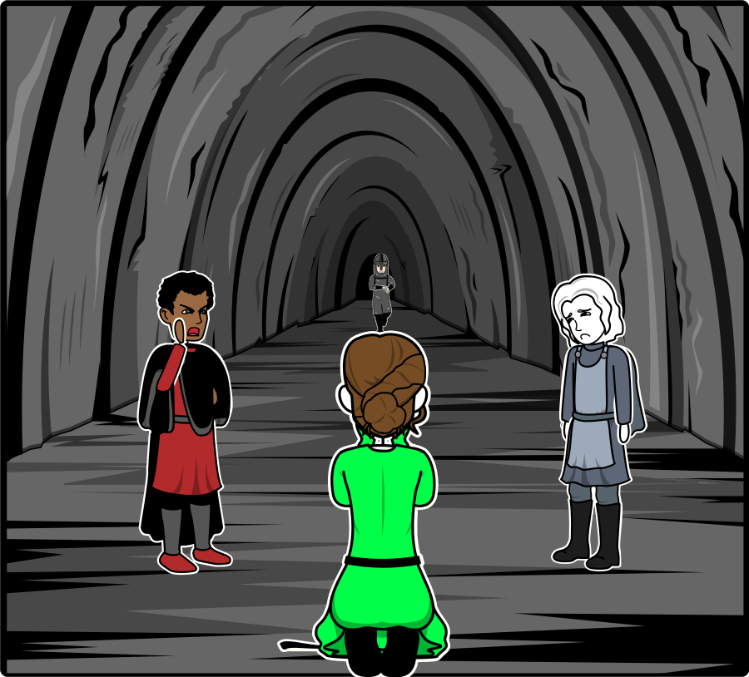
Our group reaches a dead-end, after some deliberation as to where they should go next, since the treasure they believed to be in the cave was empty.
The group consists of Gwenneth a cleric Breton known for her compassion.
Brutus (seen left) a redguard of some renown who specializes in bartering, as well as his passion for eavesdropping.
InYuAsha (seen in the background) is our protagonist, he is a squire trying to earn a name for himself.
Malakai our protagonist's half-brother is part elf, and part tiefling. By sating a blood pact the brothers can contain their dark magic.

Slide 3
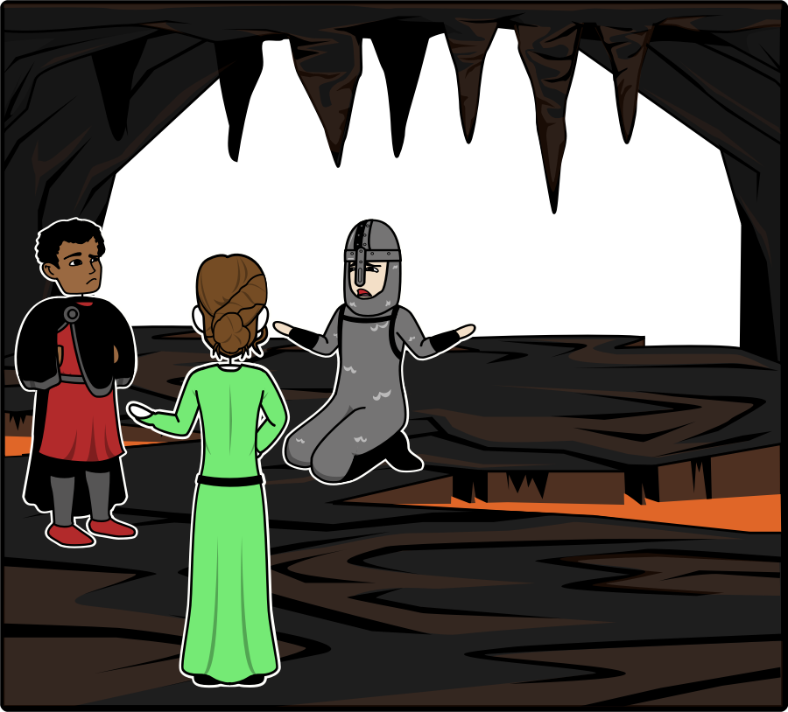
“InYuAsha I think your worst fear may come true; Malakai hasn’t been himself lately…. Is there anything I can do to help him?” Gwenneth stated appalled by Malakai’s paling skin.
InYuAsha retorted “I appreciate your concern Gwenneth but he is part elf, perhaps he hasn’t gotten enough sun?”
Upon hearing the conversation Brutus chimes in “He hasn’t been right since we left Kublokai, he has this coldness about him. We must get him treatment, or I fear he may become a danger to himself as well as us.”

Slide 4
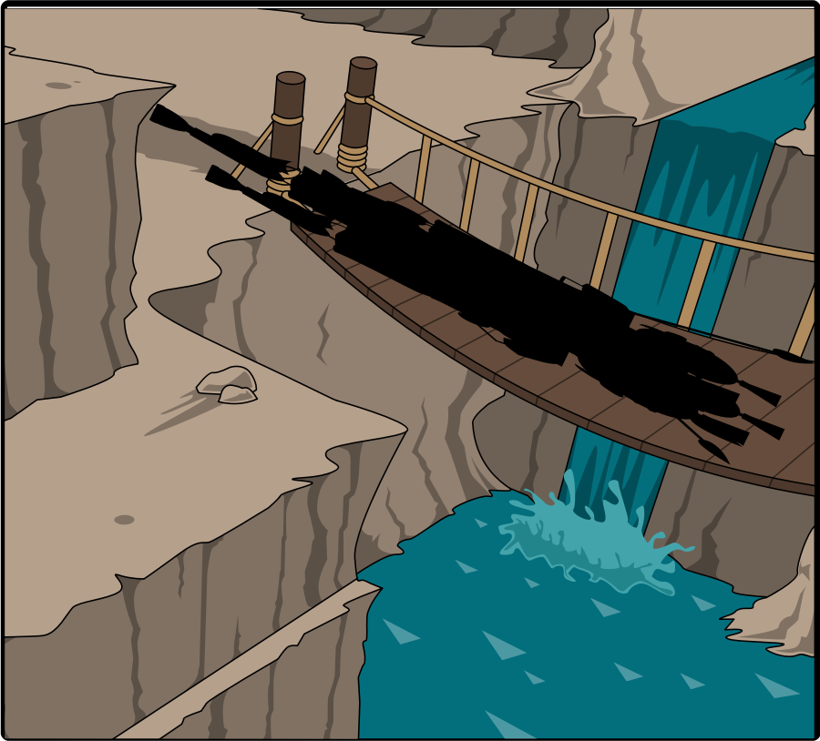
While the group makes their way back they take in the scenery, suddenly aware of potential eyes on them. The trip was a perilous one, and no one is happy they left empty-handed.
The group has been traveling together for some weeks, traveling from Suthra to the North, to Ebonwheel to the East collecting valuable relics.

Slide 5
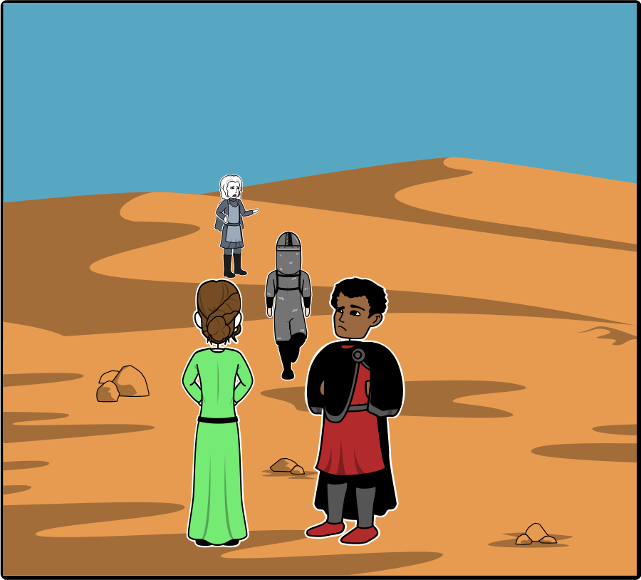
As the group leaves the cave and begins the trek back down the mountain Malakai is well aware of his compatriots eyes on him, watching his every move. Little did they know….. Malakai is yanked from his thoughts as InYuAsha closes the distance between them.
“Ho Malakai, what ails you brother?” InYuAsha calls to Malakai. The response “Nothing brother, it’s been some time since we have shed blood, and I yearn to learn more of our ancestry.” InYuAsha’s response is cold as ice “You know we are forbidden from exploring our Tiefling abilities, they represent a danger to everyone including our friends.”
Malakai is again lost in thought, absently caressing the ring he had sensed rather than found while they searched the rubble in the cave. It was a wonder the goblin inhabitants hadn’t noticed it’s gleam from the well. Malakai shudders as he remembers the sense of dread he felt as the ring touched his fingers. It was as if he had collected the memories of all who held the ring, yet he couldn’t bring himself to tell his brother….. Not yet at least.

Slide 6
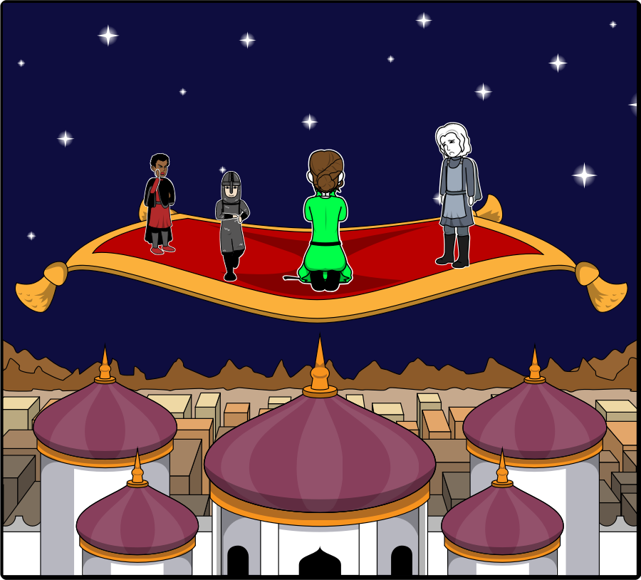
Upon arriving in town the group is met with hostility, no one will meet their eye and they are shut out from the tavern. After wandering through the once tranquil town they finally spot a cottage and begin heading towards it.
Malakai asks InYuAsha why they are being treated so poorly, the response is that the villagers fear the mountains and what lurks beneath it. Legend has it that a great evil lives within and corrupts the minds of those that venture too close.

Slide 7
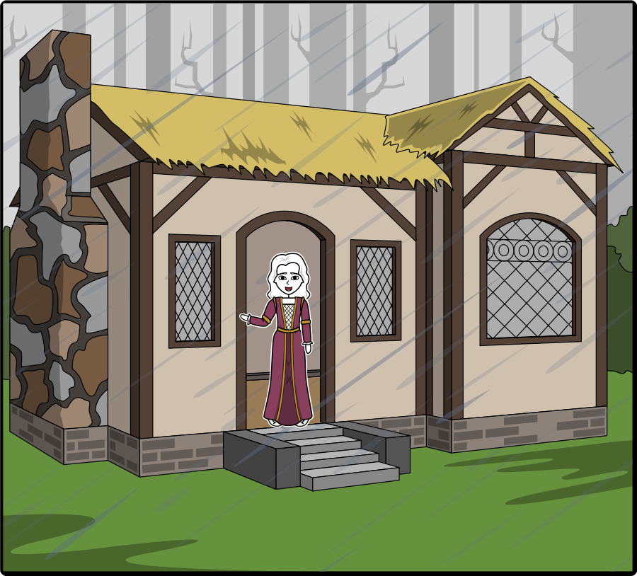
As the group draws near a quaint elder by the name of Mildred offers the group sanctuary in exchange for their help.
Decidedly the group agrees, happy to be out of the rain. As it turns out Mildred has premonitions of possible futures.
Mildred’s task is simple, there is a mine not far from there that is rumored to contain a suit of armor that protects the wearer from magic, a rare relic such as this would be worth a fortune.

Slide 8
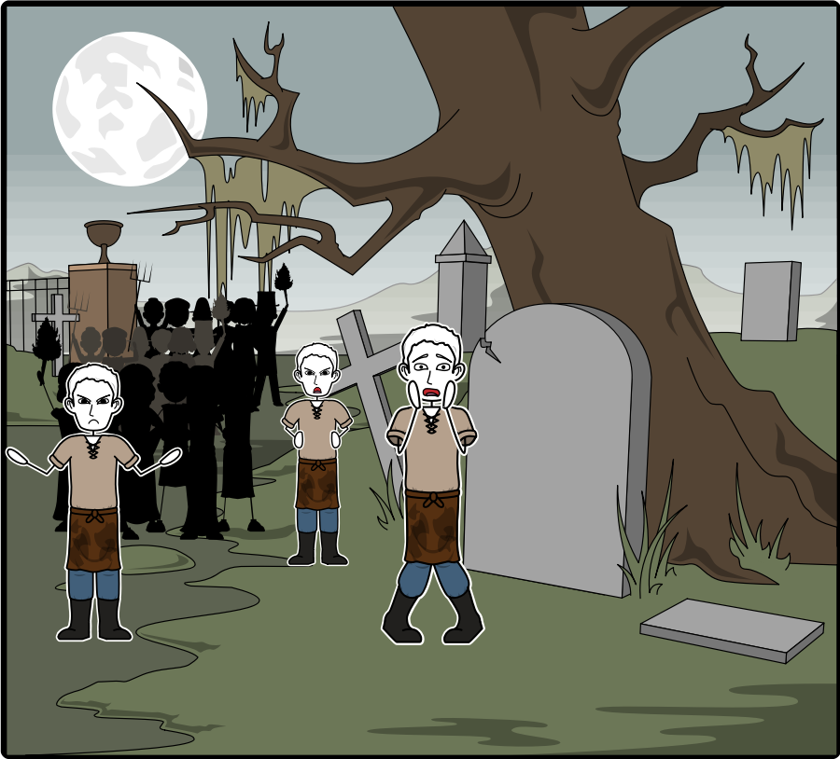
Shortly after our group embarks a large group of villagers surround them armed with pitchforks, daggers, and stones the group has no choice but to fight.
Malakai steps forward and tells his brother that he had spoken with the villagers prior to them embarking on their previous journey and promised them that they would vanquish the great evil of the mountains.
During their absence three children had gone missing which led the villagers to believe that one among the group wasn’t who they claimed to be.
Just as the nearest villager rushes the group a rustle from the Oogle bushes gives way to a legion of gnomes that quickly send the villagers running.

Slide 9
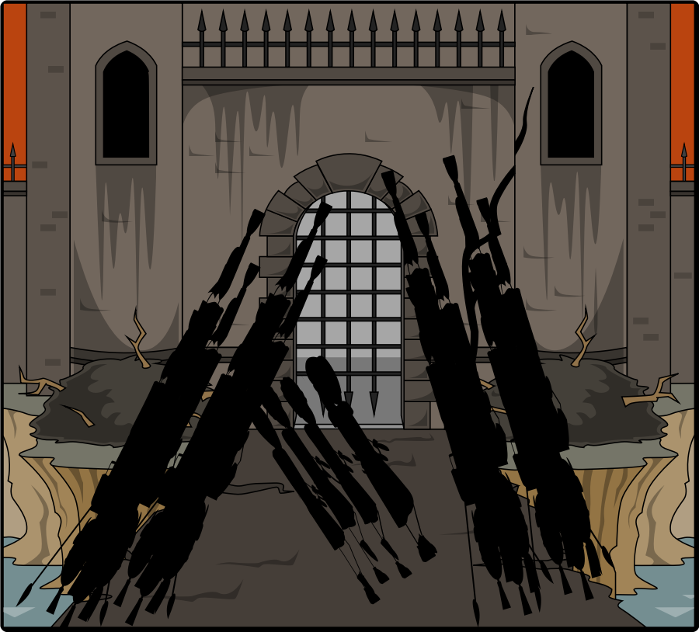
After the gnomes saved the group they bound them and led them back toward the
Brutus managed to persuade the commander to tell them where they are going, they learned the commander was named Gnomington III.
When they arrive Gnomington tells the group that they were accused of stealing a royal gem the punishment is usually death, but the queen threatens to expose InYuAsha’s darkest secret in exchange for their cooperation.

Slide 10
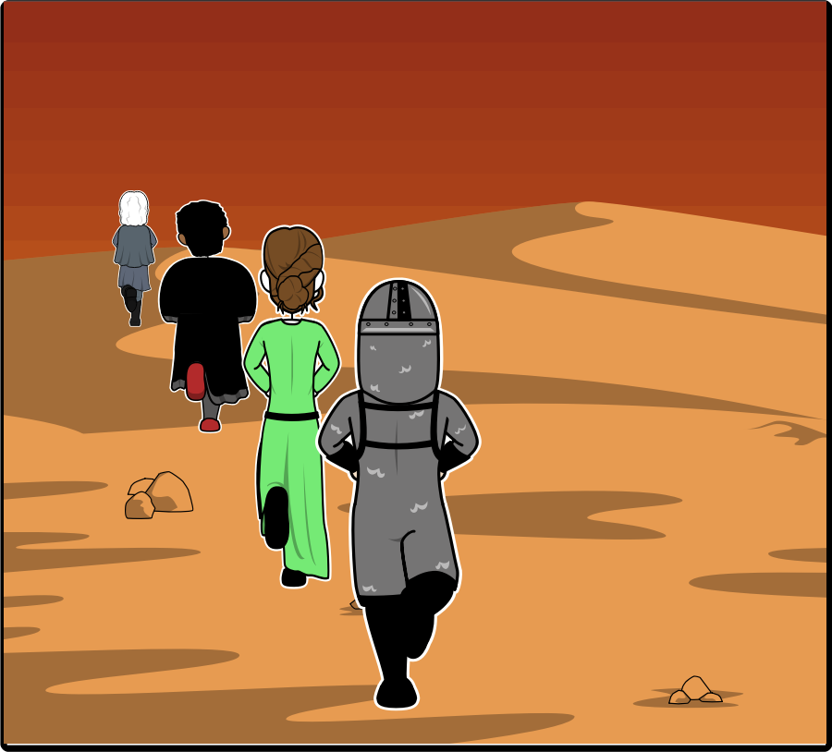
After being taken in shackles and led back up the mountain Brutus and Gwenneth spoke in hurried whispers “Brutus, surely you can’t think that Malakai is to blame, you know as well as I do that, he has a good heart.” Brutus’ response was strained “I saw that blood omen he found, it looked of pure evil and it hasn’t left his pocket since. We have to face the truth; he carries evil with him surely you can sense it?” Gwenneth had chosen to hide her premonition of Malakai who appeared demon-like and had tore his brother limb from limb in order to gain more power. Just the thought sent a shiver down her spine.
Noticing her silence Brutus cleared his throat to bring her back to her senses. Her voice was no more than a squeak as she replied “You know as well as I do that InYuAsha loves his brother and without proof we will only further worry him. Besides, I can’t shake the feeling that they keep a secret from us, perhaps it is time we ask about their origin…”

Slide 11
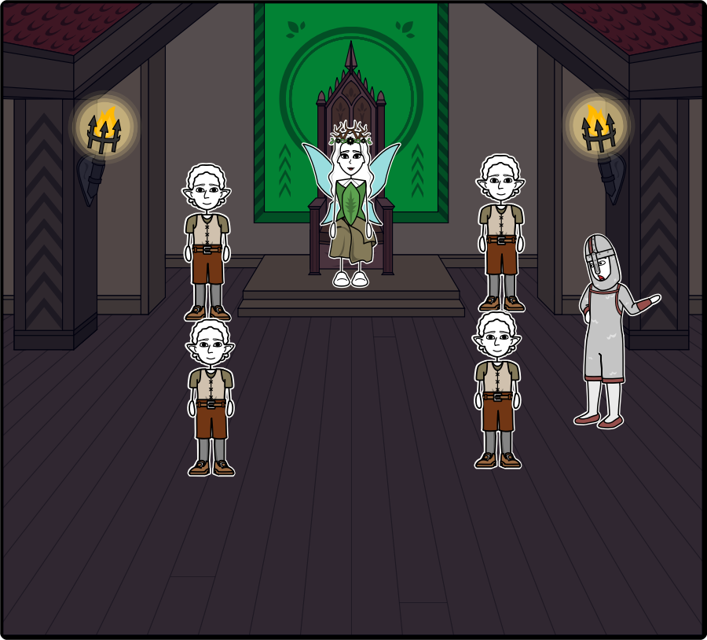
The band of adventurers arrives at the Gnome kingdom and is brought before the queen. After some debate the group decides to embark on a journey to retrieve the great gem of Elgaroth the lost Gnome kingom.
Malakai had been raised with the legends of the gem said to grant immortality, and invulnerability to all manners of weapons, which Malakai sought to use for his personal gain.

Slide 12
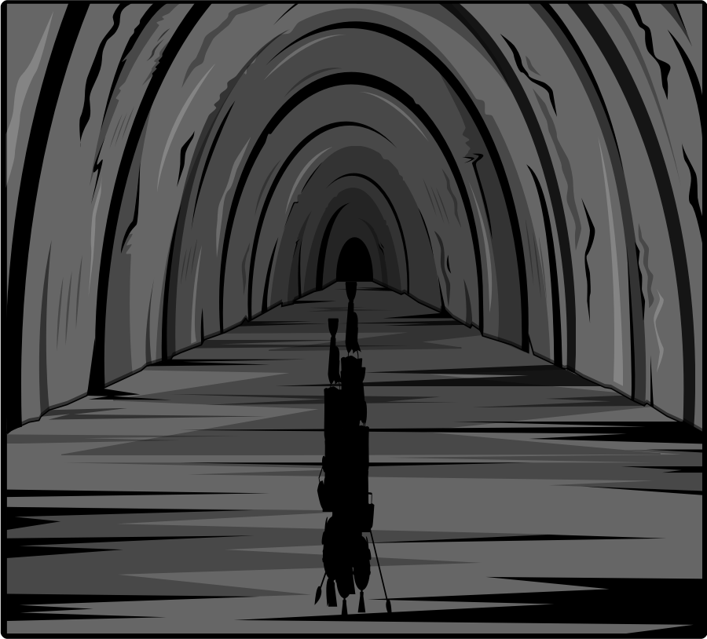
Once again the group sets off through the tunnels, traversing the dangerous terrain in search of a gem described to be the last hope for a kingdom long since forgotten.
As the group walks they can’t help but wonder who would steal such a gem, and how they could have wrested it from the Queen’s crown…

Slide 13
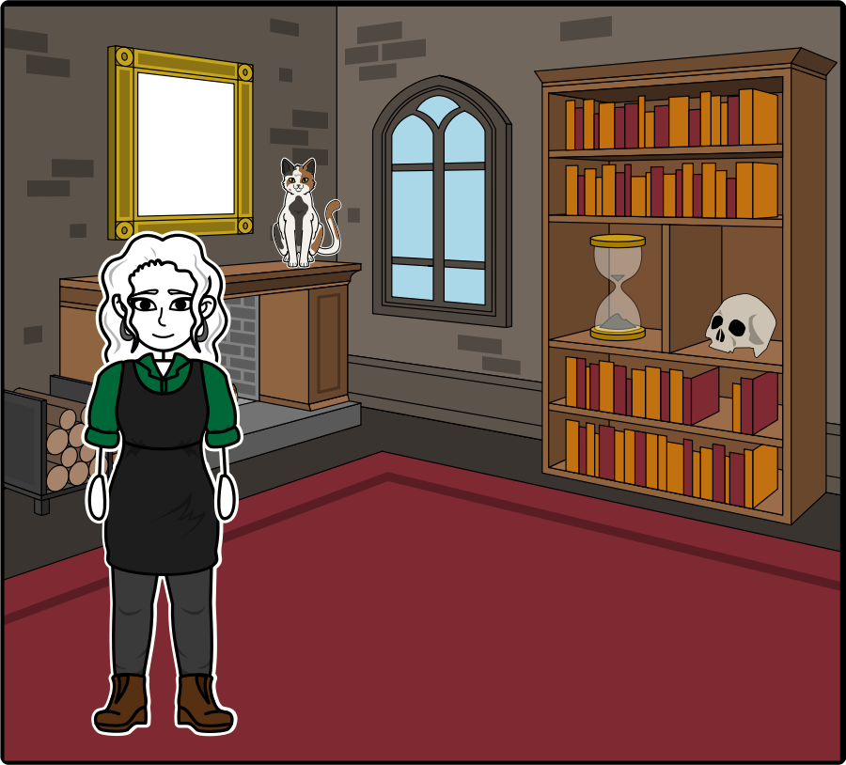
The group travels south in search of the gem, stopping at a general store called The Night Mare’s chair.
The owner of the store O’ren told them of a mysterious figure who was traveling the woods, she bore a mark unknown to the locals and blood red robes.
This information was what the group had been searching for, after thanking O’ren they set out at a breakneck pace.

Slide 14
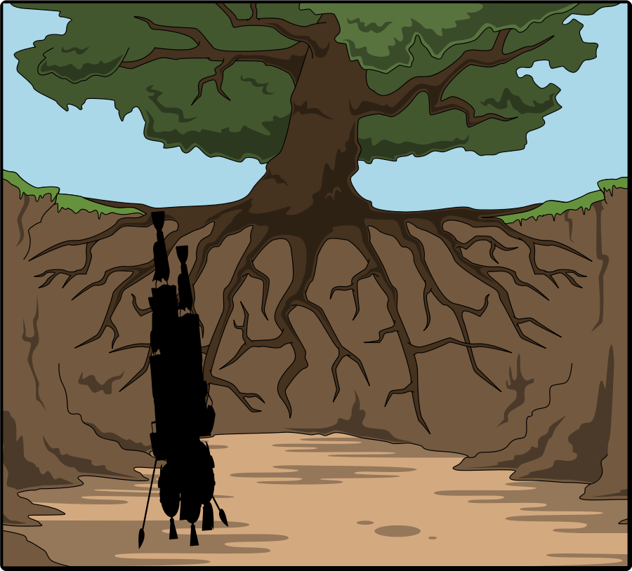
Upon arriving at the edge of the forest the group had concluded that the figure O’ren mentioned had either left or was deliberately hiding.
As they settled down to rest and refresh themselves with water and pita bread a strange rustling sound led Malakai to force his way through the bushes.

Slide 15
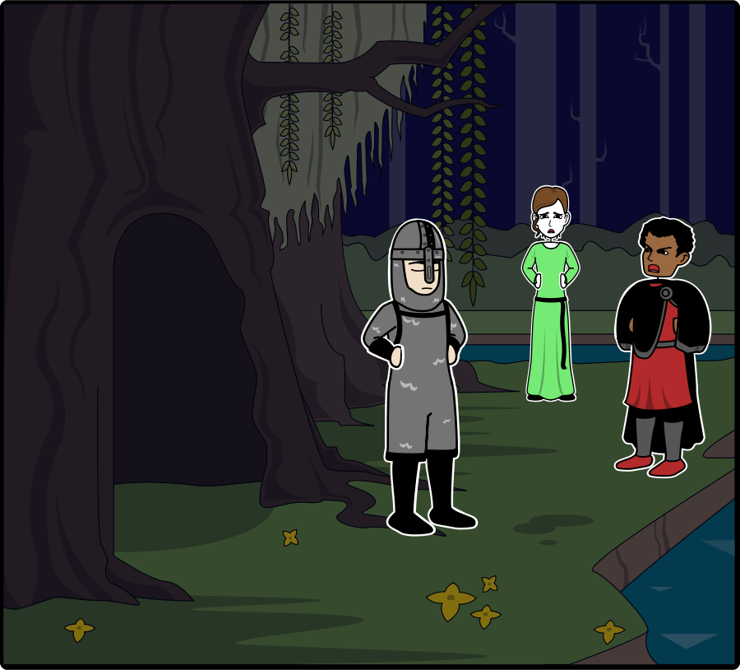
When Brutus thought Malakai was out of earshot, he spoke quickly to InYuAsha “Your brother is in grave danger InYuAsha, Gwenneth fears for his soul. He has carried a dark burden for some time…” InYuAsha coolly replied “That is none of your concern Brutus, I will handle him. For now our concern is where this girl is so we can bring her back to the Gnomes. Perhaps they will spin tales for us, or at the very least she will tell us where that gem is… Afterall legend has it that gem contains immense power and surely would serve not only to bring great renown but would allow us to further our adventures further than we have before.” What InYuAsha didn’t say was that his brother believed the power could sate the Tiefling blood pact for them both.

Slide 16
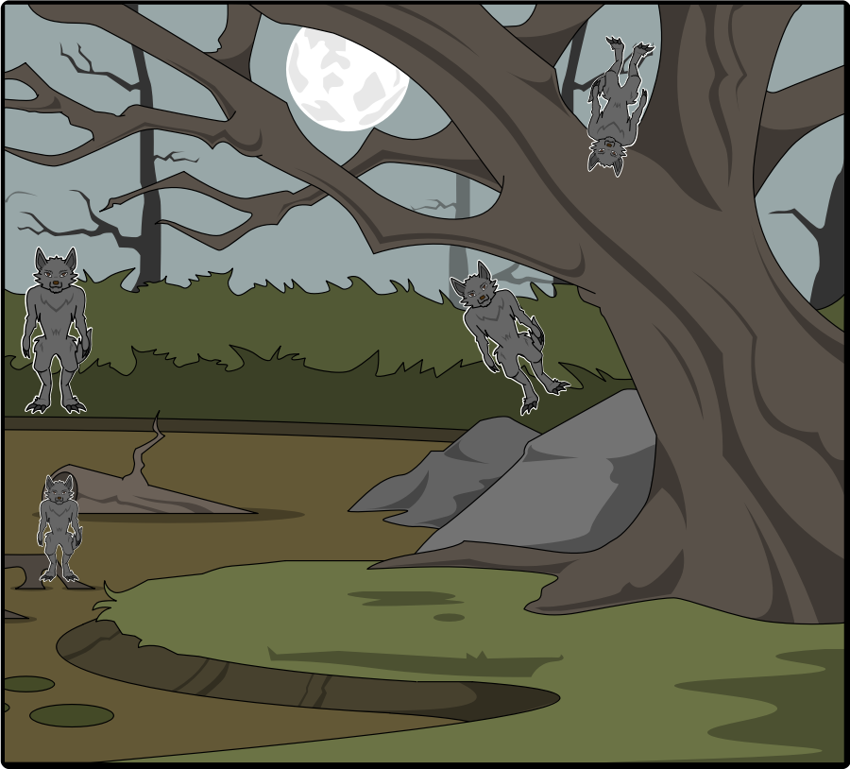
Upon forcing his way through he was met by four sets of eyes peering at him from various vantages.
The rest of the group came crashing through the brush ready to rescue Malakai, but there were no eyes to be seen now instead they heard a blood-curdling scream and saw a small hooded figure dart past them.

Slide 17
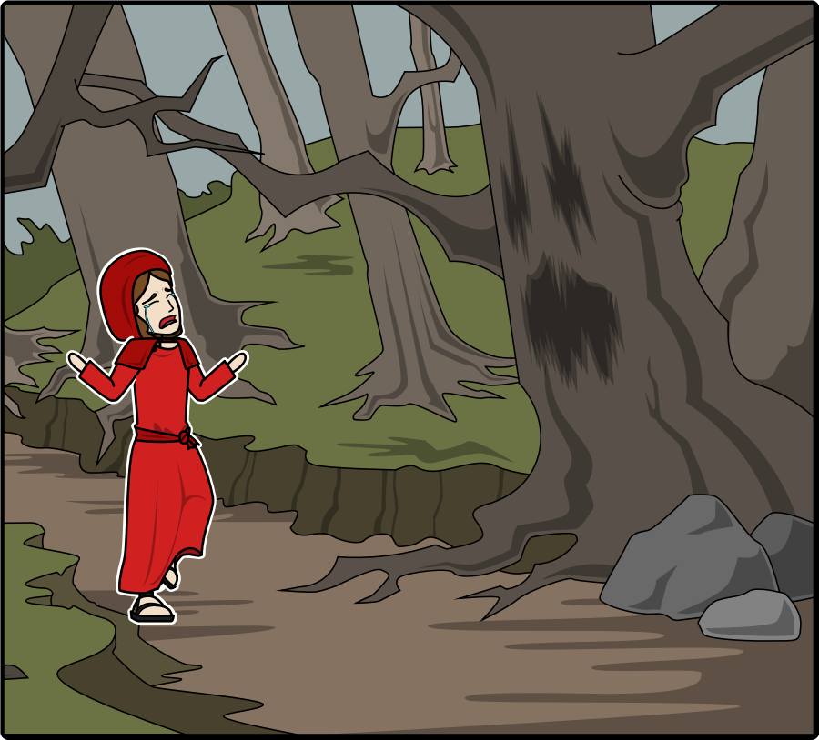
As the group gave chase to the hooded figure they couldn’t help but notice heavy thuds stalking their every move. As they came to the heart of the forest the girl pivoted revealing a young gnomish girl who was crying.
Please help me she pleaded, I have made a grave mistake…. I took the gem from Elgaroth, my mother spoke of it’s power and I wished to be rid of it before it corrupted those I love.
Malakai darted forward snatching the gem, its power radiated him a green, in that moment his eyes turned black as the charred remnants of a fire.
The group stood dumbstruck by the sudden change of heart as Malakai intended to use the gem for personal gain rather than saving the Gnome kingdom.

Slide 18
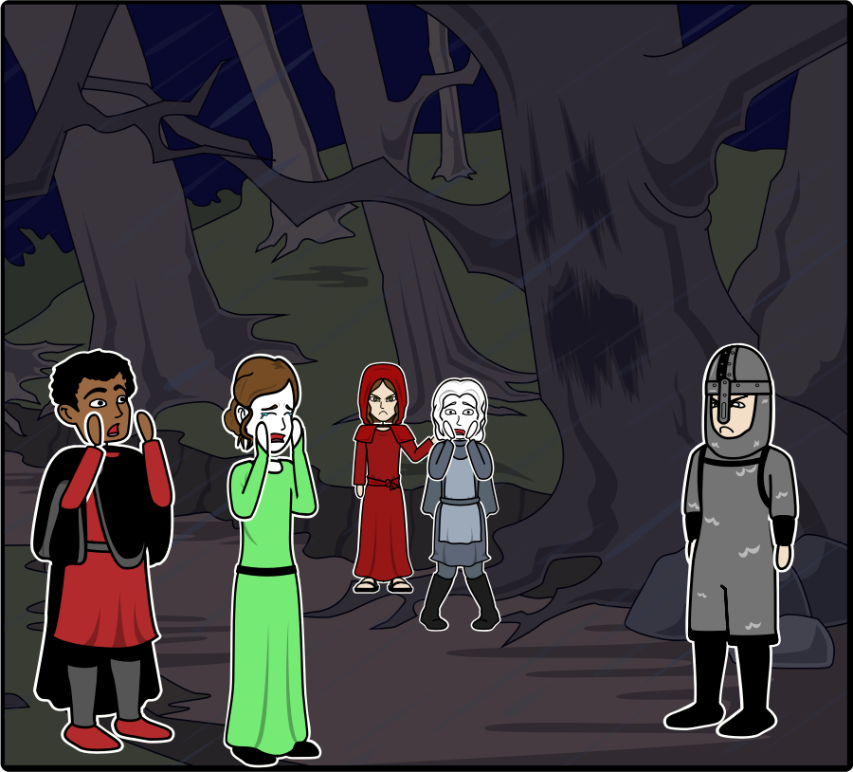
Malakai snuck a glance at InYuAsha, realizing his brother’s eyes had gone white which only meant one thing…. InYuAsha intended to use his Tiefling powers to stop Malakai!
He shouted to the group “My brother and I aren’t what we seem, we are Tieflings. We retain our human figure by offering the blood of those we slay, or our own blood to the demons from which our ancestors came. But today that ends, with the power of the ring from Elgaroth and the gnome gem I can finally break the curse!”
While Malakai was trying to convince his group that he and his brother weren’t monsters but slaves to their ancestors the girl had slipped behind him unsheathing her dagger….
InYuAsha called to his brother “Malakai there must be another way, surely you can’t be serious that you would sacrifice an entire kingdom for our benefit? These are the same people that ensure adventurers like us are rewarded and our tales told around the lands.”

Slide 19
Just then four massive werewolves crashed through the forest trapping the group into a cove of Oogle bushes.
Knowing they had no choice but to fight InYuAsha gashed his thumb unleashing his Tiefling powers and rending the flesh from the werewolves.
When the dust settled InYuAsha’s group was confused, frightened, and relieved.
It was then that Malakai was ran through by the hooded figure, as she retrieved the gem Gnomington and his troops surrounded the girl…. The band had two choices they could use gem which would mean the gnome kingdom would die and would lead to Malakai’s death… or they could return with the girl, and the gem to save Malakai and the Gnome kingdom.

Slide 20
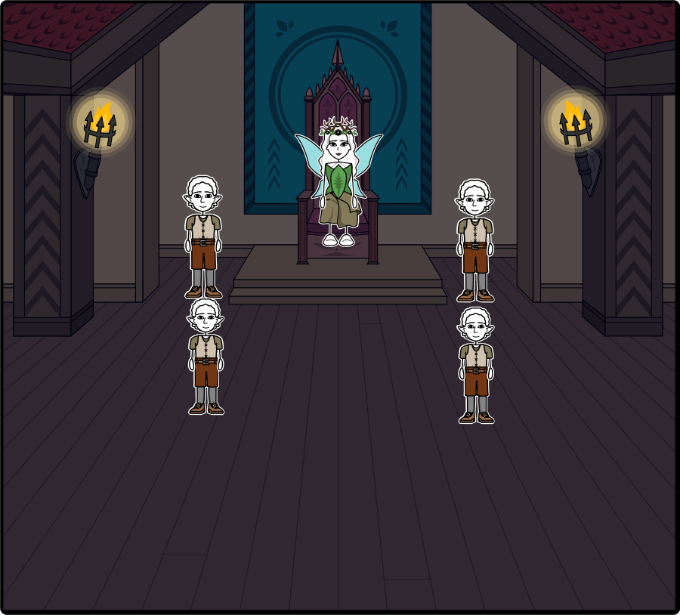
Upon arriving back at the Gnome kingdom as InYuAsha had suspected the Queen was immensely grateful they had saved her daughter and returned the gem. For their bravery and compassion she healed Malakai, the group noticed his color changed and with it his demeanor… He was no longer cold and aloof.
InYuAsha realized he would have to tell Gwenneth and Brutus the tale of their origin, but in the mean-time he wanted nothing but to appreciate the rewards of their hard work and honesty. As adventurers they had conquered both their fears and stereotypes but had also done their part in making the world a better place. In return they were given armor and weapons of great caliber, food, and tomes that would allow them to further their skills.

Slide 21
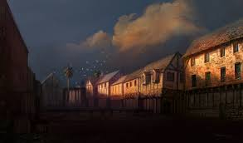
To this day the group travel, though the chapter of the Elgaroth Dungeons has come to a close the group will never forget what they learned their. Nothing pays off on an adventure more than trusting your heart and helping those around you. Though the group all have their own reasons for doing it which range from fame, wealth, and knowledge, they were all content riding off into the sunset already looking for their next adventure.

