Slide 1
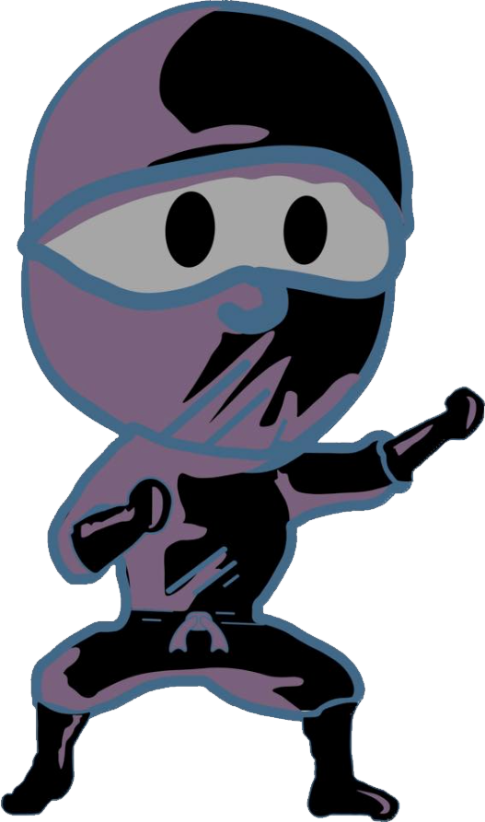
LIL Shuriken
A Game Idea
By
Joshua Jackson

Slide 2
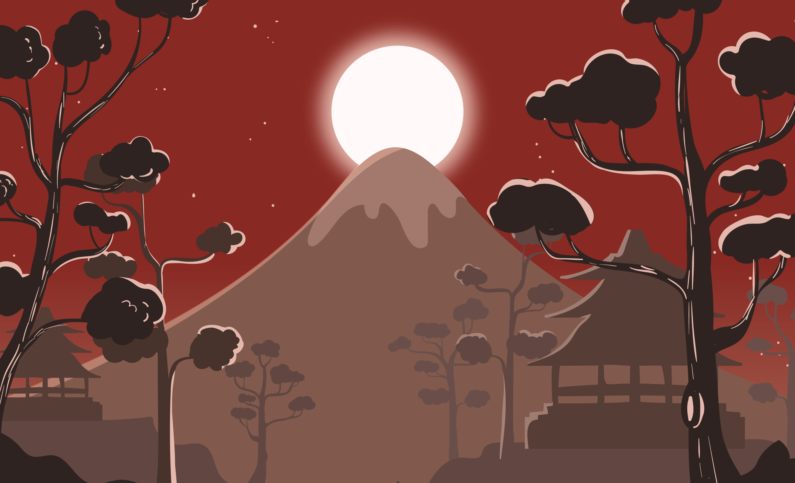
LIL Shuriken
“Our Hero”
Our hero in the game. Now that he is all that is left of his clan, the protectors of the elements, he is the only one that can stop The Erementaru, but he must believe in himself first, in order to do so. The ultimate test has made its way upon this young ninja, and he will learn more about himself as the story unfolds. The boy ninja has a secret, but you must guide him through worlds of dangerous enemies to discover what that secret is.

Slide 3
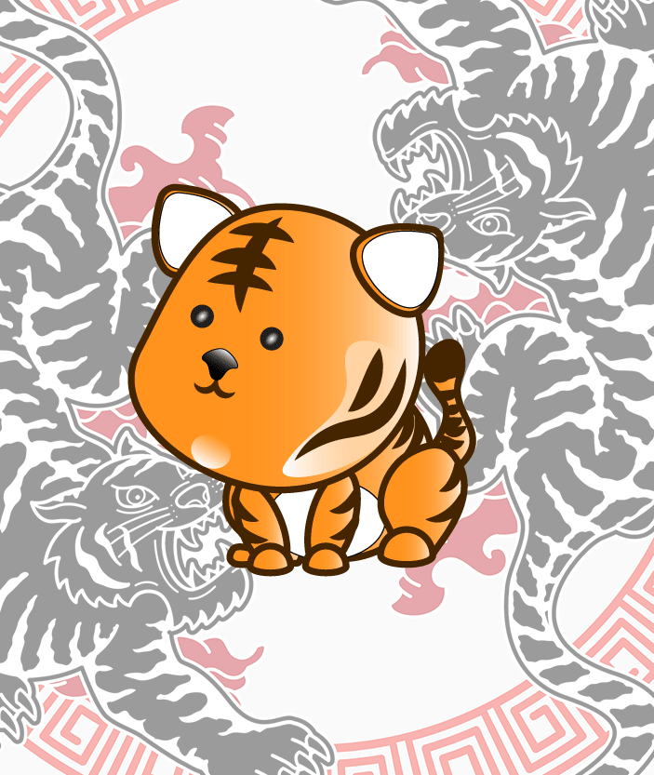
LIL Meow
“The Fearless”
Shuriken's best friend. He is a baby tiger that can roar like a beast. This fearless companion will be at Shurikens' side each step of the way and every once in a while, let his true fury be known. Do not mess with this guy, he may be cute and cuddly, but look out he might just bite.

Slide 4
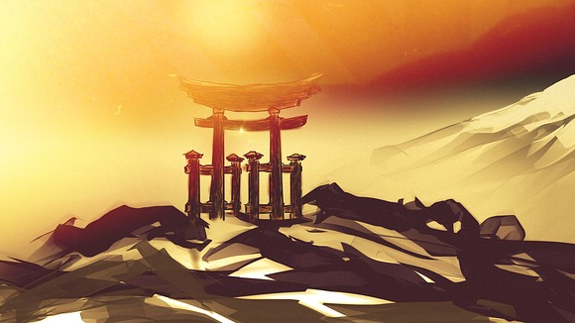
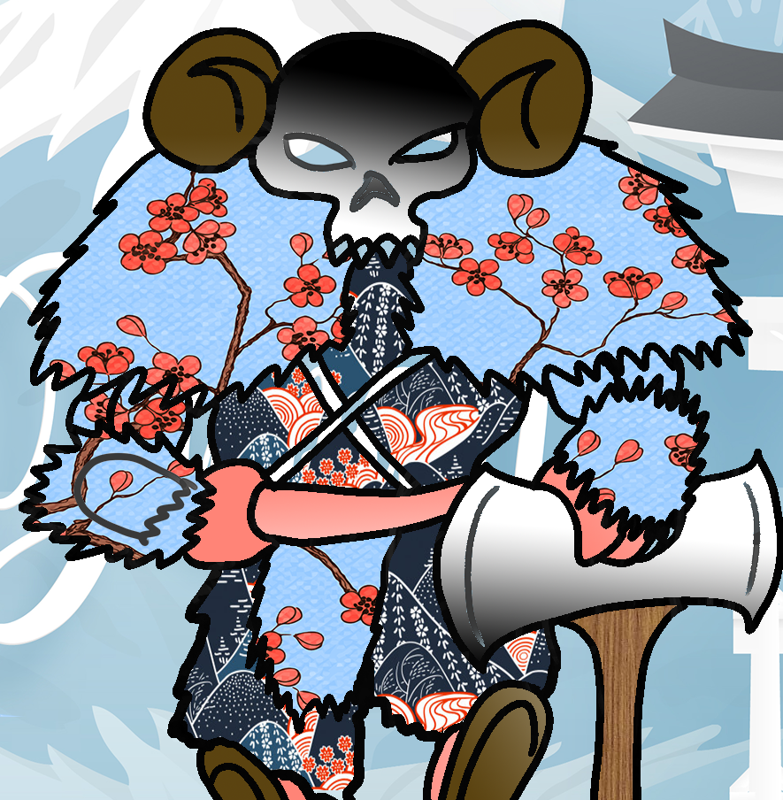
The Frozen Master
Once a Master Ninja and Overlord in Shurikens father's group of stealthy assassins, The frozen master tried to steal the elements and was banished to the snowy mountains for his thievery. His cold and calculating composure, as well as his lust for power, is matched only by his hatred of the Ninja Ancestry. He has joined The Erementaru to exact revenge on shuriken and to help the Shogun destroy the world.

Slide 5
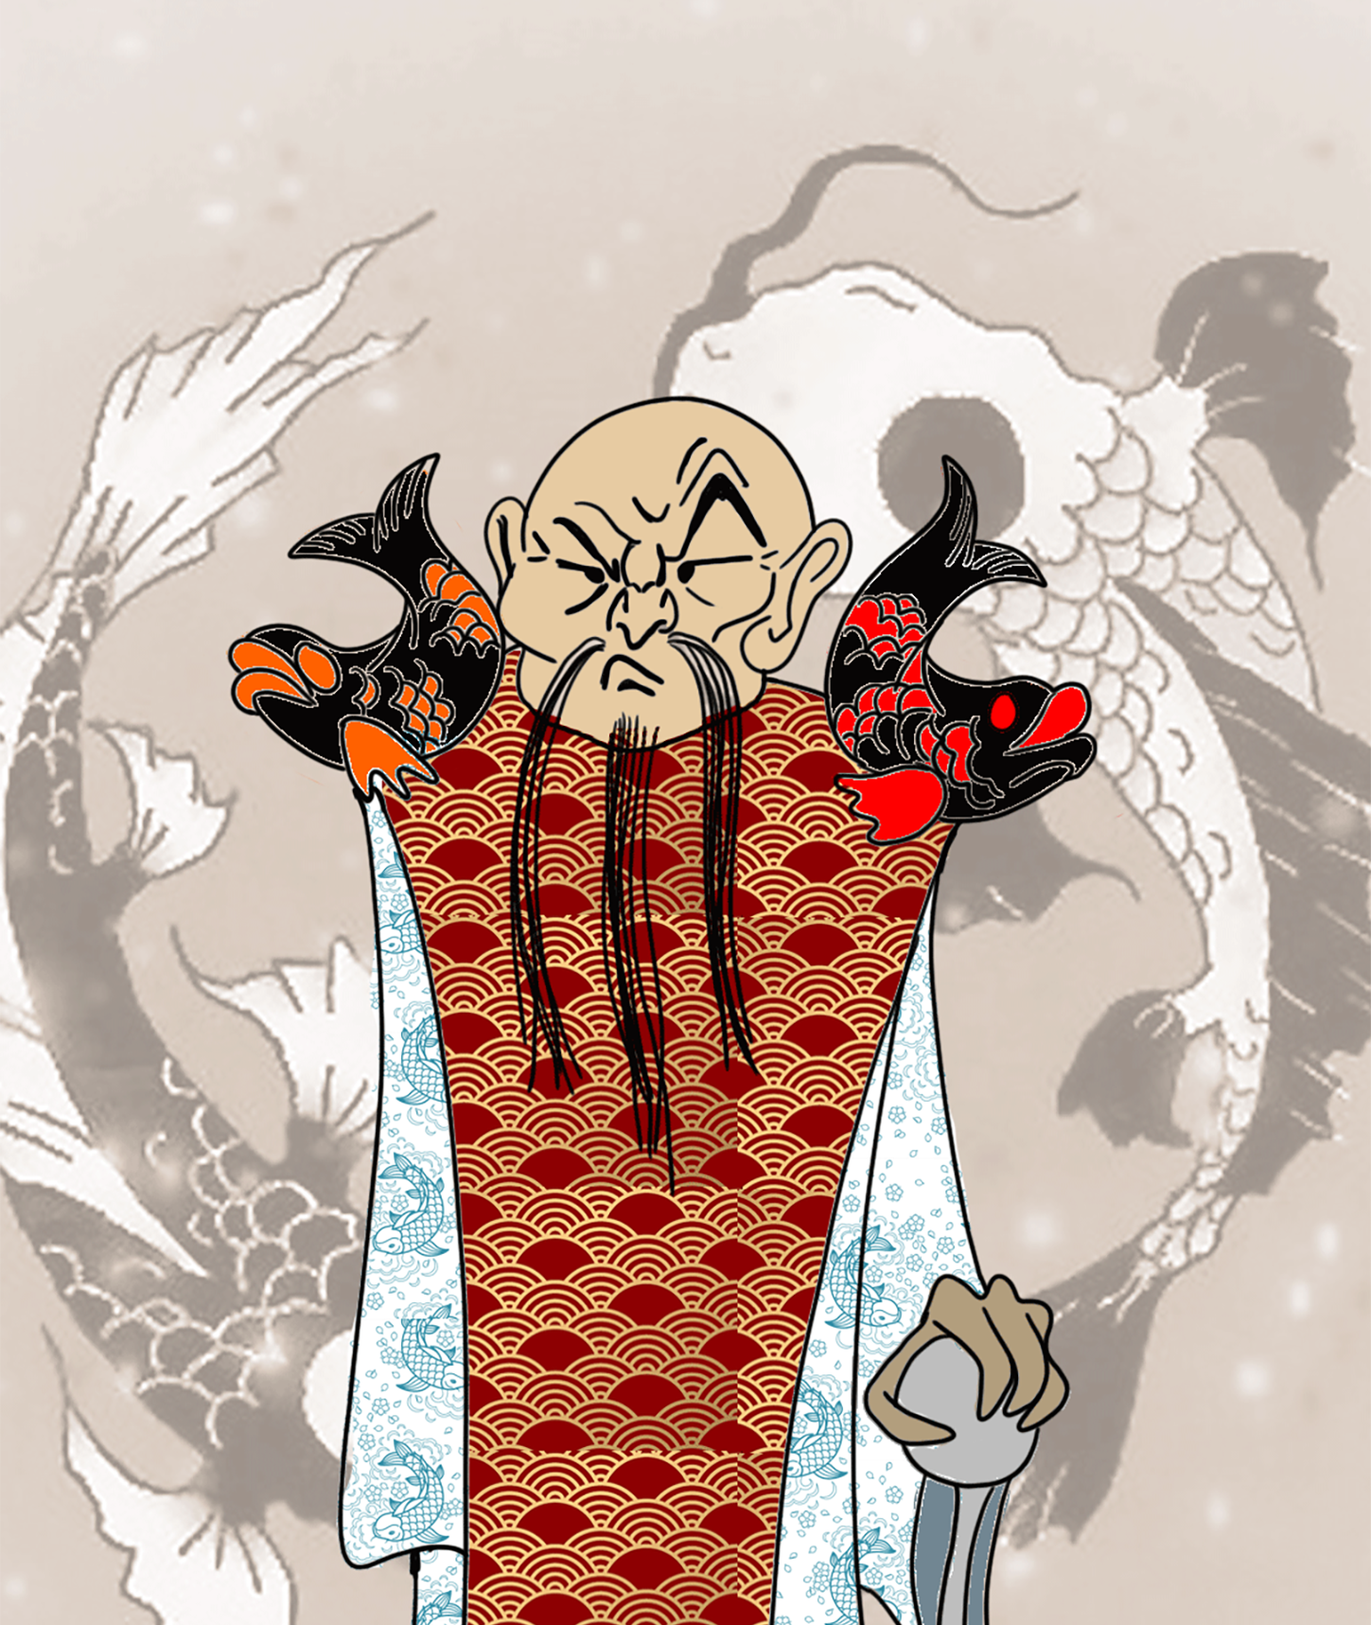
The Koi King
Has been at the Side of the Shogun for as long as we know. He was once a personal sorcerer and oracle and is said to control all things from the water. The Koi King resides at the foot of the pagoda temple, and although small in stature, he is very skilled in combat and very powerful with magic. The koi King will stop at nothing to serve his master and use his powers to help obtain the elements, and destroy the world.

Slide 6
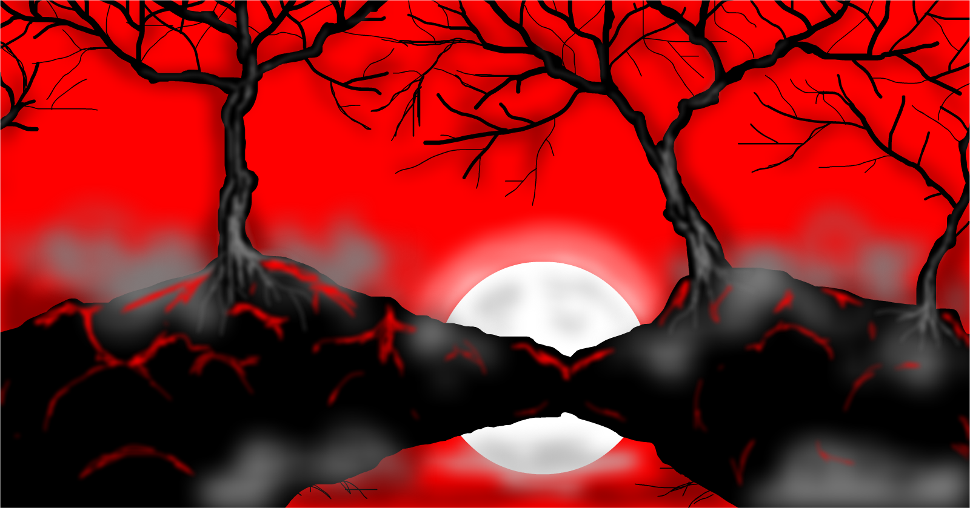
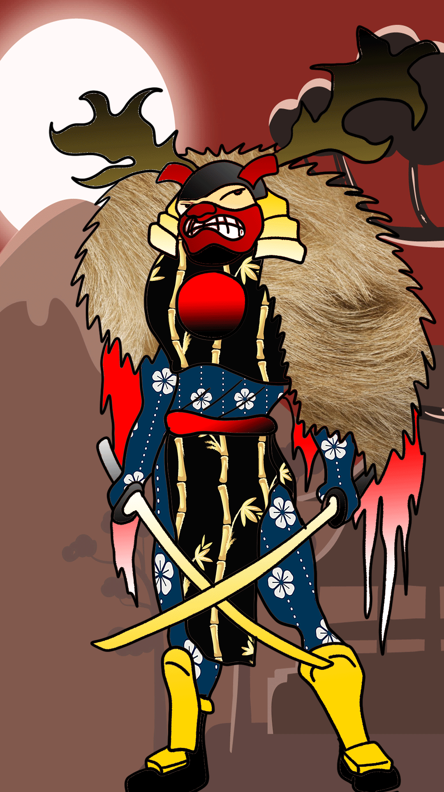
The Forest Sensei
She was born in a samurai village, and as the ninja and samurai battled for land, her family was killed in an unfortunate accident when a pagoda collapsed onto her mother and father when she was just a girl. The forest was her only escape, and as she grew, she found she had the power to control all things in the forest. After some time, The Shogun convinced her to join The Erementaru to avenge her family. She has vowed to serve the Shogun until death.

Slide 7
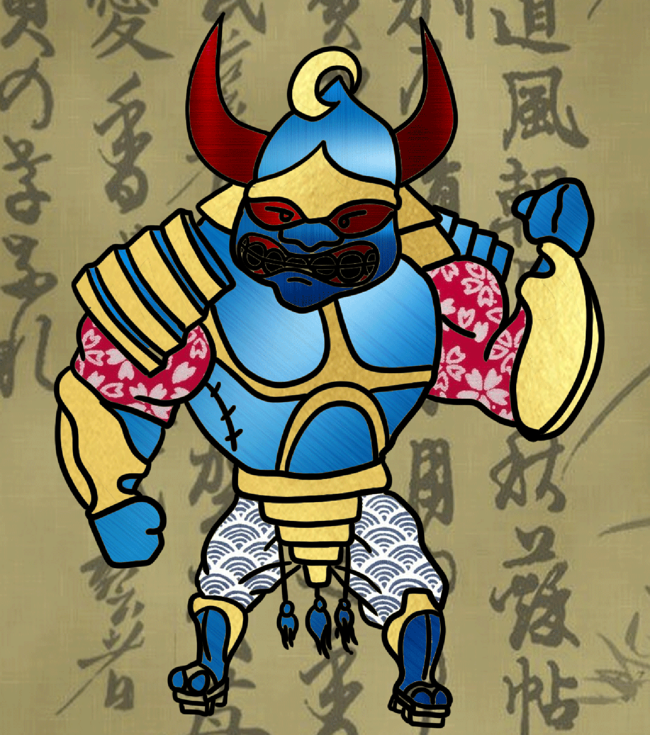
The Evil Shogun
He is The Erementaru Clan leader and the main antagonist in Lil Shuriken. Once peaceful towards the ninja, he turned into a raging monster when he found out the ninja had been hiding the secrets of the five elements. He is brutal and nasty as they come and the person responsible for the destruction of Shurikens village and the deaths of Shurikens family. The Shogun will stop at nothing to gain all elements to take over the world.

Slide 8
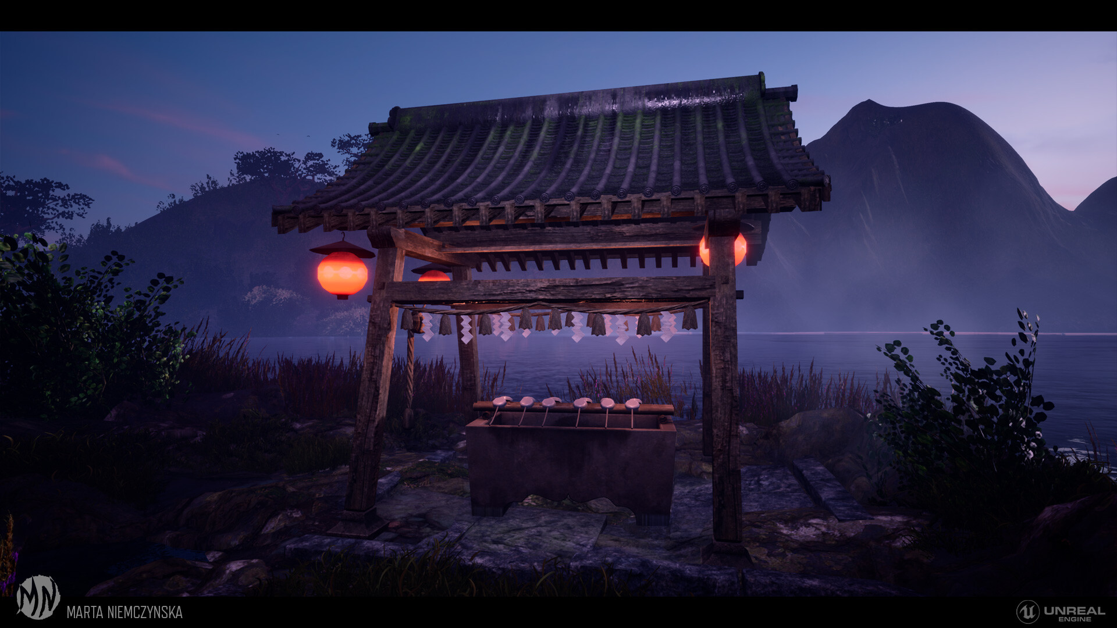
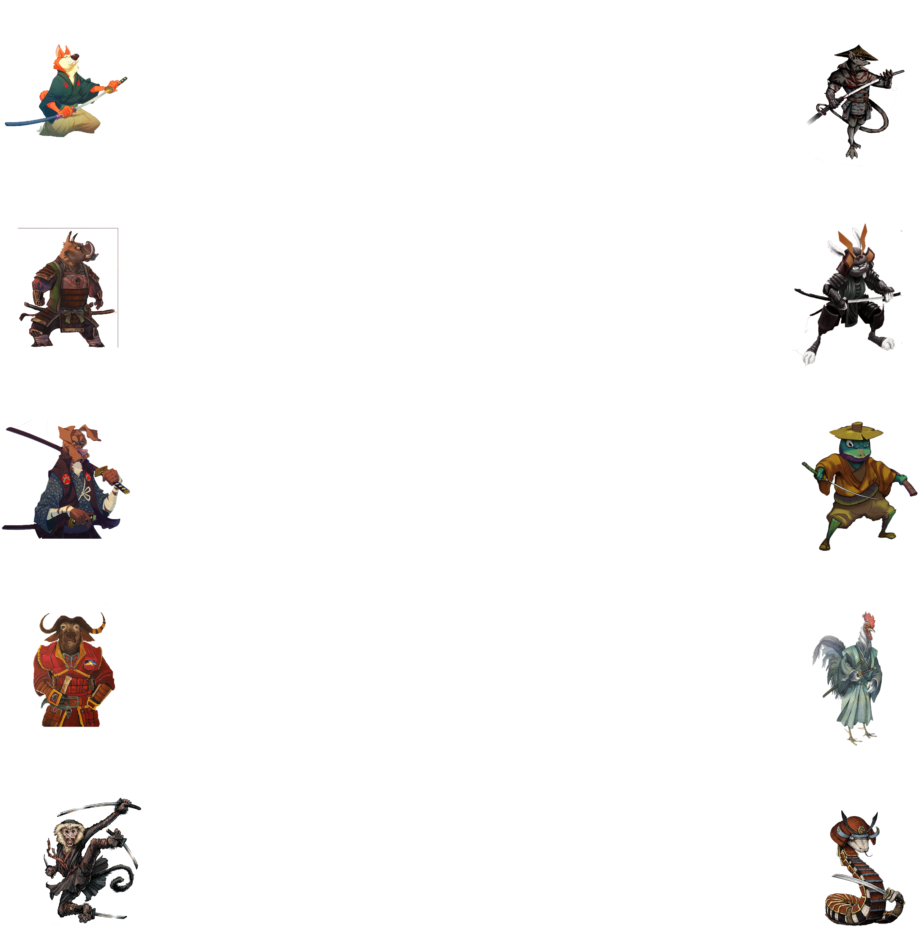
BADDIES
KITSUNE (FOX)
NE (RAT)
INOSHISHI (BOAR)
USAGI (RABBIT)
INU (DOG)
HIKIGAERU (TOAD)
USHI (OX)
TORI (ROOSTER)
SARU (MONKEY)
MI (SNAKE)

Slide 9
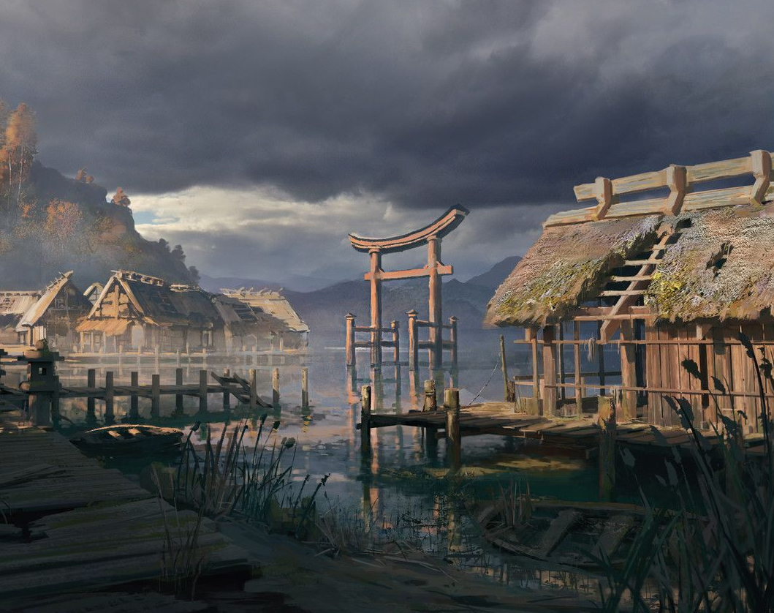
Backstory
In order to defeat the Erementaru, Shuriken must harness the power of all the elements. But how? Shuriken finds out that there are four masters scattered throughout the land that possess a ring of each element in the event that one clan may one day want to take over the world.
Shuriken must travel to these forgotten realms and find each master. But he must also prove his worth by doing battle with each of the four elemental masters. Once he defeats a master, he is granted the ring worn by the master and blessed with Chi that can be used to add attacks for both Shuriken and Meow.
Each master represents an element and they can only be found after Shuriken fights across massive battles and levels.
In the end, Shuriken must fight the grandest and most powerful warrior that leads the Erementaru. The Shogun of Death. The battle is a stalemate and neither gains the upper hand. Shuriken is laid low and the Shogun stands over him with a sure victory. “Give up little Ninja.” He says laughing. Shuriken strikes out and with one swift kick knocks off the Shoguns mask revealing….HIMSELF! The greatest villain and warrior was Shuriken! He realizes that he has two paths in front of him…the Ninja or the Shogun… so Shuriken decides to banish both from existence and sacrifices himself by clenching his hand and uniting the rings into the final element…Void.
Peace reigned across the land for millennia. But if you look up into the sky on a clear night, you will see the stars for a perfect Shuriken alongside a tiger’s fang to remind us of the great sacrifice that was made.

Slide 10
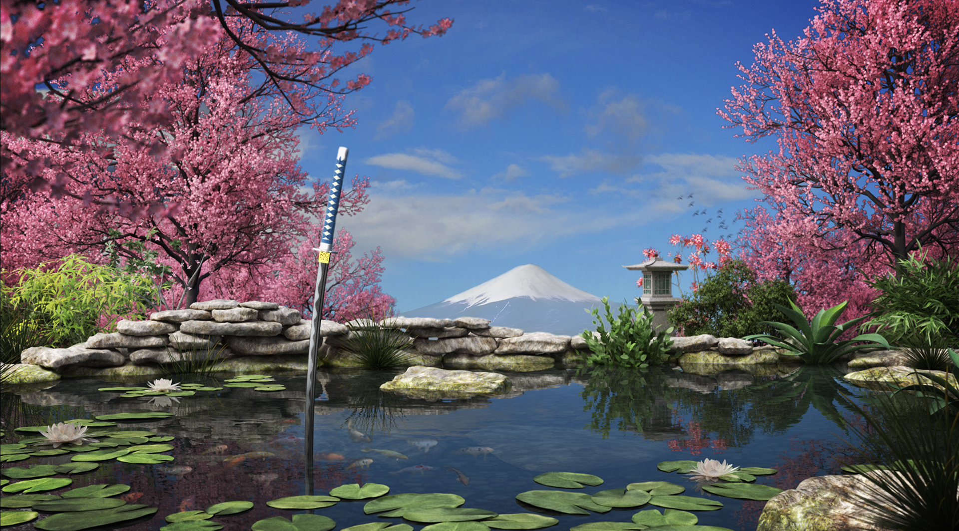
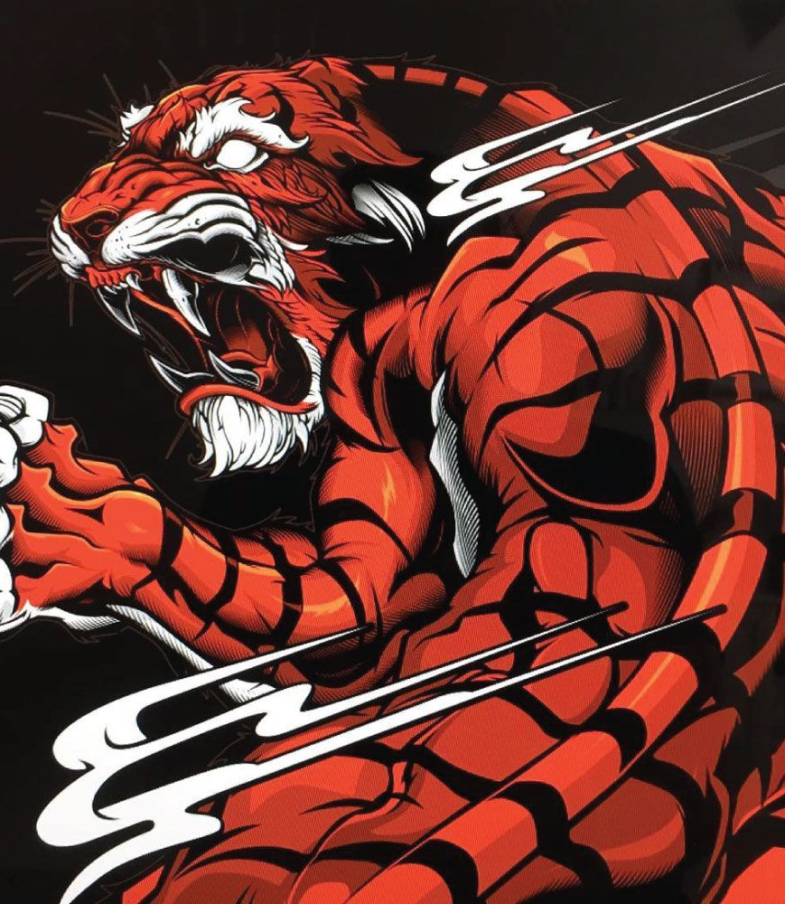
UI design for your game; game screen rendering.
The UI for the game gives beautiful backgrounds while using the onscreen gamepad to control Shuriken and Meow. Users will have a timer at the top center screen with a magic and health meter to the top right. Players can collect a multitude of power-up orbs to help them complete each level, and when Meow receives the Orange orb, you will see him grow into a raging beast taking out enemies on his own while you fight to the level boss. Use magic to stun enemies or gain throwing stars and swords to aid in your fight.
The Frame rate of Lil Shuriken runs at 30FPS. This is optimal for iOS and Android platforms. The game will have the feel of an epic old school game such as Mario or Legendary Axe, yet it will have the benefit of amazing graphics rendered on an iPhone or Android-based handheld. Through modern game design tools such as XCode, Unity, and Unreal Engine 4, we will have the ability to have fast refresh rates and still give the user a nice side scroller feel from the days of nickel arcades.

Slide 11
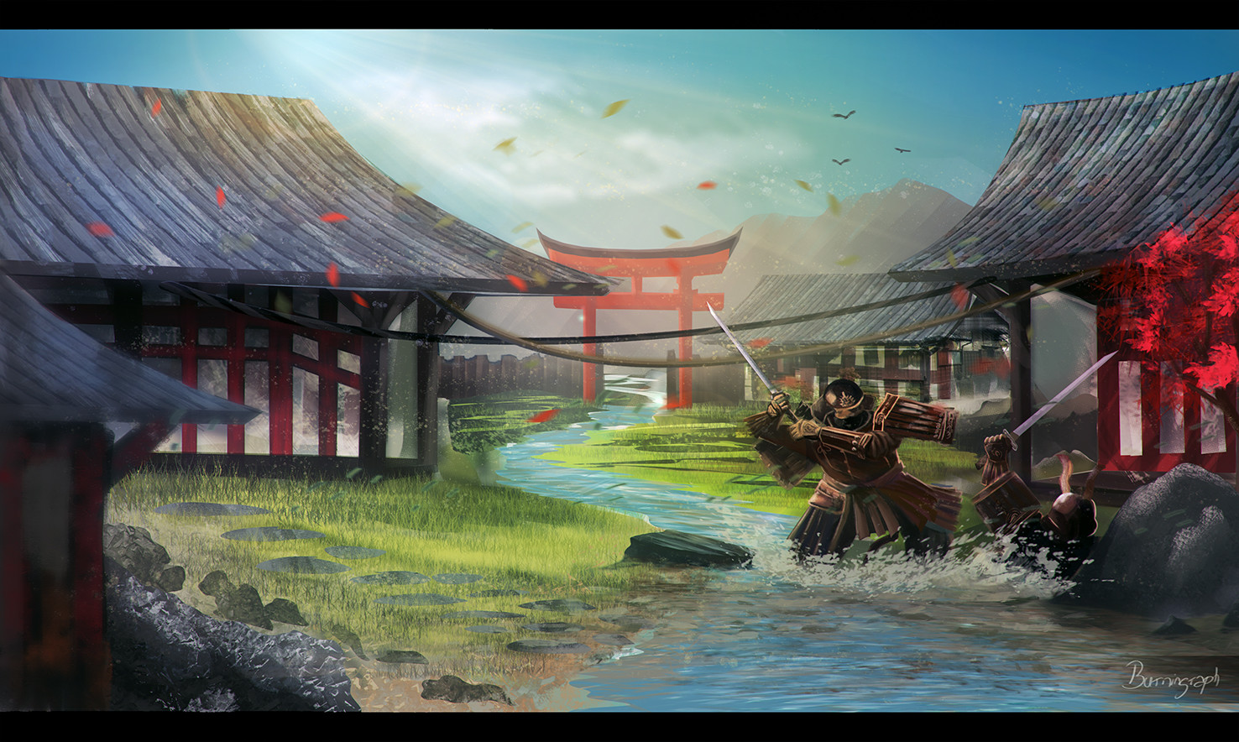
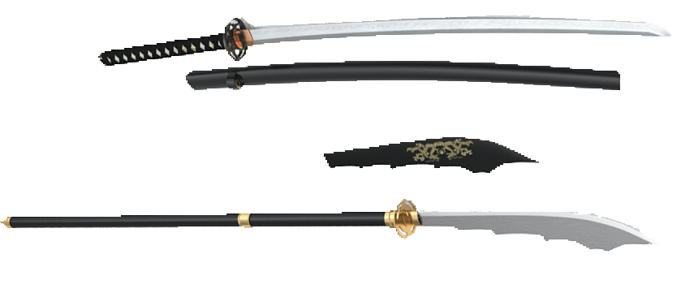
Rules and gameplay/action descriptions.
Rules
In our game, the rules are simple. Users will have three lives to start and a health bar that decreases one increment each hit taken. Users can collect health orbs to get back 1 bar at a time. If The User falls in a pit or trap, you lose a life. All enemies encountered take two hits unless a user has obtained one of the weapon upgrade orbs in which enemies only take one hit to defeat. Make it to the checkpoints that will save your spot each quarter the way through a level until you reach the end where you will face a level boss.
Gameplay/action descriptions.
Gameplay will be in landscape mode on iOS and Android devices. Users will have the choice of having an onscreen controller, which consists of the directional pad on the left and two buttons on the right or an invisible gamepad in which users will place hands where they would with the visible controller. The directional pad allows for movement Up/Down/Left/Right, and the buttons are attack and jump. The game screen enables users to move backward and forwards in case an orb is passed, and they want to retrieve it, but there is a 100 second time clock to get to the boss. There are checkpoints along the way each ¼ of the level because there are no 1ups but only three lives. The levels are long and arduous, but after each level is complete, users will receive three new lives for the next level.

Slide 12
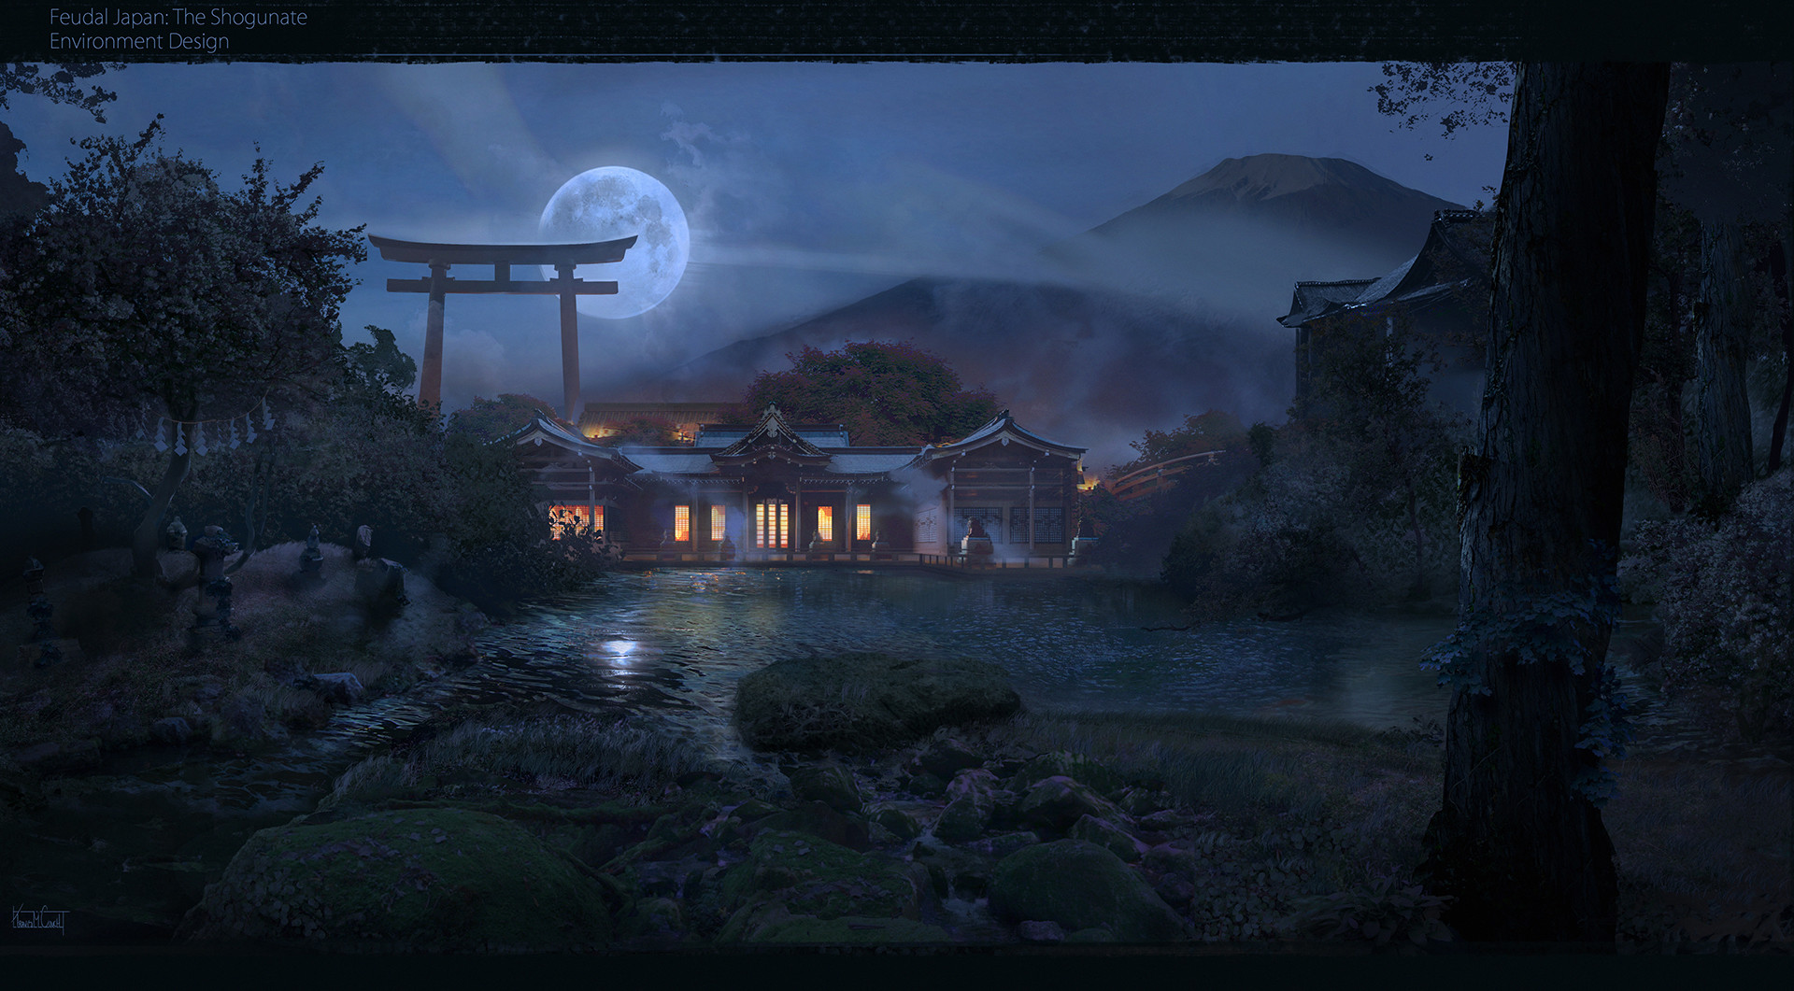
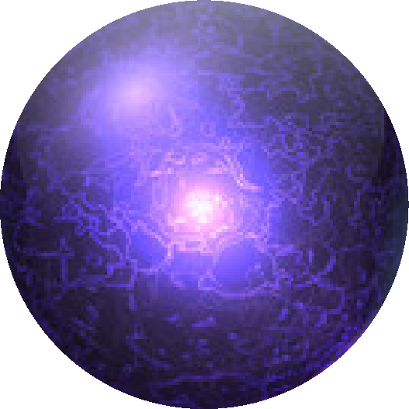
POWER UPS
GREEN ORB – RESTORES HEALTH
YELLOW ORB – RESTORES MAGIC
RED ORB – GIVES SHURIKEN A SWORD
PURPLE ORB – GIVES SHURIKEN A NAGINATA SWORD
BLUE ORB – GIVES SHURIKEN THROWING STARS
ORANGE ORB – TURNS MEOW INTO A FULL-SIZE TIGER FOR A SHORT TIME

Slide 13
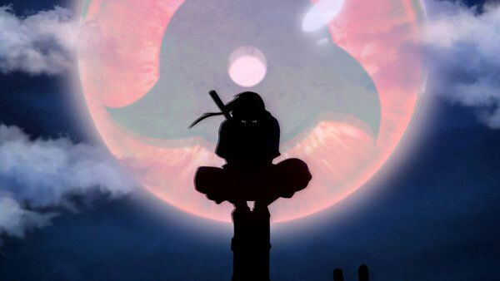
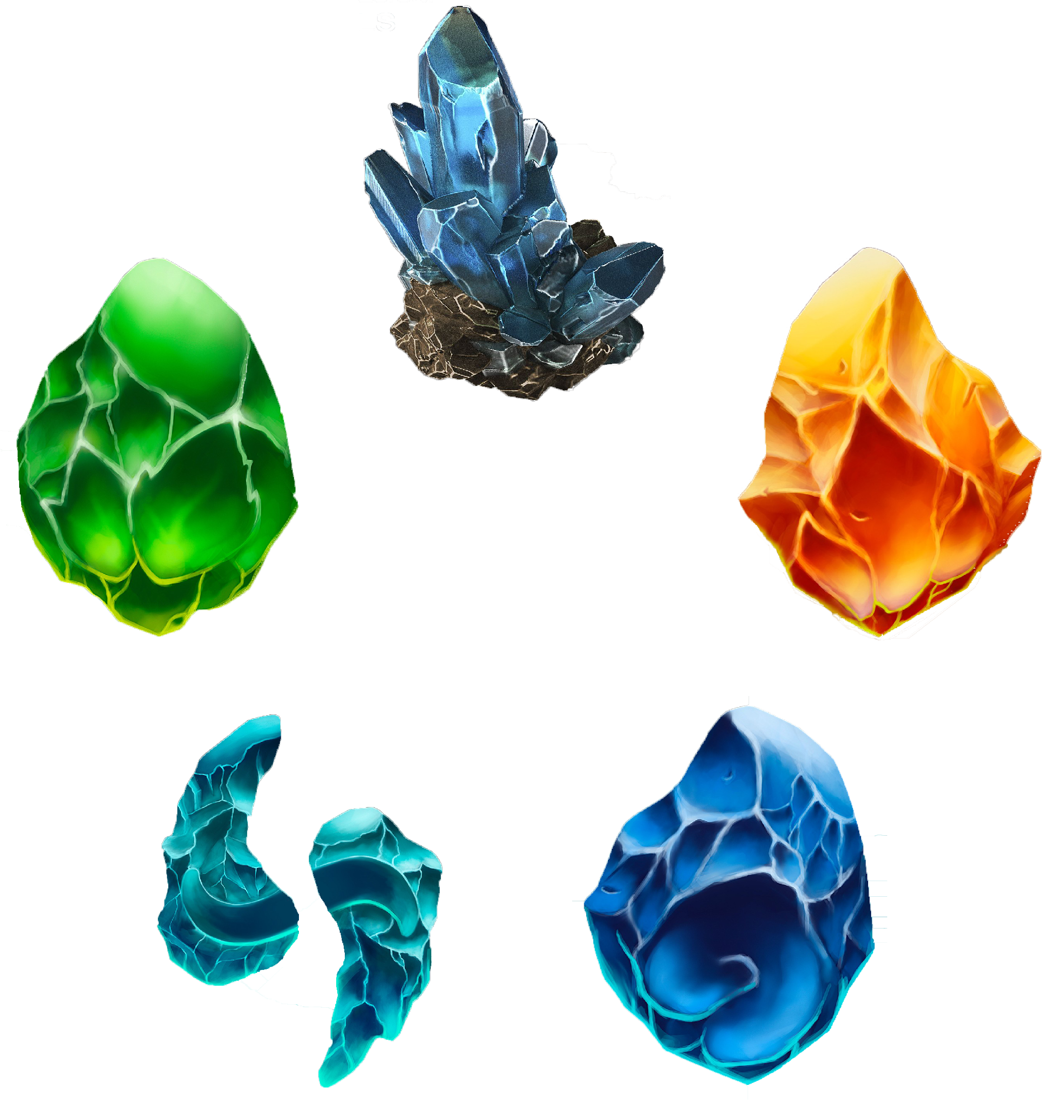
The Elements
VOID
EARTH
WIND
WATER
FIRE

Slide 14
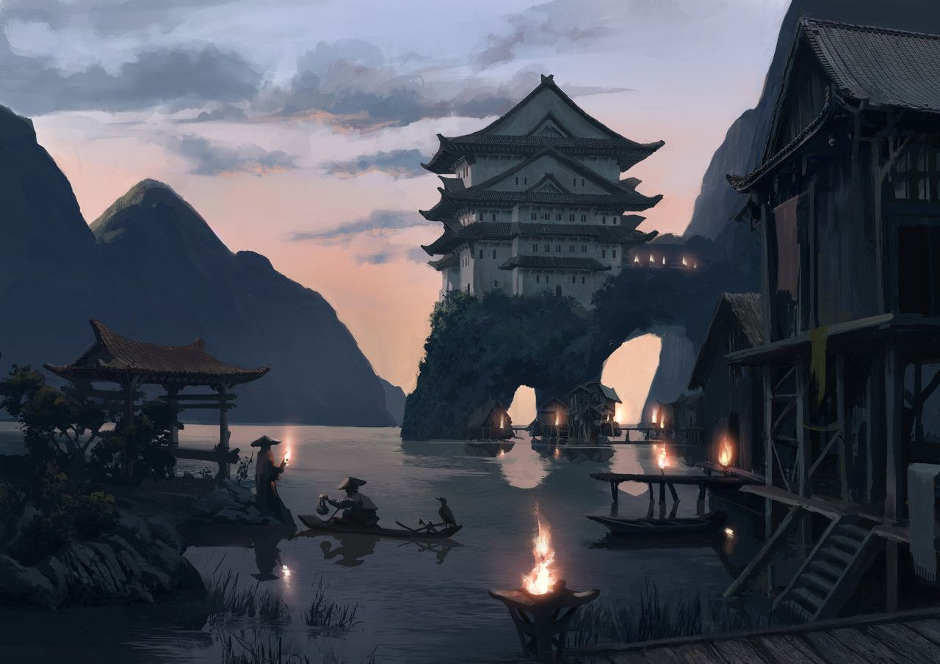
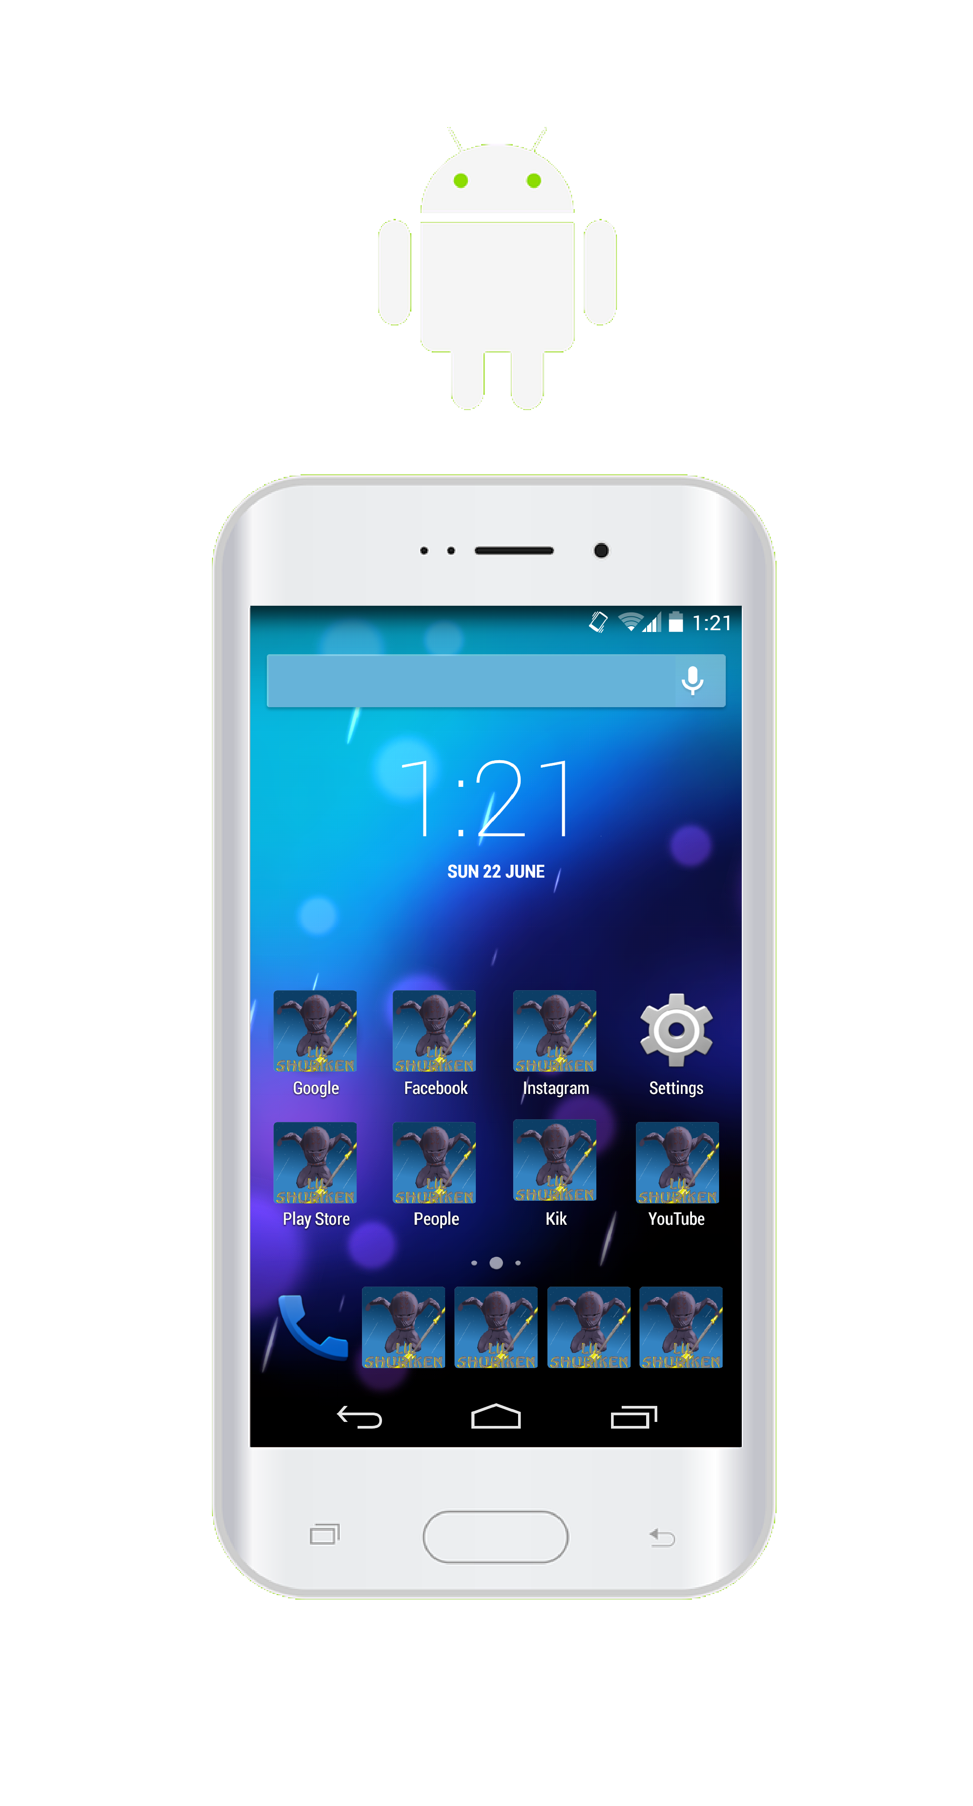
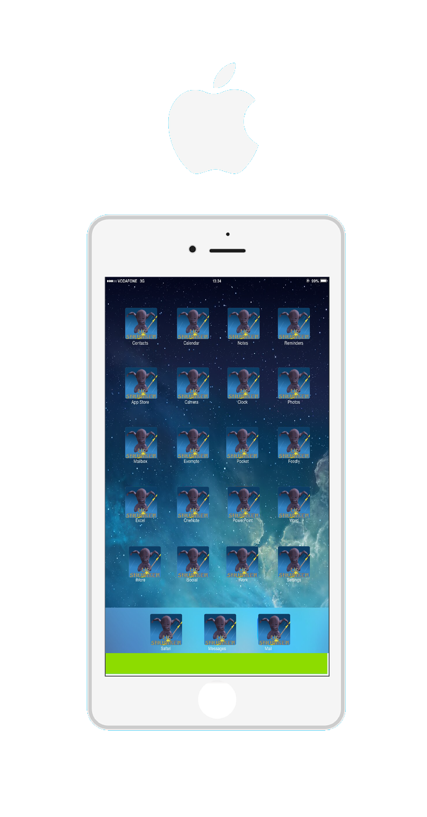
LIL Shuriken is available on IOS and Android

Slide 15
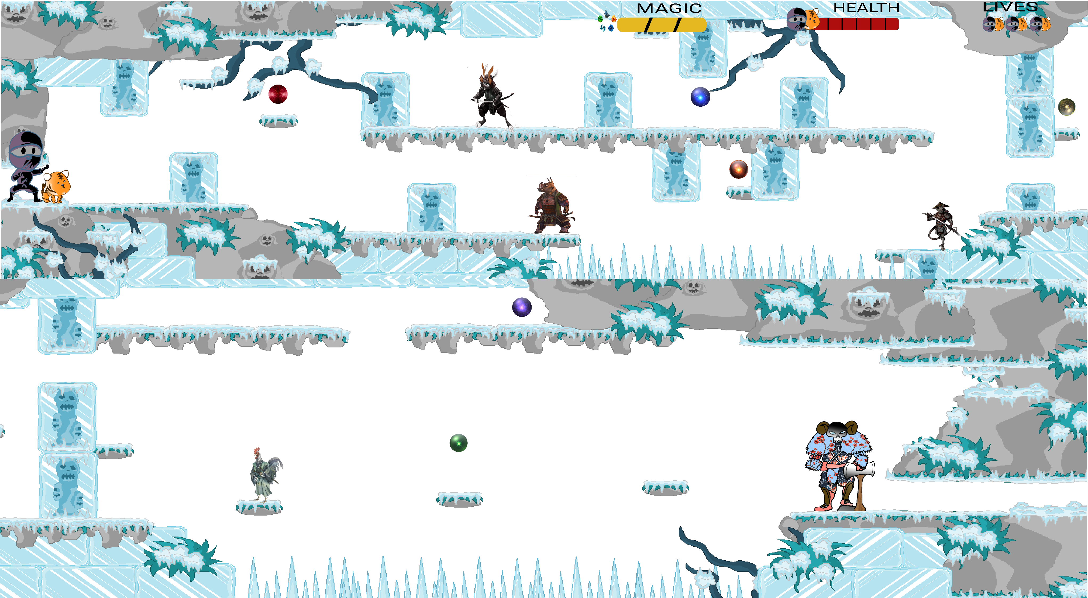
SAMPLE LEVEL

Slide 16
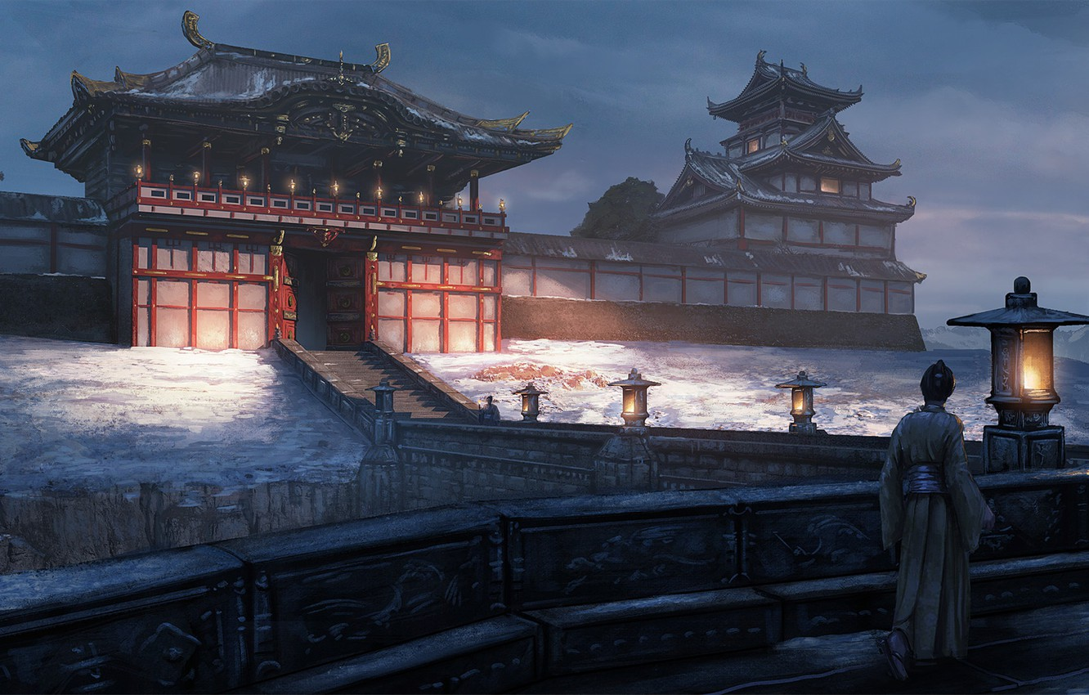
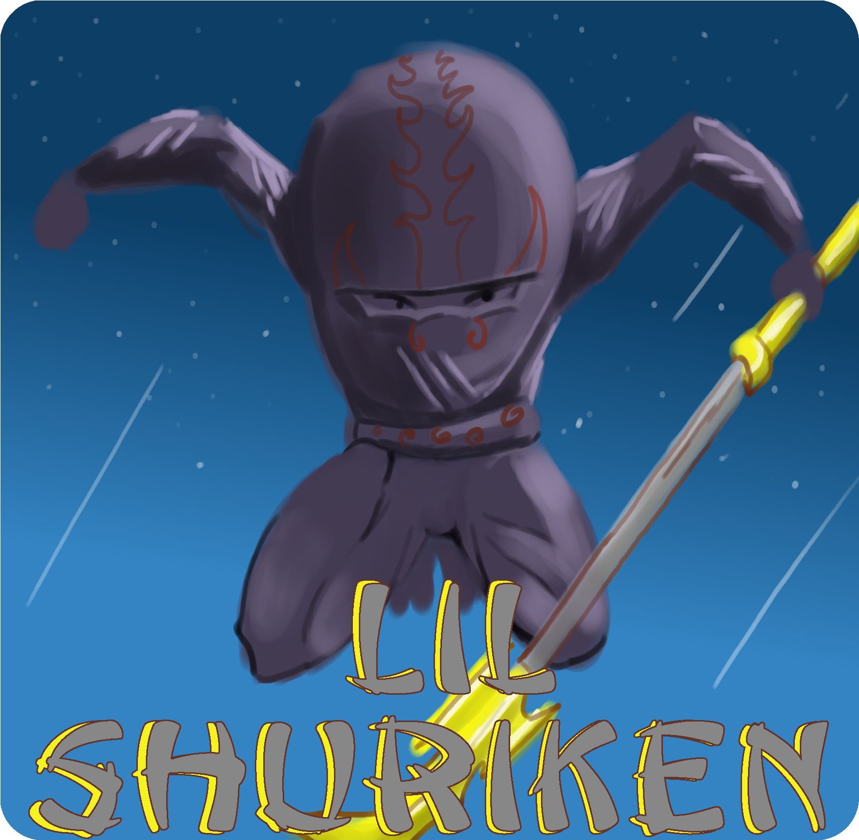
GAME LOGO

Slide 17
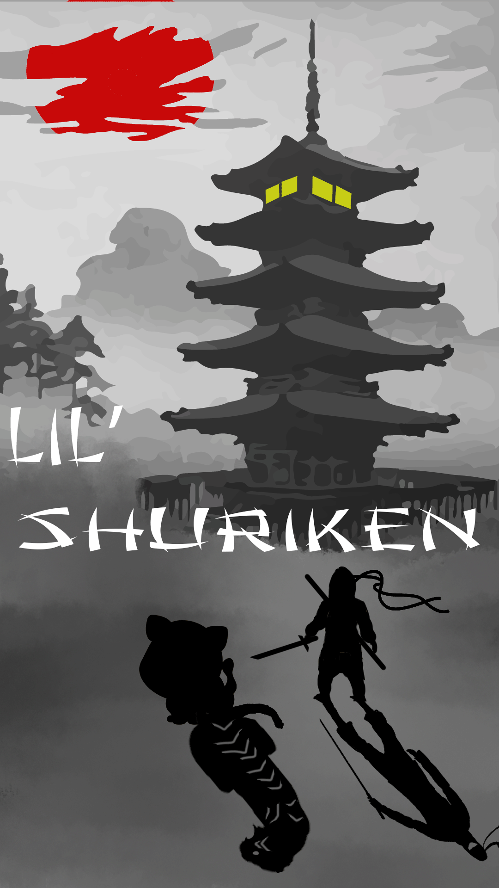
PROMOTIONAL POSTER

Slide 18
Thank you
Game design and Artwork Created by Joshua Jackson
All images of Japan in the background were obtained royalty-free from Google images

